Slide 1
OOSCM
Object Oriented SCM
SCM Next Generation

Slide 2

We’d like to declare…
Barcelona
The SCM Conference

Slide 3
Why?
Colin Putney’s Monticello 2
  “Merging is the most important feature of an SCM”
Veronica Urquillaz-Gomez
  Torch: Code review before integration
Fernando Olivero
  Reify the programmer an his “unit of work”
Dale Henrichs and Mariano Martinez Peck
  Metacello
And at the same time as this talk Alan Knigth
  Taking about Store

Slide 4

We NEED a BETTER SCM tool

Slide 5

What are we going to talk about
Yet!
OOSCM
A new SCM concept
WHY?
  Current tools do not fulfill our goals
  Current tools have conceptually different approaches to solve SCM that our idea
  We want to promote Smalltalk

Slide 6
Motivation 1
I want to know
  where a change was integrated
  By who and when
  On what versions
  What were the changes made to that code during integration
  Provide feedback to the programmer at all levels (method, class, etc)
MANAGE CHANGE LIFECYCLE

Slide 7
Motivation 2
Did all the test run after implementing that change?
  The programmer should run all tests before submitting the change to integration
Does the change provide new tests?
CHANGE QUALITY

Slide 8
Motivation 3
We don’t want this to be an integration conflict
V1
Object subclass: #Class1
instanceVariableNames: ‘’
SMART AUTOMATIC INTEGRATION
Object subclass: #Class1
instanceVariableNames: ‘a’
Object subclass: #Class1
instanceVariableNames: ‘b’
V1.1
V1.2
Integration Conflict!

Slide 9
Motivation 4
I want the decisions I made during the pre-integration code review to be applied during integration
  Reformat the code
  Do not integrate this method
PRE-INTEGRATION TOOLS

Slide 10
Motivation 5
AUTOMATIC REFACTORING INTEGRATION

Slide 11
Motivation 6
Seaside releases version 3.1 that includes lots of method renames
  I want the system to tell me there is a new version
  I decided Patagonia should work with seaside 3.1!!
    I can’t because I have to do the rename myself in Patagonia!
    Why not applying those renames to Patagonia automatically?
AUTOMATIC UPGRADE

Slide 12
Motivation 7
How do I know if programmers are doing TDD or just testing?
  Writing the test first really
How do I know the system architecture and its evolution?
  Maven in Java, but can not see its evolution or internal architecture, only dependencies.
QUERY THE REPOSITORY

Slide 13
What can we do withthecurrenttools?

Slide 14
Traditional SCM
Requirements | Traditional SCM (SVN, Git, etc)
MANAGE CHANGE LIFECYCLE | NO
CHANGE QUALITY | NO
SMART AUTOMATIC INTEGRATION | NO
PRE-INTEGRATION TOOLS | NO
AUTOMATIC REFACTORING INTEGRATION | NO
AUTOMATIC UPGRADE | NO
QUERY THE REPOSITORY | NO (there is no model)

Slide 15
Traditional SCM
Archive oriented: Archive is the minimun trackeable item
  Between commit changes are lost! (lost of information)
  Not easy to track group of changes
No reification of what a module is, what a system is, etc. Just files and directories
Not easy to model the development process
  It has to be defined from outside the tool
Good for versioning files, not so for OO development
Advantages:
  Simple interface
  Can work offline

Slide 16
Monticello/Metacello
Requirements | Monticello/Metacello
MANAGE CHANGE LIFECYCLE | NO
CHANGE QUALITY | NO
SMART AUTOMATIC INTEGRATION | Medium
PRE-INTEGRATION TOOLS | Torch
AUTOMATIC REFACTORING INTEGRATION | NO
AUTOMATIC UPGRADE | NO
QUERY THE REPOSITORY | Yes (But limited to the info it stores)

Slide 17
Monticello / Metacello
As traditional SCM, only “commits” are saved
  Between commit changes are lost
Metacello helps to model the system architecture
But it does not help to
  model the development group
  Integrate different development lines
  See the integration history (evolution)
Advantages:
  Simple
  Can be use offline
  Metacello provides tools that allow to use it easily

Slide 18
Store *
Requirements | Store
MANAGE CHANGE LIFECYCLE | NO
CHANGE QUALITY | NO (could be added)
SMART AUTOMATIC INTEGRATION | Not sure
PRE-INTEGRATION TOOLS | Medium
AUTOMATIC REFACTORING INTEGRATION | NO
AUTOMATIC UPGRADE | NO
QUERY THE REPOSITORY | Yes (But limited to the info it stores)
* We do not have experience with Store, so this could be wrong

Slide 19
ENVY
Requirements | ENVY
MANAGE CHANGE LIFECYCLE | NO
CHANGE QUALITY | NO (could be added, in fact we did it)
SMART AUTOMATIC INTEGRATION | NO (we did it)
PRE-INTEGRATION TOOLS | Three way Differences
AUTOMATIC REFACTORING INTEGRATION | NO
AUTOMATIC UPGRADE | NO
QUERY THE REPOSITORY | Yes *
New objects can be added to the repository

Slide 20
ENVY
Trackable items are methods, classes, modules (application) and systems (configuration maps)
Between commit (versioning) changes are saved
Easy to see method, class and module history
Not so easy to see the system history
Kind of difficult for agile development (unless you remove security, etc)
No reification of programmers changes
No automatic integration (unless you develop it)

Slide 21
ENVY
Disadvantages:
  Proprietary
  Old server technology
  Complex implementation
  Only for Smalltalk
The best one we have used so far

Slide 22
OOSCM
Proof of concept

Slide 23
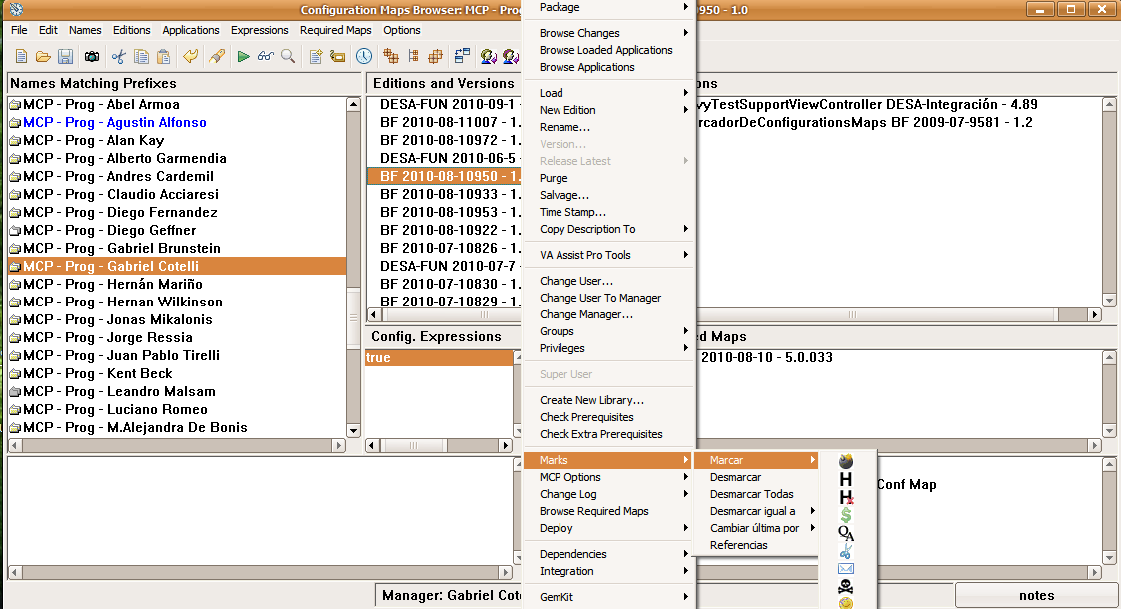
Managechangelifecycle

Slide 24
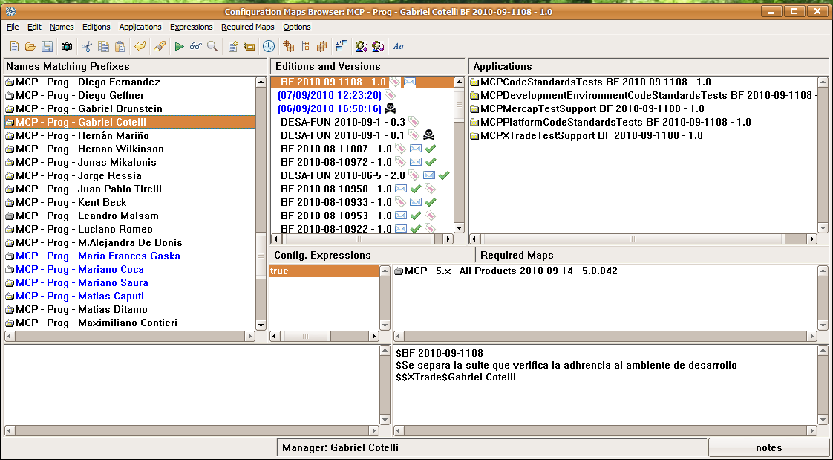
Managechangelifecycle

Slide 25
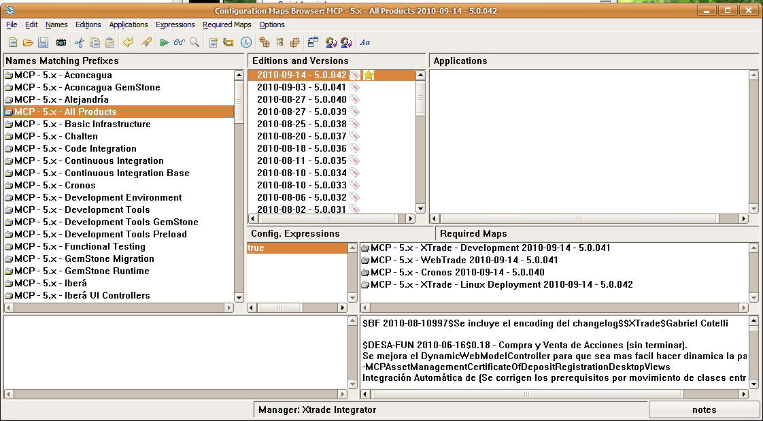
Managechangelifecycle

Slide 26
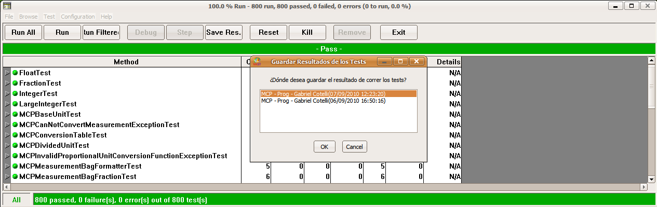
ChangeQuality

Slide 27
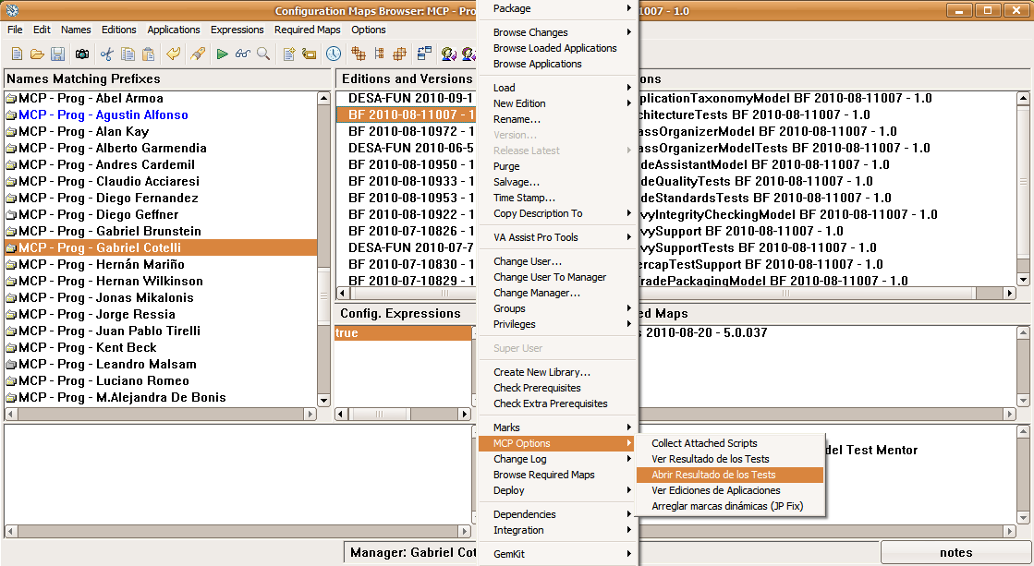
ChangeQuality

Slide 28
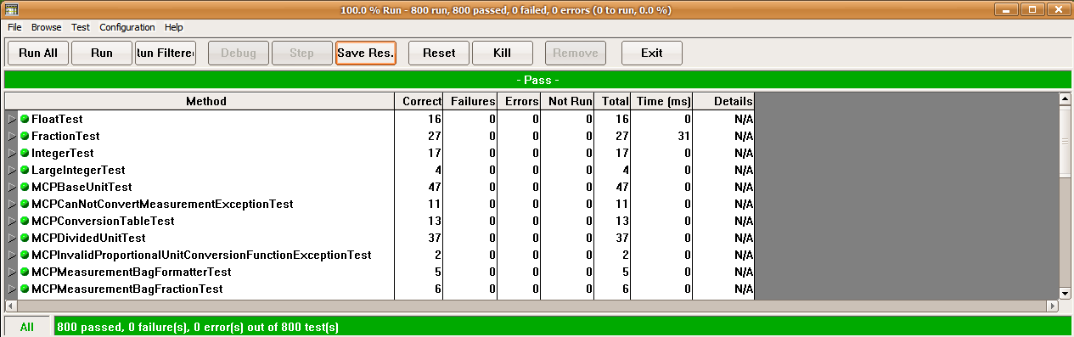
ChangeQuality

Slide 29
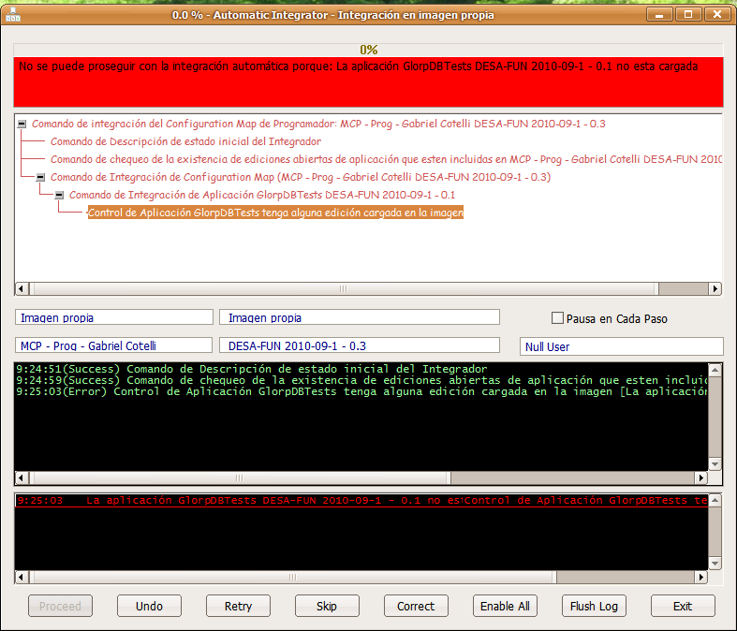
SmartAutomaticIntegration

Slide 30
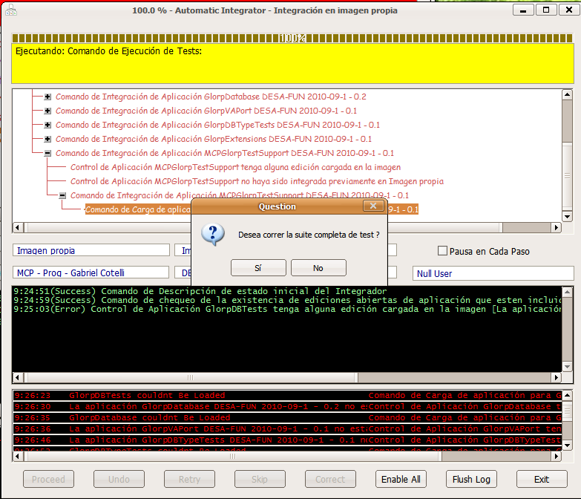
SmartAutomaticIntegration

Slide 31
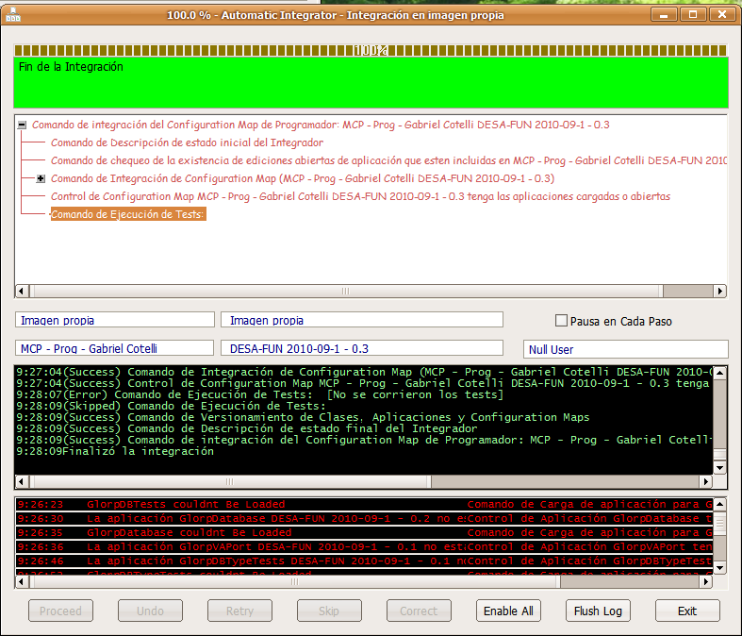
SmartAutomaticIntegration

Slide 32
OOSCM
The solution…

Slide 33
OOSCM Goals
SCM oriented to development with Objects
  Paradigm shift from traditional SCM
Easy to track programmers work
Easy to track system evolution
  Be able to model system architecture
Automatic Integration
  Smart
  Easy to integrate complex changes (i.e. refactorings)
Upgrades
  Automatic upgrading
Not only for Smalltalk:
  Planned: Java with Eclipse
  Open to other languages

Slide 34
Architecture
Client-Server
  REST
Multi-repository
  Offline support
  IDE Client: Plug-In Architecture
  WebBrowser support

Slide 35
Details
Technology:
  Developed with Pharo
  Production: GLASS
Project:
  Subsidy of the Argentine Ministry of Technology (USD 38 K)
  Total time: 13 months (with out refactoring integration)
  We just started
License:
  Not sure, open client, close server?
  Open for Smalltalk, paid for other languages?
  Based on projects, customers, SaaS?

Slide 36

Suggestions – Help – Support - Ideas

Slide 37
Thank you!
info@10pines.com
www.10Pines.com
twitter: @10Pines
Hernan Wilkinson
hernan.wilkinson@10pines.com
Jorge Silva
jorge.silva@10pines.com

