Slide 1
ActiveContext
Erwann Wernli

Slide 2
Outline
Why dyn. software update is challenging (5’)
Our approach (5’)
Current stage of the research (5’)

Slide 3
About safety
Let’s consider the evolution
Page
Html
Page
Title
Body

Slide 4
About safety
How can we migrate the state?
What happens if old running code accesses field html ?
What if an execution mixes old and new code?
aPage : Page
Method
Body / header
Method
Method
html
Method
…
Method
Request V1
Method
…
Request V2

Slide 5
Trade-offs
practical
timely
safe

Slide 6
Trade-offs
Run-time errors
Dynamic C++
Smalltalk
practical
timely
Gemstone
POLUS
Boyapati
JVolve
HotSwap
Fickle_{MT}
Ginseng
Delay update
Impose constraints
safe

Slide 7
Trade-offs
Dynamic C++
Smalltalk
practical
timely
Gemstone
ActiveContext
Boyapati
JVolve
HotSwap
Fickle_{MT}
Ginseng
safe

Slide 8
Our approach
a context is always version-consistent
html := aPage html.
newCtx := NewContext ancesor: oldCtx.
newCtx do: [ aPage header ,
aPage body ].
new

Slide 9
Bi-directional transformation
Shared object has one identity but two states
Request V1
Dynamic evolution
Method
Method
aPage: Page
Old context
Solution:
State transfer
Safe concurrency
Reflective extension
…
Method
Method
…
New context
Request V2
Notes:
Context
Different behavior and state
Extension of the reflective programming model
State transfer
First-class

Slide 10
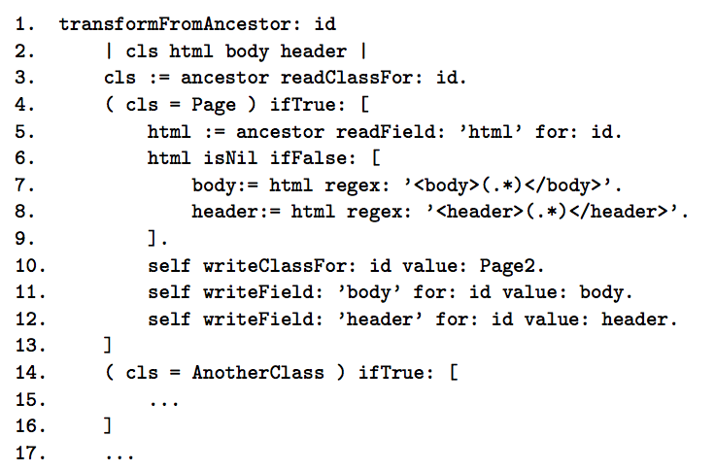

Slide 11
Design
Strategy | Instantiation | Concurrent read/write | Garbage collection | Expected overhead
Eager | Migrate objects | Sync on write | Garbage when not used | High
Lazy | Does nothing | Sync on dirty read | Force migration prio to GC | Medium

Slide 12
Conclusion
First-class contexts ensure version consistency
Safe dynamic software update
Working implementation
Future work: enable lazy sync & GC

Slide 13
Design
Contextual first-class classes | Impact
yes | Different versions are the same object Nice with inheritance Class-side variable synchronized
no | Different name per context Not nice with inheritance Class-side variable not synchronized

Slide 14
Validation
What about daemon threads?
Can we evole class hierarchies this way? (interdependent classes,inheritance)
Is the run-time overhead acceptable? (in space & time)

Slide 15
Safety: no type error, no functional inconsistency
Time: quickly, or at least, eventually install the update
Practicality: no extra constraint during development

