Slide 1
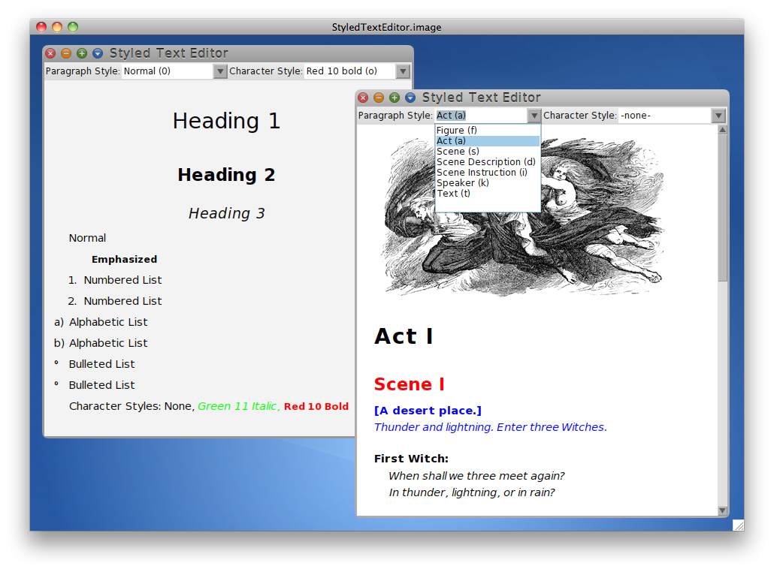
StyledTextEditor
Rich Text Editing for Cuis
Idea & Funding by Bernhard Pieber
Implementation by Juan Vuletich
Bernhard Pieber Software Generation | 22.8.2011

Slide 2
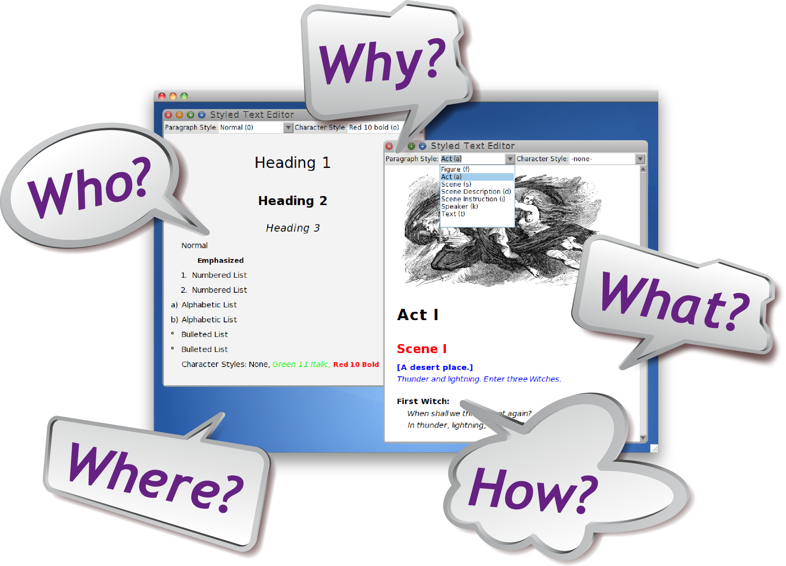
Bernhard Pieber Software Generation | 22.8.2011

Slide 3
Why? Goals
Rich text editing using only Styles
As simple as possible
Apply Styles by keyboard shortcuts
Different Style Sets
Embeddable in different applications

Slide 4
What? Features
Styles
Paragraph Styles
Character Styles
Bulleted and Numbered Lists
Completion
Pasting Images
Copy and Paste
StyledTextBuilder
API for creating text with styles programmatically
Refactoring and bug fixes

Slide 5
What? Demo

Slide 6
What? Collateral Features
Text Editor Refactoring
in Squeak and Pharo
Filtering drop-down list
Improved layout for Morphs
Removed StringHolder
Code completion

Slide 7
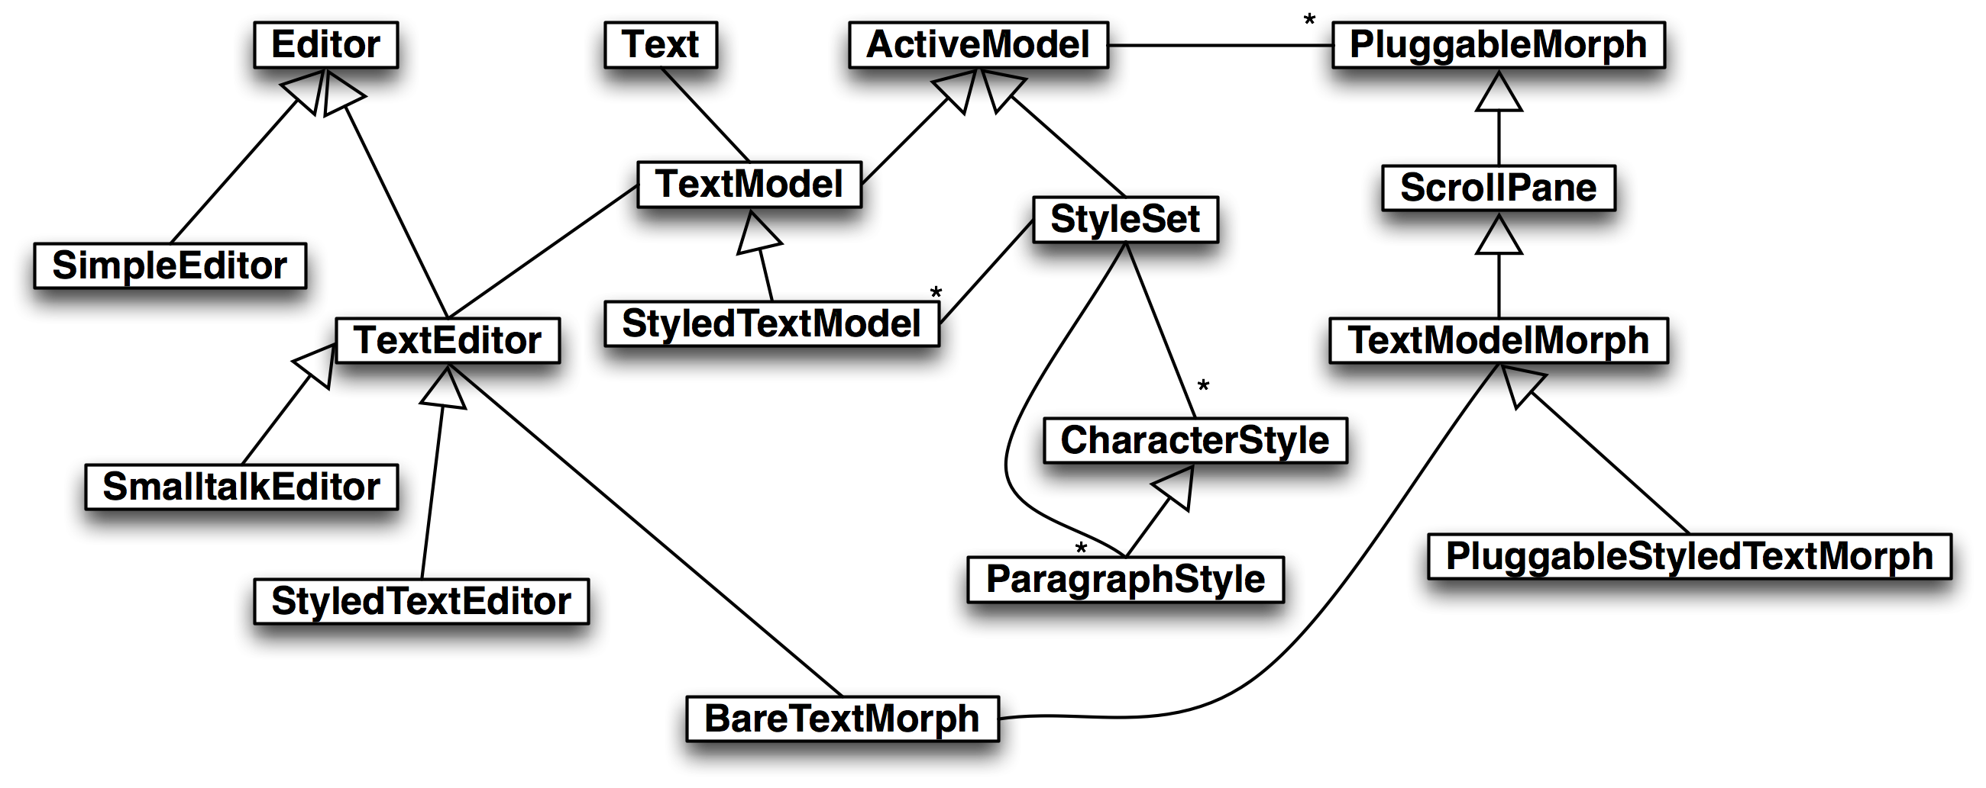
How? Design

Slide 8
Where? Future Features
Release as open source
Port to Squeak and Pharo
Hyperlinks
Search UI
Model for text changes
Merge branches
Multiple undo
Tables

Slide 9
Where? Possible Applications
StyledTextNotepad
StyledTextWiki
StyledTextHelpBrowser
Rich text comments

Slide 10
Lessons Learned
I am always too optimistic.
I knew that already. ;-)
900 hours since July 2009
€17.000 ($24.000)
I miss Monticello.
I learned something about ChangeSets, though.
Funding a port to Cuis alone is beyond my financial capability.
Forks are much worse than I thought.
Port to Squeak estimated to be a considerable effort.
A big waste of community time.
No solution for it, though. :-(

Slide 11
Questions & Feedback & Discussion Many thanks for your attention!

