Slide 1
Data Mining The Social Web
By Gary Short
Developer Evangelist
Developer Express

Slide 2
Introduction
Gary Short
Developer Evangelist
gary@garyshort.org
garys@devexpress.com
www.garyshort.org
@twitter

Slide 3
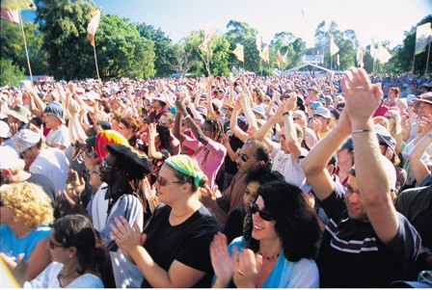
What About You Guys?

Slide 4
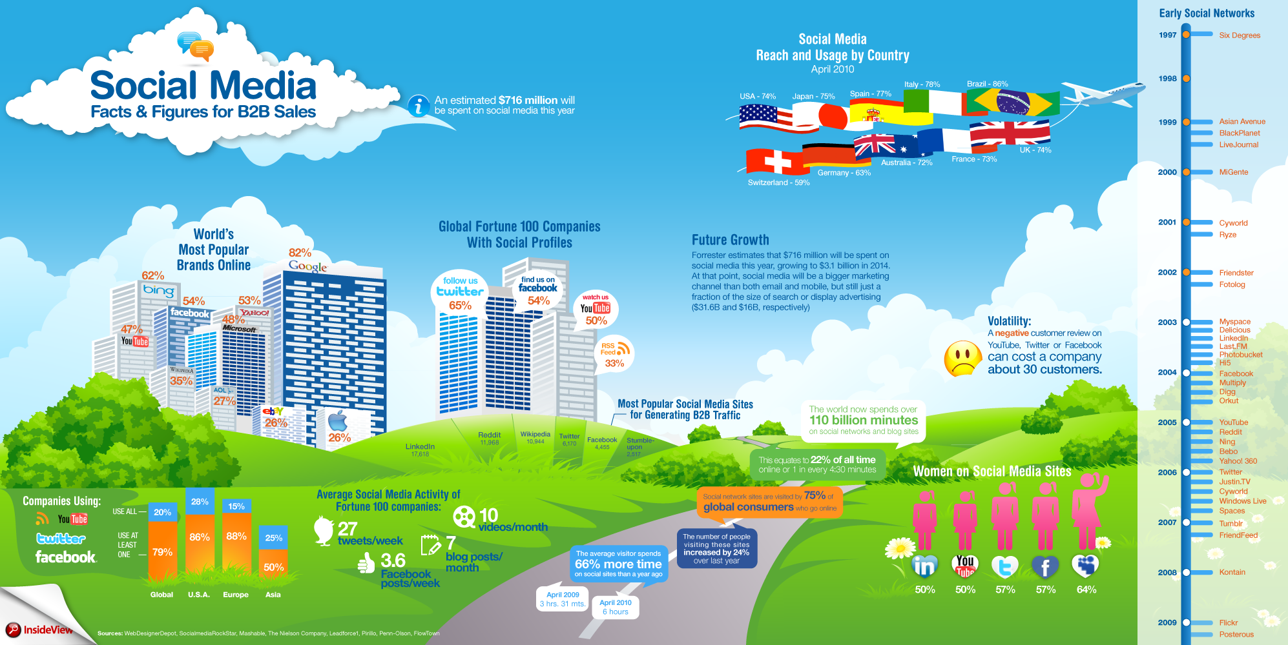
Why Bother Data Mining The Social Web?

Slide 5
How do we Data Mine The Social Web?
Public API
Data Store
Analysis
Visualise
Beyond Visualisation

Slide 6
My Set UP
Public API
cUrl to file
Preprocessing
Store to CouchDB
Analysis & Visualisation

Slide 7
Today’s Sample
~6,000 tweets
Mention
Apple
Google
Microsoft
Doesn’t include last night’s announcement ☺

Slide 8
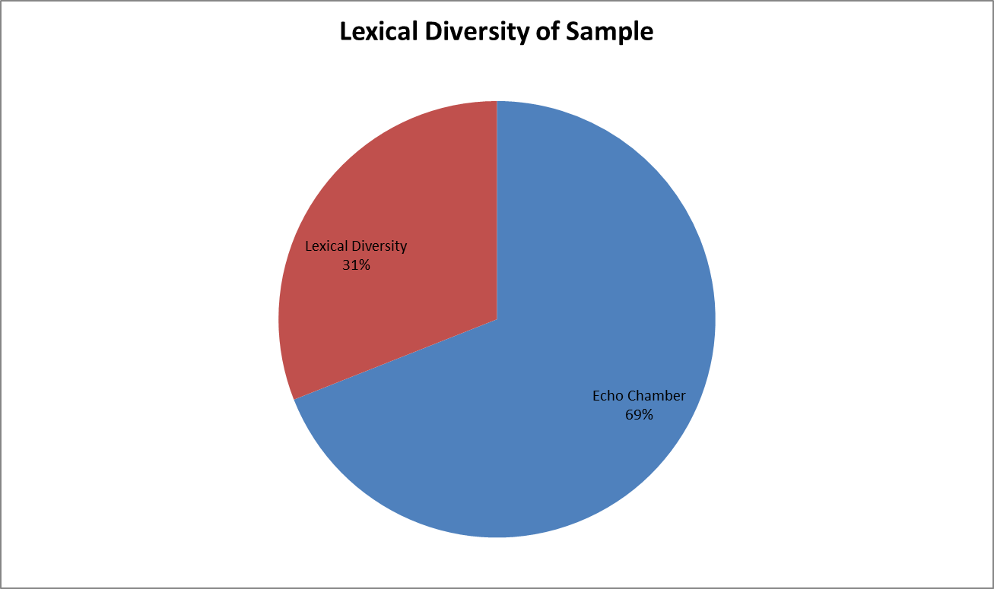
Lexical Diversity

Slide 9
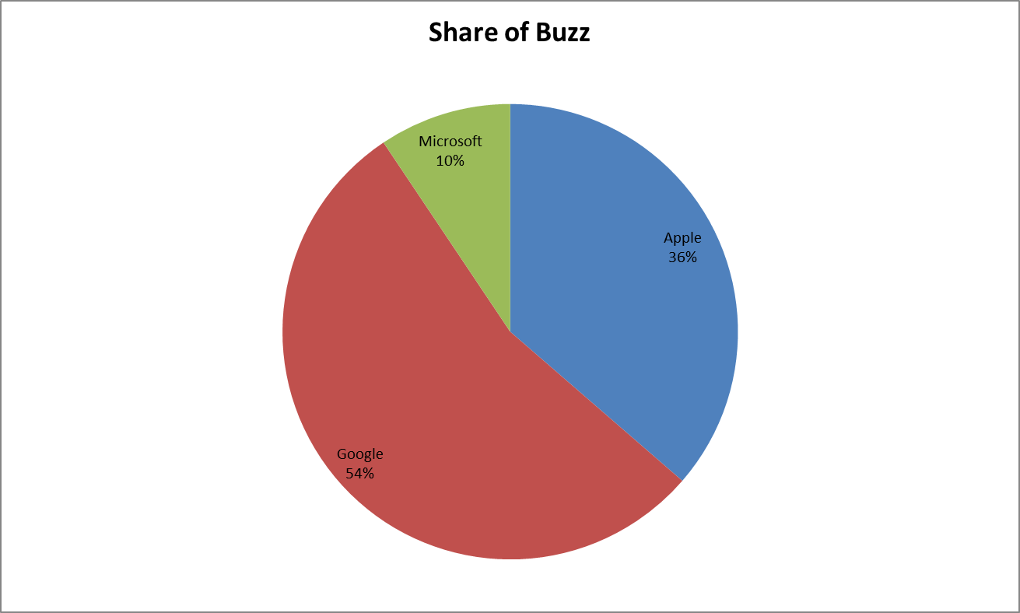
Competitive Analysis

Slide 10
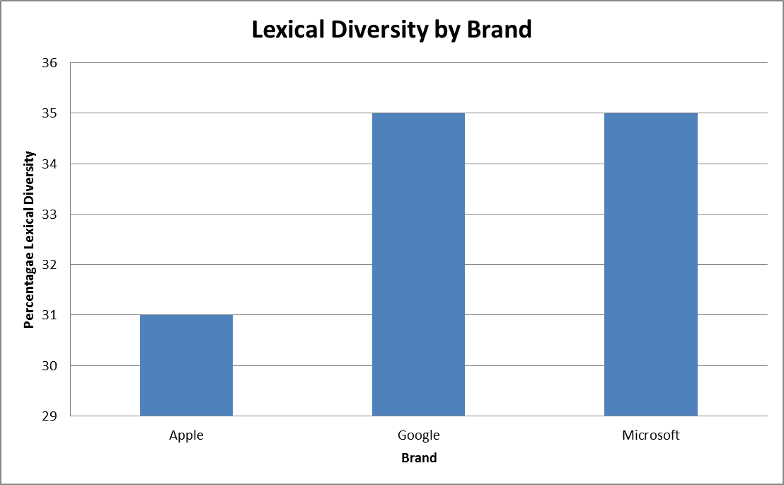
Lexical Diversity by Brand

Slide 11
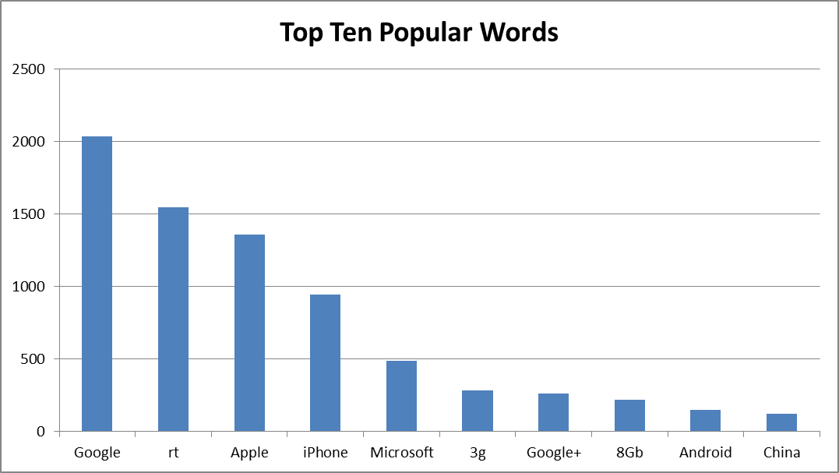
Top 10 Popular Words

Slide 12
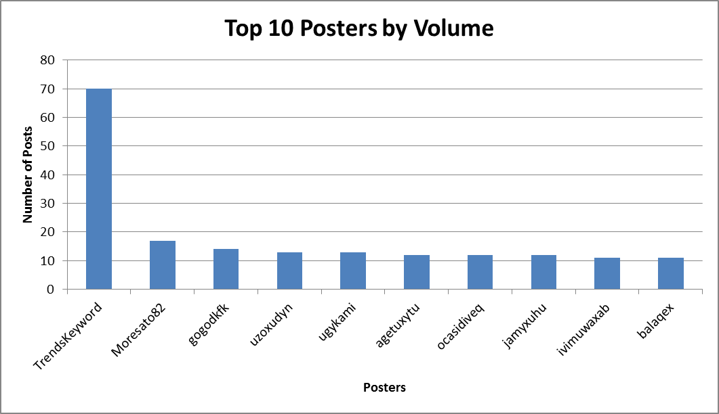
Top 10 Posters by Volume

Slide 13
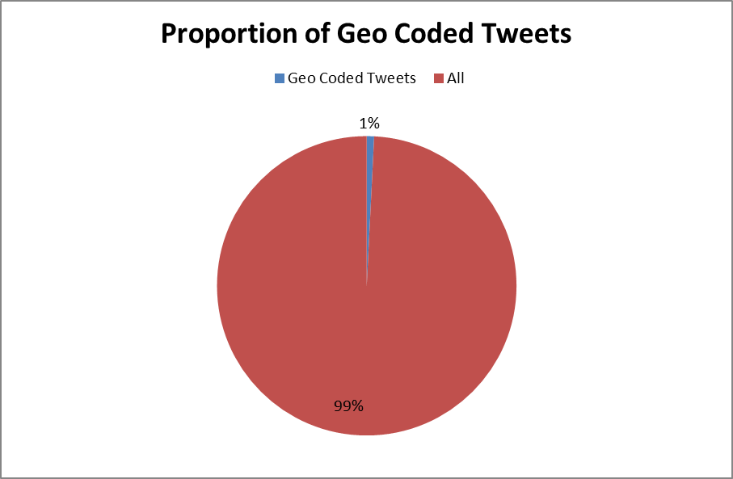
Proportion Of Geo Coded Tweets

Slide 14
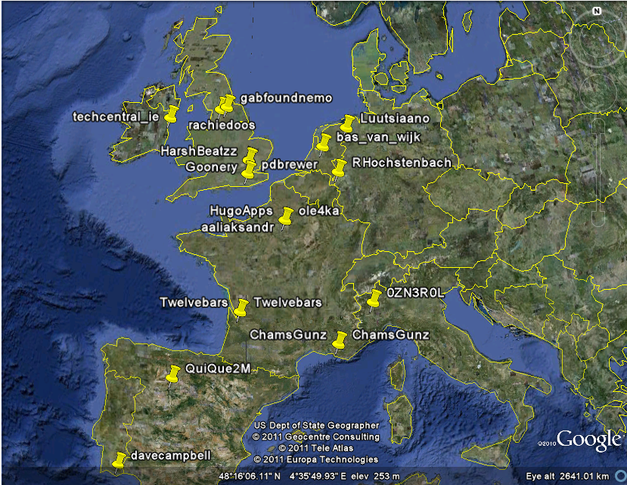

Slide 15
Questions
gary@garyshort.org
garys@devexpress.com
@twitter

