Slide 1
Shared Memory Management for VisualWorks

Slide 2

Shared Memory Management
for VisualWorks

Slide 3

Holger Guhl
Senior Smalltalker at Georg Heeg eK
      www.heeg.de
mailto: holger@heeg.de

Slide 4
Shared Memory Management for VisualWorks

Slide 5
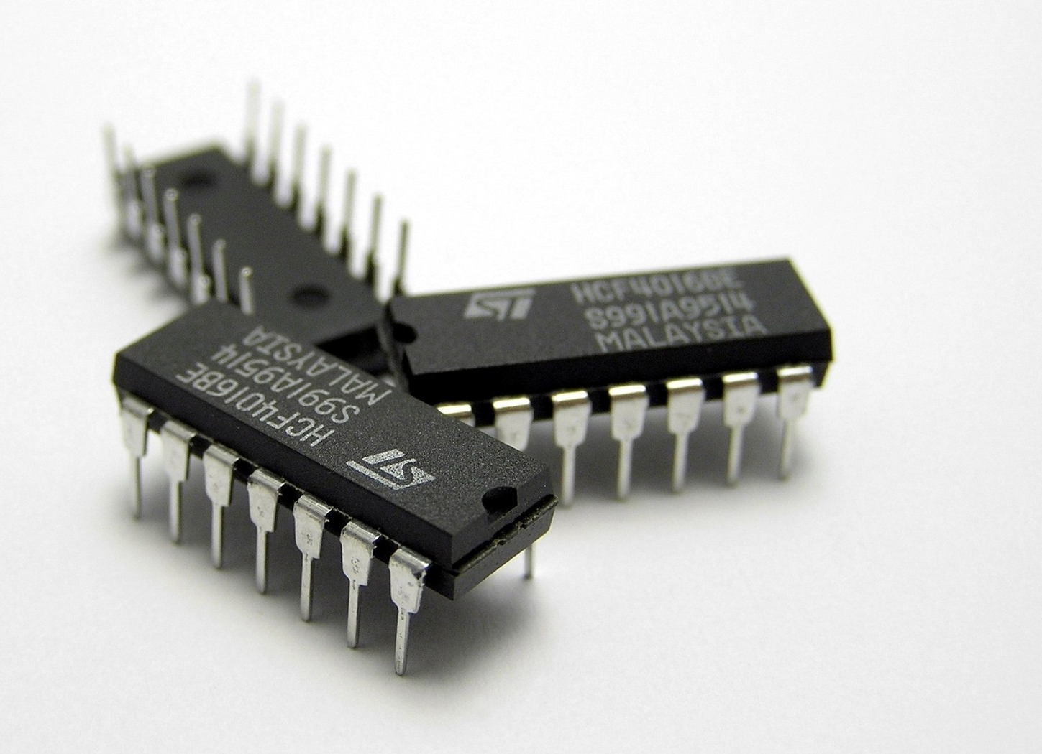
What?
shared memory
Why?
http://www.flickr.com/photos/ben_salter/
Notes:
What?
Reclaiming memory reserves space on the heap. This space is for exclusive use of the reclaiming program. Shared access is inhibited, i.e. programs may not read or write the heap memory reclaimed by other programs. Shared memory is a feature of all operation systems. It explicitly allows shared access of memory for different programs. On Windows, shared memory is backed by the system page file. Reclaiming shared memory means reserving space in the page file.
Shared memory was a preferred approach back in the 80ies and 90ies. There are a couple of reasons why it has become a bit “out of fashion”:
- only for applications running on the same host. There is no such thing like cross-host shared memory. Modern applications are designed for networks and applications run on different hosts. They cannot share memory.
- Internet and b2b applications interchange with HTTP and web services.
- Increasing processor and general hardware speed make explicit data transfer bearable.
- concept seems to be “legacy” now.
Why? (Motivation)
With upcoming multi-core computers a new development has started that might be a platform to revive the shared memory approach. There is a strong demand to “make more” from those many CPUs that even consumer-level laptops have.

Slide 6
Personal Experience: software assessment project
huge customer project took 4 hours!
Notes:
Personal Experience
Once I had a project about software assessment. All code (bundles, packages, classes, method, etc) of a given project had to be analyzed and metrics had to be applied. The result was exported in XML format. Normal test projects were analyzed within acceptable time:
Project Classes Methods Lines of code Exec.time
Cust. test project 1,227 11,992 97,274 00:02:27
Base-VisualWorks 2,118 31,501 236,932 00:28:45
But the customer projects were huge and took 4 hours and more.

Slide 7

Polycephaly
= use all CPUs
Notes:
My idea was to speed up using more CPUs, and I chose Polycephaly.
An attractive approach is Polycephaly or its more recent version Polycephaly2 (now MatriX): One VisualWorks image works as master image and starts multiple clones of itself (called drones) in order to build a “computing team”. Drone images are automatically distributed by the OS over available CPUs. The master image sends Smalltalk blocks to drone images which evaluate them and answer the result. Both blocks and results are exchanged between master and drone images via sockets.

Slide 8
Polycephaly Example
| drones result |
drones := VirtualMachines new: 4.
result := drones
do: '[:a :b | a + b]'
with: #(1 2 3 4 5)
with: #(5 4 3 2 1).
result = #(6 6 6 6 6)
Notes:
The Polycephaly framework takes over most of the work to distribute actions over drones as available.
Cincom and Heeg developers have already shown that certain kinds of problems benefit from the extra power and finish in less time. For instance, the computation of Mandelbrot figures is ideal for distribution over many drones, because the math calculation effort is much more than the result objects to interchange. An implementation at Heeg was made faster by a factor of 7.7 with use of Polycephaly and 8 CPUs.
A disadvantage of the multi-drone approach is that it is not suitable for tasks which need much communication. If there is much communication necessary to distribute the tasks over drones, synchronize the work and – last not least – answer the result, then it is easily possible that all the performance gains are devoured by the communication overhead.

Slide 9


Project “Software Assessment”
Perfect options for task distribution
(per package, class)
Needs to report much results
Disappointing results:
Communication overhead consumed all time gains
Notes:
A disadvantage of the multi-drone approach is that it is not suitable for tasks which need much communication. If there is much communication necessary to distribute the tasks over drones, synchronize the work and – last not least – answer the result, then it is easily possible that all the performance gains are devoured by the communication overhead.
Project “Software Assessment”:
Options for task distribution were perfect: Every unit of code containment (package, class, method) could be made its own distributable analysis task. Unfortunately, the result could not be produced by helper images alone, but the specified final output needed filtering of duplicates and merging of partial results. This made necessary to report a lot of structured information back to the controller or master image.
When I tried the first Polycephaly version the results were disappointing: Communication overhead consumed all time gains from using multiple CPUs. The first implementation was even slower than using one image only. The simplest example (project 1 in the table above) took 24 seconds! That was 3 times as long as the original implementation. By minimizing the result communication I could bring the execution time down to 8 seconds which is the same time as using a single CPU.
Obviously, the demand for much communication is the killer argument against the multi-image approach. The primary problem is the number of communication events, not the size of transmitted data.

Slide 10
Shared Memory
= more speed?
Notes:
Shared memory could be a solution, and it’s one of the objectives of this project to find out how much performance can increase.

Slide 11
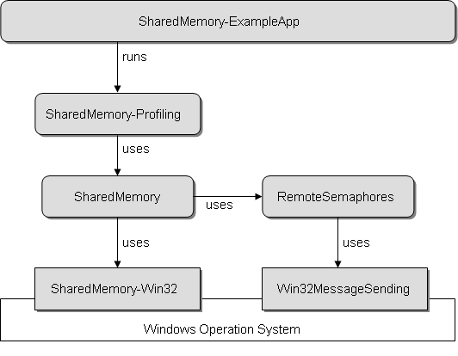
Tools Architecture

Slide 12
Application Scheme
CPU 1
CPU 2
Remote Semaphore
MASTER
DRONE
Shared Memory
Notes:
connect multiple images running on different CPUs on the same host (1 master, n drones).
basic assumption: drone images communicate with master only, not with other drones.
Data is exchanged via Shared Memory.
Access control to ensure mutual exclusive access by RemoteSemphores.

Slide 13

RemoteSemaphore
Mutually exclusive Shared Memory access
Created by master image
Twin in drone image
Synchronized via OS event messages
Notes:
Concept: 1 RemoteSemaphore synchronizes 2 images (master creates the semaphore, other image is a client which keeps a mirror instance linked to the master.
protocol keeps both instances of this linked pair in sync:
#signalLocal and #waitLocal simply signal or wait with a normal Semaphore.
#signalRemote sends a message to the remote pair which in turn does simple #signalLocal.
#waitRemote is a synchronous message send: First, a message is sent to the remote pair to request a blocking state, i.e. any excess signals are reset so that the next #waitLocal in the remote image meets a blocked semaphore. The remote image processes the message and sends a result message which tells whether the required state could be achieved. If so, the requesting image can continue, otherwise we have an exception that needs to be handled, e.g. by repeating the request.
#signal triggers the two actions #signalRemote and #signalLocal.
#wait invokes #waitRemote and #waitLocal.

Slide 14
SemaphoreEventRelay
Organize connection to other images
Instances in connected images
Communication center for remote semaphore messages
  #signalRemote
  #waitRemote

Slide 15
SharedMemory-ExampleApp
Install Shared Memory
Start Polycephaly drone.
Start drone client, use Shared Memory.
Start drone service
for pure Shared Memory use cases.
Run profiler.
Notes:
Install Shared Memory
Start Polycephaly drone image. We need only one for profiling data exchange.
Start Drone Client: Let the drone start a client which uses the master’s SharedMemory.
Start Drone Command Service: Let the drone start a service to accept and process commands sent via SharedMemory.
Run Polycephaly and Shared Memory use cases and collect profiles.

Slide 16
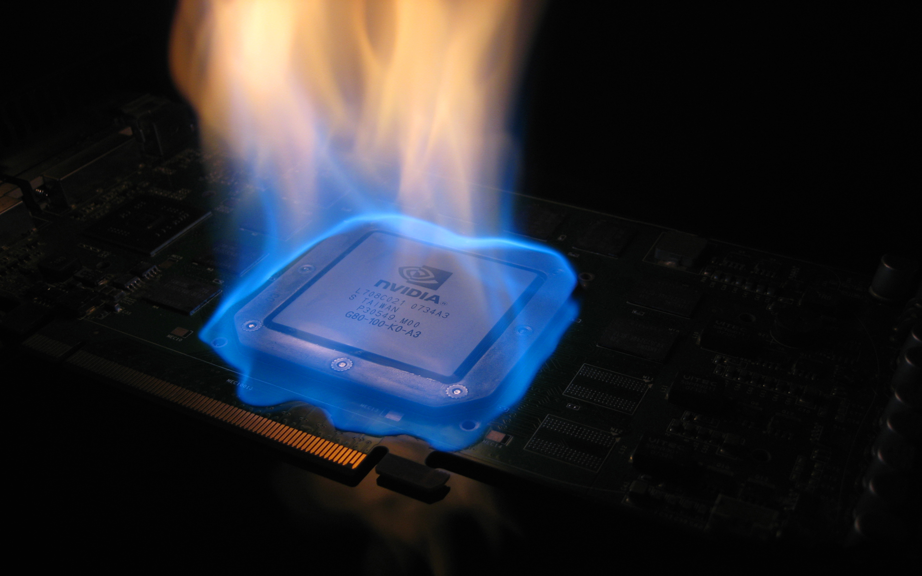
Time Profiles
Notes:
For comparing performance of Shared Memory we have measured a couple of basic transmission tasks. The focus is on transferring bytes or Arrays of Integer. “Real” applications might need to interchange more complex data, but with proper encoding this can always be reduced to simple byte transfer.
Measurements were always taken as average of a series of 10 repetitions. Time values are expressed in microseconds (µs).

Slide 17
Shared memory raw read/write
Notes:
SharedMemory unprotected read / write / write+read

Slide 18
Shared memory raw read/write

Slide 19
Shared Memory Overhead
SemaphoreEventRelay mutex roundtrip
  with OS event messages = 117 µs
  with UDP socket messages = 399 µs
Notes:
„mutex roundtrip“ covers
sending the #waitRemote message
time to process the message on the remote side
sending the (synchronous) answer message from the remote side
sending OS messages is nearly 4 times faster than using UDP

Slide 20
Polycephaly Use Cases
Overhead: Request to evaluate the empty block = 12,519 µs

Slide 21
Polycephaly with Shared Memory
Polycephaly requests, result via protected shared memory
Notes:
Polycephaly requests, write+read result via protected shared memory
Using shared memory for exchanging results can slow things down! Obviously, the overhead for synchronization with remote semaphores is too much when transmitting tiny packets. Better performance can be seen with packets of size larger than 100 kB or Array of size 10,000. Performance gains of 90% are possible with large packets.

Slide 22
Shared Memory Command And Data Exchange
Shared memory command, protected write, unprotected read
Notes:
The picture changes drastically when using fast shared memory communication also for the request, rather than sending the request via Polycephaly.
Outline:
drone connects to the master image and listens for commands communicated via shared memory. The connection is synchronized with a remote semaphore.
master sends command and waits for the semaphore to signal.
drone reads the command from shared memory,
evaluates the request,
writes the result into shared memory
signals the remote semaphore
master can continue and reads the result from shared memory.
This gives us very fast results:

Slide 23
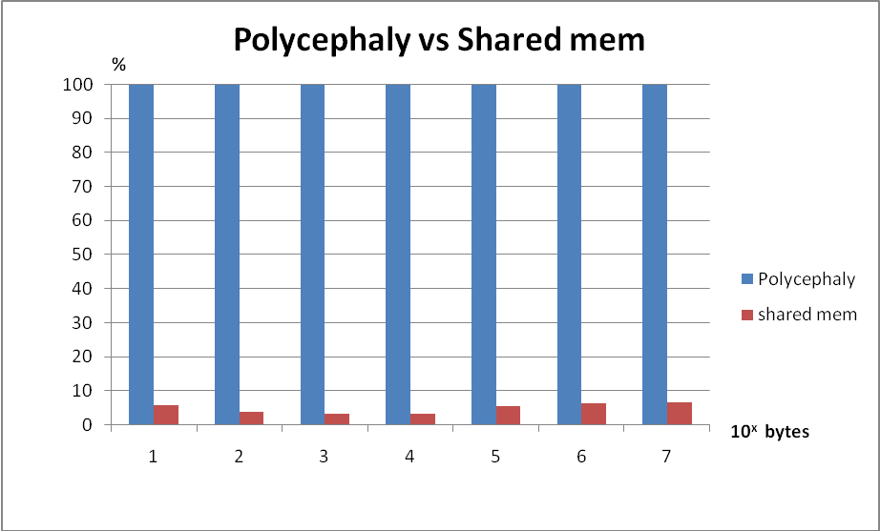
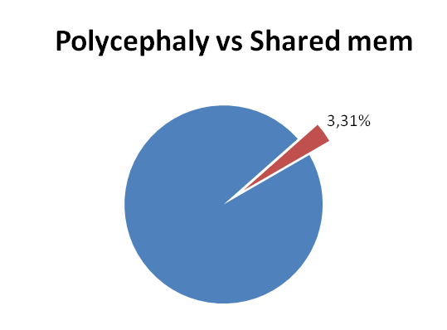
Notes:
The factor compares shared memory performance with the measured values obtained for basic Polycephaly requests shown in Table 7: Polycephaly requests. These figures suggest a maximum reduction by 97%.

Slide 24
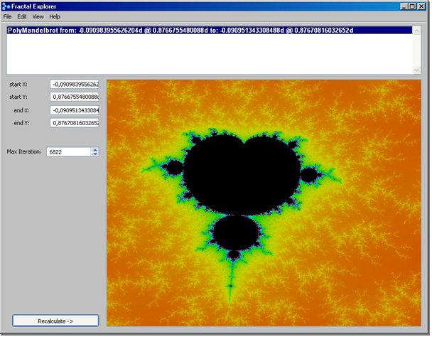
Fractal Explorer
Shared Memory data exchange saves 5 seconds
from a total of 109 seconds…
Notes:
Perfect example for Polycephaly: Much calculation, full stress for engaged CPUs and minimal overhead for small result communication.
Counter example for Shared Memory: not much data to exchange

Slide 25
Conclusions
Shared Memory can speed up transfer significantly
  massive data exchange
  simple data
Impressive reduction potential of 97%
Perspectives for applications that suffer from high load for data exchange.
Notes:
This study is focused on transmission of simple data (bytes, strings, arrays with simple data). Another use case could be keeping shared objects in shared memory. These objects should also be simple. With the nature of Smalltalk implementations where garbage collectors steadily move objects in memory, you simply cannot “move” a complex object structure (e.g. a graph) into shared memory. But maintaining a shared matrix with simple data cells in shared memory could gain some time profit.
The maximum gains are achievable if interchanged data are simple. As long as we cannot put our Smalltalk object model over shared memory, the whole thing boils down to transmitting bytes and strings. The more effort is needed to encode objects to bytes and back from bytes to its original shape, the less time is saved. Some figures for BOSS encoding/decoding of simple structures have been presented. More complex object will take more time to encode and definitely more to decode. The overhead for this encoding consumes time that must be fed by shared memory transmission gains.
Developers who want to give the shared memory approach a try, should determine the encoding overhead and then decide whether the expected time benefit still pays off.
After all, it’s a matter of trying and measuring. This study may be helpful for first estimations.

