Slide 1

SYSTEM TOOLS WITH
CINCOM® OBJECTSTUDIO®
By Andreas Hiltner

Slide 2


Slide 3
Overview
Intention
Power Capabilities / - State
  BatteryMeter
GUID Generator
Windows
  Window Spy
  Window Finder
Processes
  Process Exlorer
  GDI Log
Questions

Slide 4
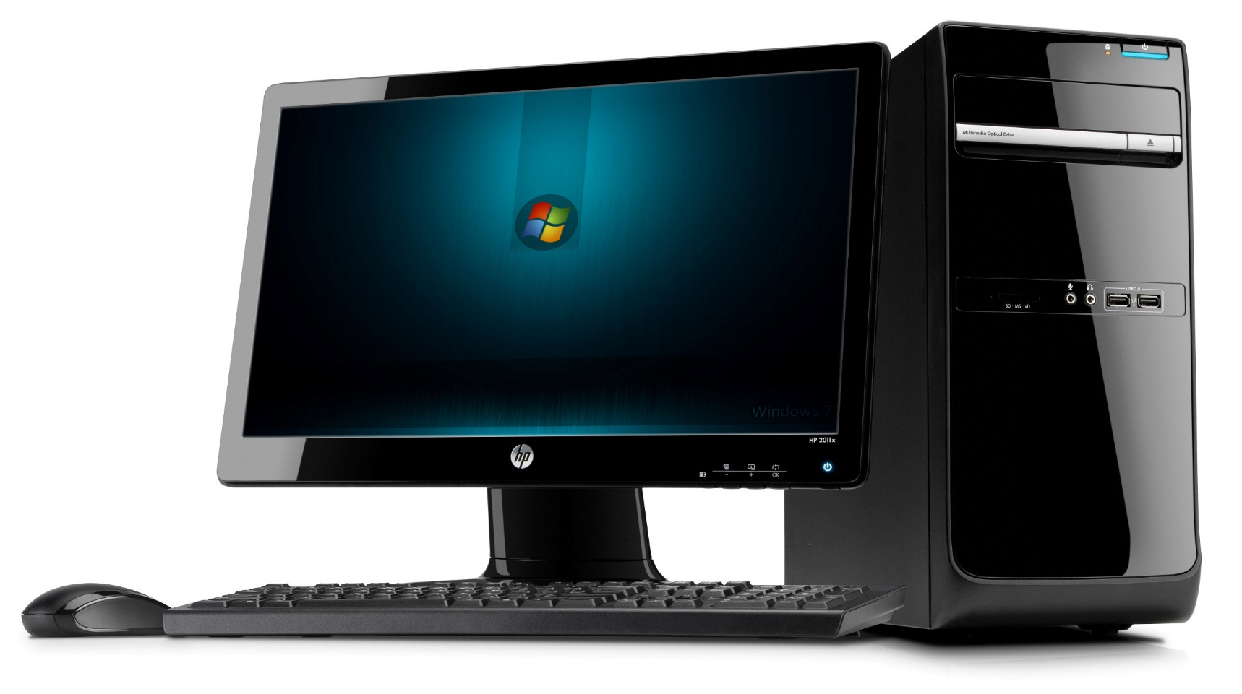
INTENTION
Produce tools that help test and debug next generation UI windows and controls.
Notes:
Why brand is important

Slide 5
Power Capabilities
Class PowerCapabilities Contains information about the power capabilities of the system.
e.g.
  is there a system power button
  is there a lid present
  is a battery present
  Is a thermal control present
  (…)

Slide 6
Power State
Class PowerState provides a system-wide set of power management features. The class retrives the power status, notify the application of power management events and notify the system of the application‘s power requirements.

Slide 7
Power State (con‘t)
Away Mode required
Display required
System required
Suspend / Hibernate
Announcements for
  Suspend operations
  Resume from Suspend
Battery state (charging/high/low/critical)

Slide 8
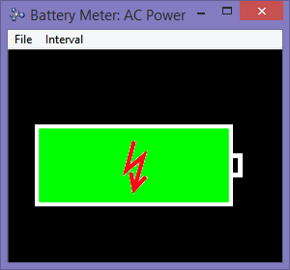
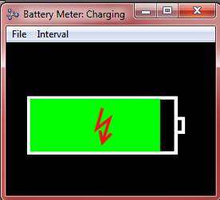
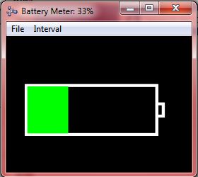
Battery Meter

Slide 9
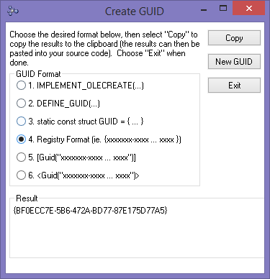
GUID Generator
Generate GUIDS with different styles.

Slide 10
Window Spy
Window Spy shows all registered windows, that exist at the present time in a hierarchical view.
Not just of its own Smalltalk process, but all existing processes, starting with the Windows Desktop.
Window Spy also retrieves information about the process, the window belongs to.

Slide 11
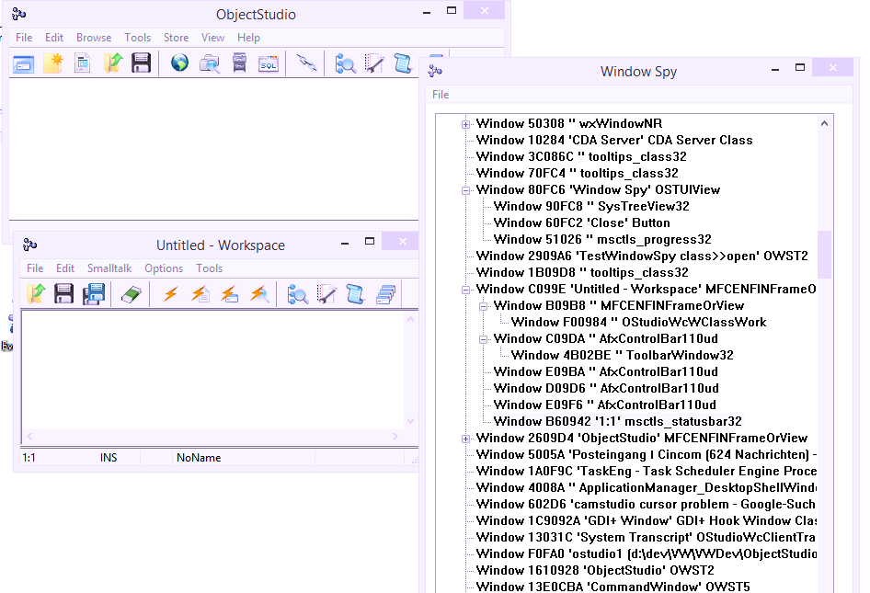
Window Spy (con‘t)

Slide 12
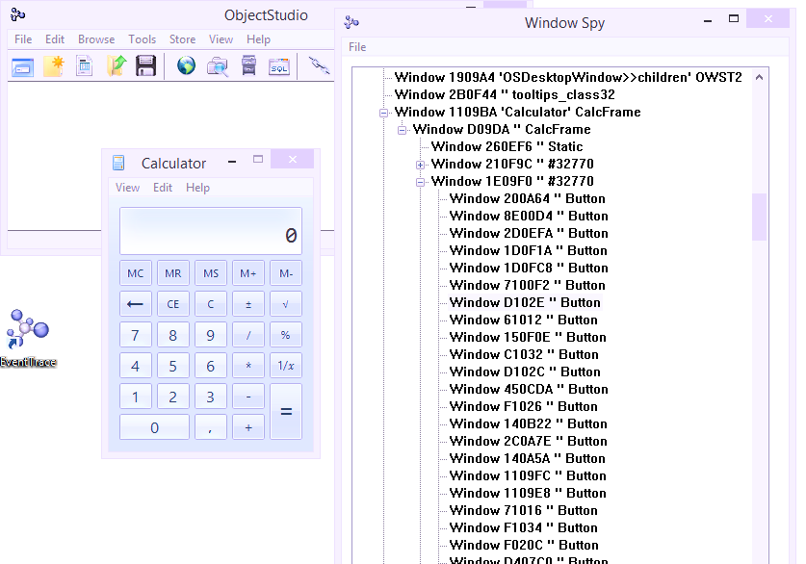
Window Spy (con‘t)

Slide 13
Window Finder
Window Finder locates and retrieves styles and extended styles of any open window in the system.
It works in conjunction with Window Spy.

Slide 14
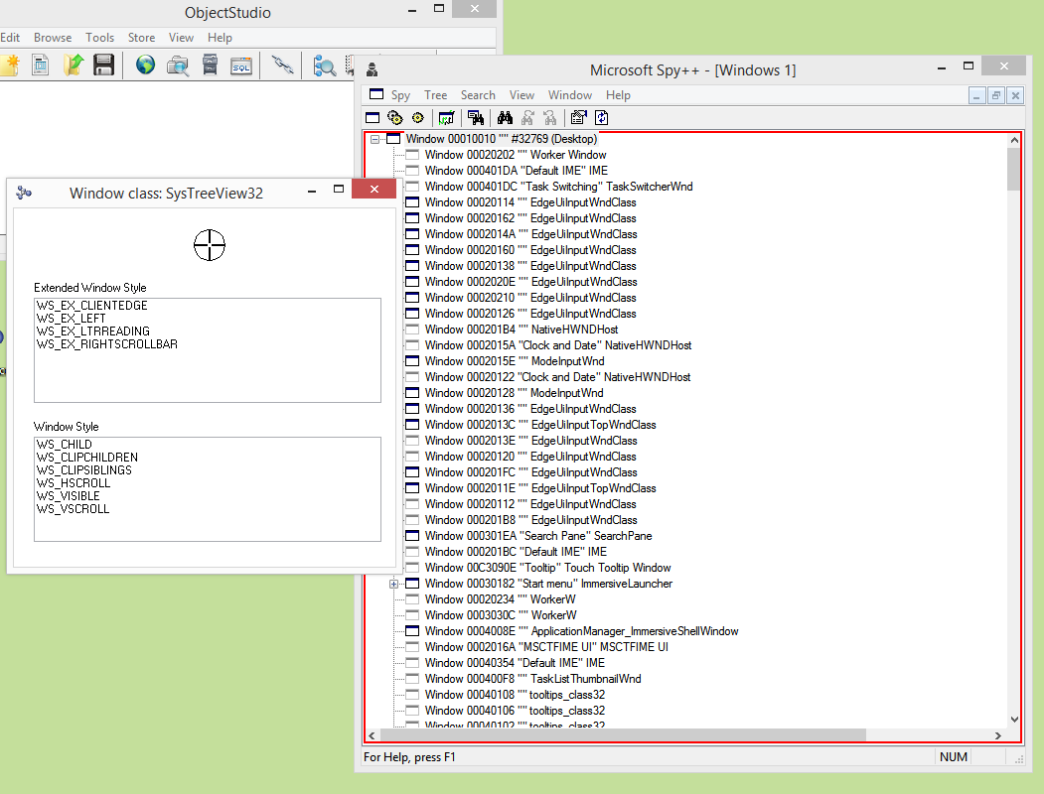
Window Finder (con‘t)

Slide 15
Process Explorer
ProcessExplorer displays all existing processes and information about
  Process ID (PID)
  Number of GDI objects
  Number of User Objects
  Creation time
  Time spend in User Mode
  Time spend in Kernel Mode
  Search for the Executable Name

Slide 16
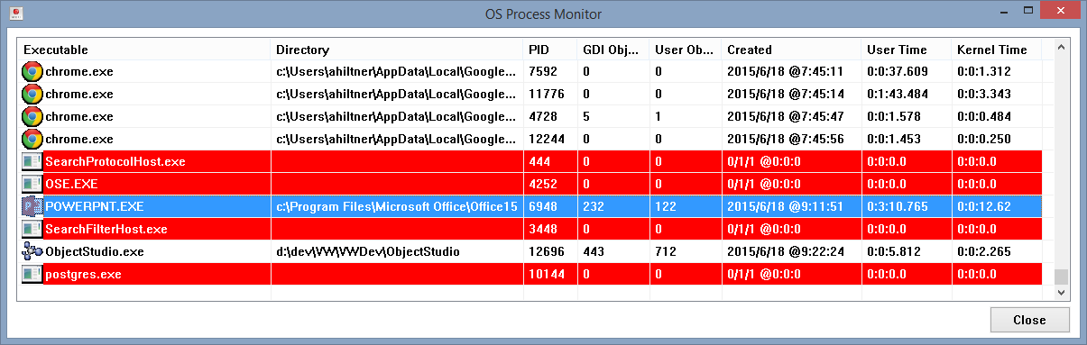
Process Explorer (con‘t)

Slide 17
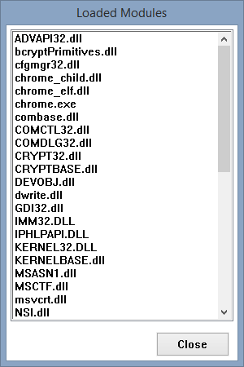
Process Explorer (con‘t)

Slide 18
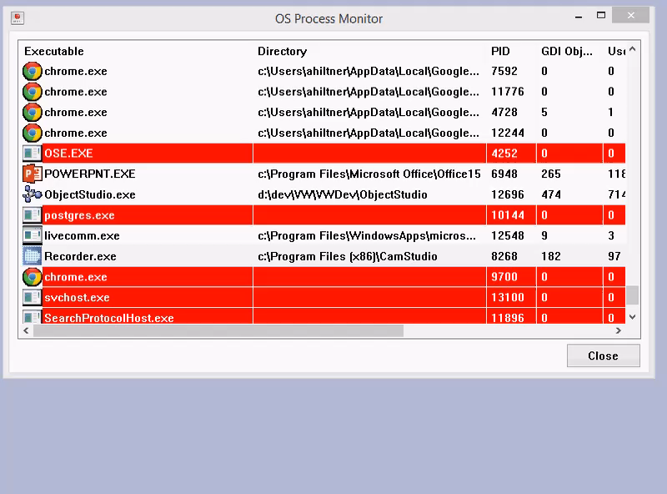
Process Explorer (con‘t)

Slide 19
GDI Log
GDI Log shows the usage of the various GDI resources over time.
It can help to identify resource leaks and indicate, which resources are used during operations.

Slide 20
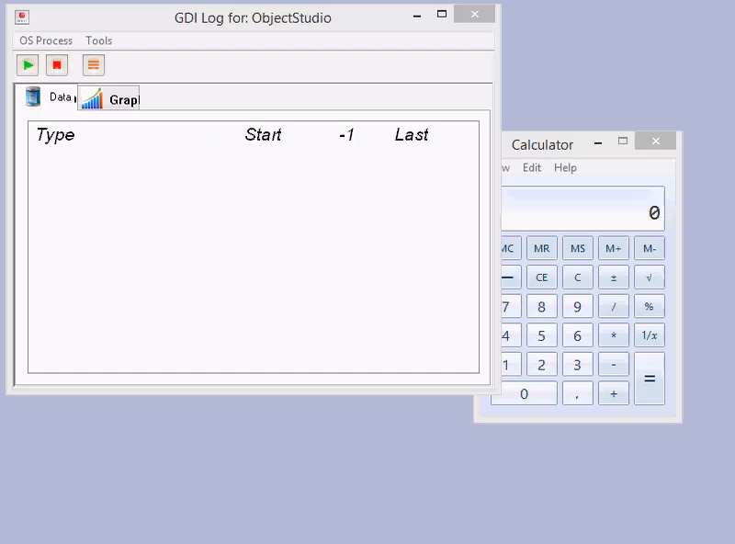
GDI Log (con‘t)

Slide 21
Questions?

Slide 22
Contact Information
Star Team (Smalltalk Strategic Resources)
  Suzanne Fortman (sfortman@cincom.com)
Cincom Smalltalk Program Director
  Arden Thomas (athomas@cincom.com)
Cincom Smalltalk Product Manager
  Jeremy Jordan (jjordan@cincom.com)
  Cincom Smalltalk Marketing Manager
  Suzanne Fortman (sfortman@cincom.com)
Cincom Smalltalk Engineering Manager

Slide 23
Try Cincom Smalltalk
Evaluate Cincom Smalltalk:
try.cincomsmalltalk.com
Join our Cincom Smalltalk Developer Program:
develop.cincomsmalltalk.com

