Slide 1

CINCOM SMALLTALK™ ON A TABLET
By Andreas Hiltner

Slide 2


Slide 3
Overview
Intention
Gesture Support
  GestureConfig
  GestureAnnouncement
  Example: NGWorkspace
  Example: PieChart
Display Change Event
Questions

Slide 4
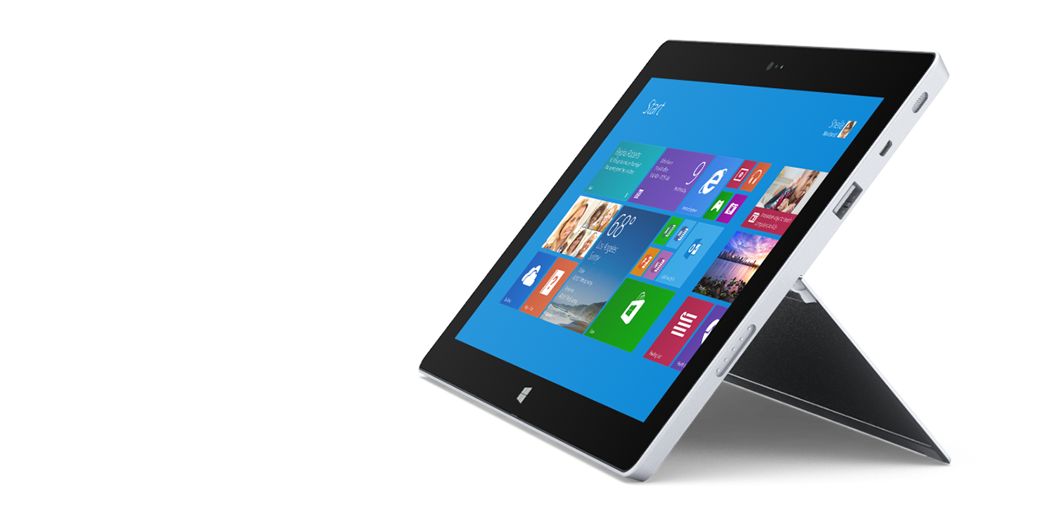
INTENTION
Allow clients to use touch input and react on display changes
Notes:
Why brand is important

Slide 5
Gesture config
Class GestureConfig allows the configuration of individual gesture events, e.g.
Pan
PressAndTap
Rotate
TwoFingerTap
Zoom
Gestures can be enabled/disabled for each window

Slide 6
GestureAnnouncement
Gesture events result in Announcements, e.g.
PanGestureAnnouncement
PressAndTapGestureAnnouncement
RotateGestureAnnouncement
TwoFingerTapGestureAnnouncement
ZoomGestureAnnouncement

Slide 7
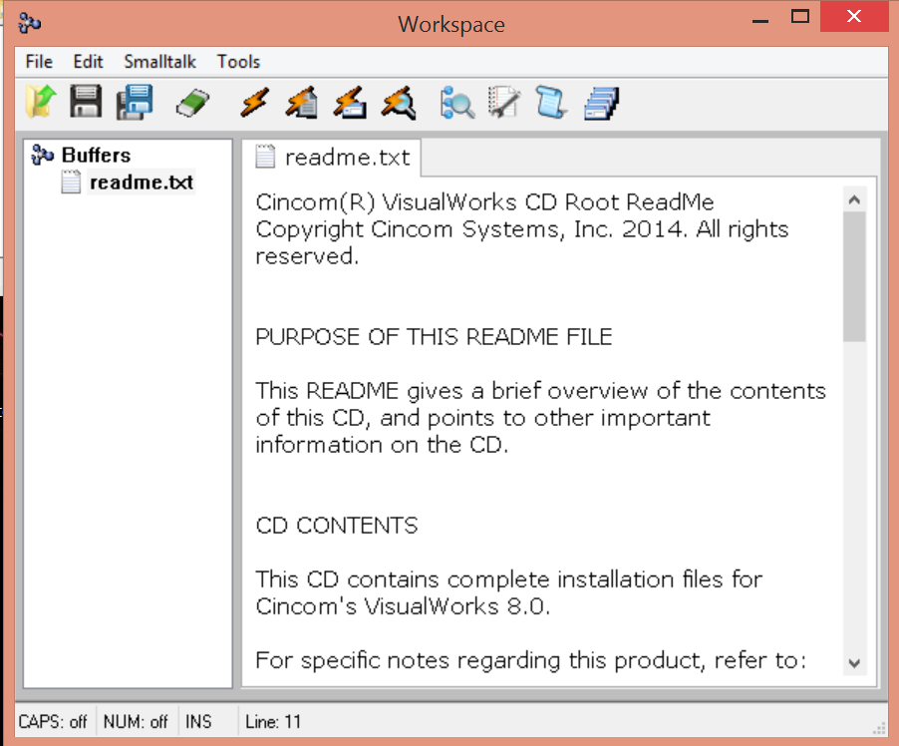
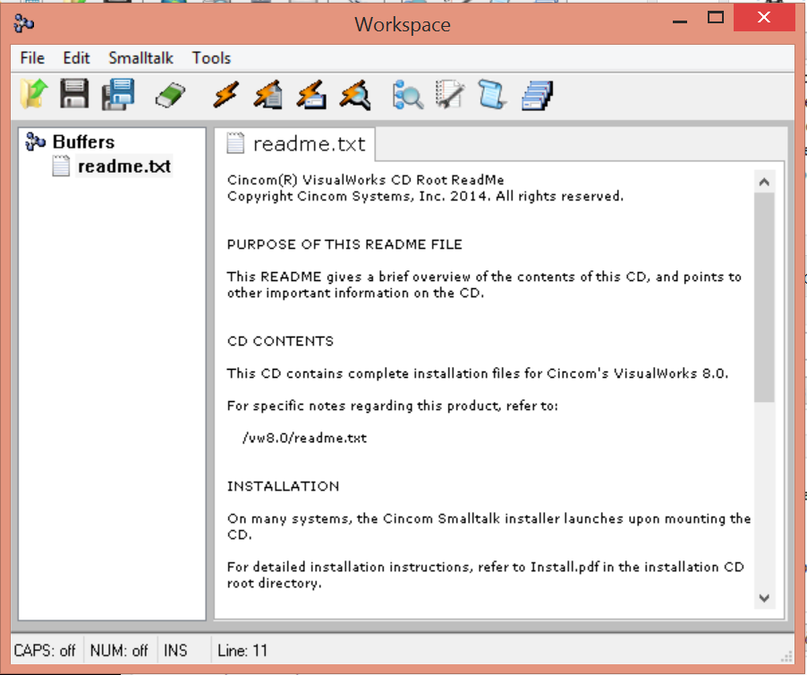
Example NGWorkspace (zoom out)

Slide 8
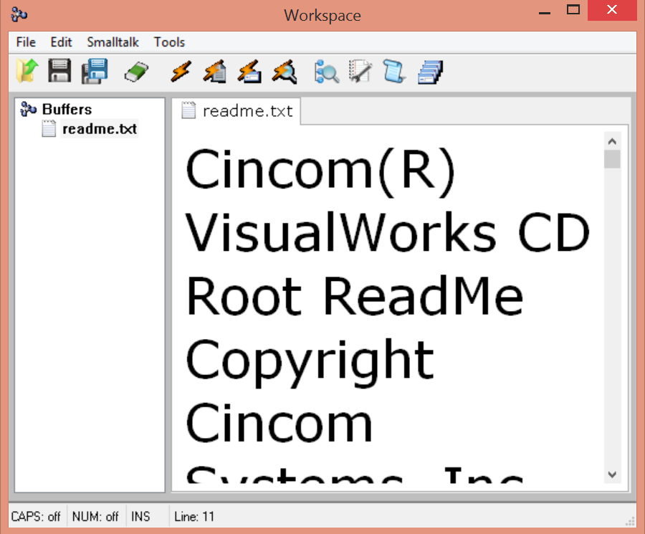
Example NGWorkspace (zoom in)

Slide 9
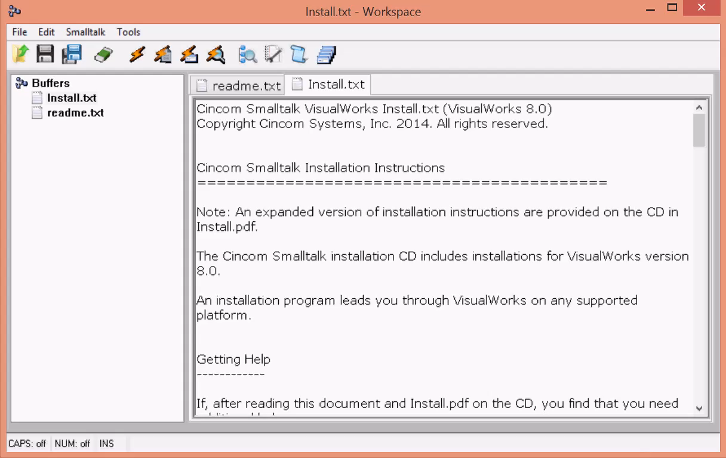
Example NGWorkspace Zoom (video)

Slide 10
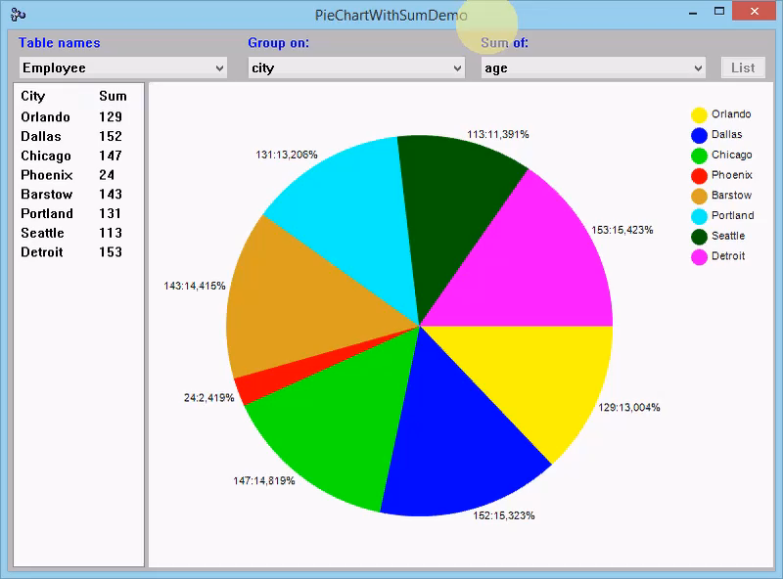
Example PieChart (rotate)

Slide 11
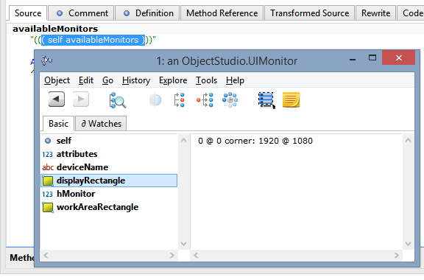
Display Change Event
WM_DISPLAYCHANGE is sent, when a tablet is rotated.
Class UIMonitor reflects the changes to the resolution.

Slide 12
UIMonitor
Class UIMonitor retrieves information about all attached screens, e.g.
Available Screens
Default Screen
Display Rectangle / Work Rectangle
Device Name
DPI
Scale Factor

Slide 13
Questions?

Slide 14
Contact Information
Star Team (Smalltalk Strategic Resources)
  Suzanne Fortman (sfortman@cincom.com)
Cincom Smalltalk Program Director
  Arden Thomas (athomas@cincom.com)
Cincom Smalltalk Product Manager
  Jeremy Jordan (jjordan@cincom.com)
  Cincom Smalltalk Marketing Manager
  Suzanne Fortman (sfortman@cincom.com)
Cincom Smalltalk Engineering Manager

Slide 15
Try Cincom Smalltalk
Evaluate Cincom Smalltalk:
try.cincomsmalltalk.com
Join our Cincom Smalltalk Developer Program:
develop.cincomsmalltalk.com

