Slide 1
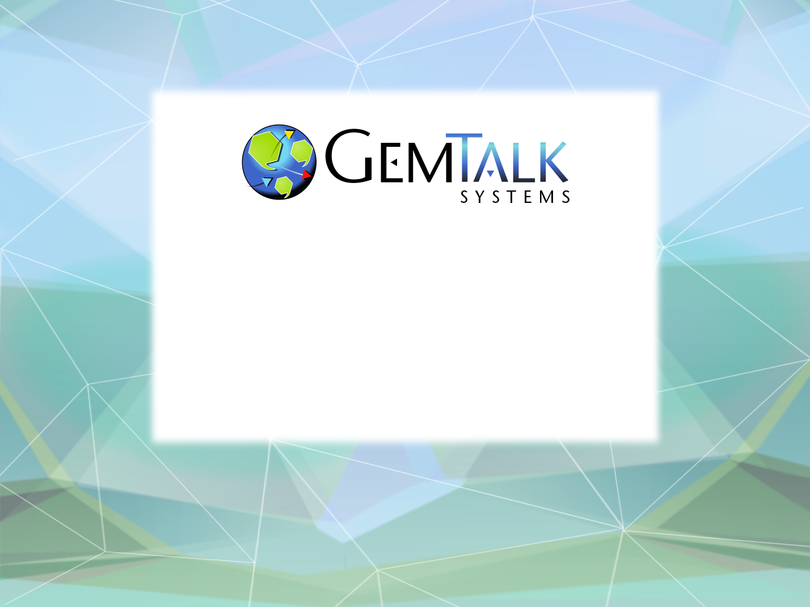
GemStone/S 64 Update
(with jokes!)
Norm Green
Senior VP & CTO
ESUG 2016
Prague, Czech Republic
24 August 2016

Slide 2
Agenda
So what is this GemStone thing you speak of?
GemStone/S 64 v 3.3
GemStone/S 64 v 3.4
Licensing Options

Slide 3
Q: How can you tell an extroverted programmer from an introverted programmer?
A: An extroverted programmer looks at your shoes when he talks to you.

Slide 4
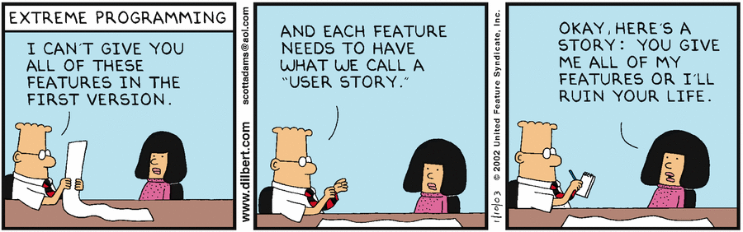
XP Implemented….

Slide 5
How Many Have Actually Used GemStone ?
How Many Have A Good Feel For What GemStone Is?

Slide 6
So What Is This GemStone Thing You Speak Of?
A solution to the limitations of traditional Smalltalk:
  Object space limited to one VM.
  Object space limited to one host.
  Object space limited to available RAM.
  Object changes (since last image save) lost when VM exits.

Slide 7
Welcome To The Magical World Of GemStone!
Object space visible to thousands of VMs on thousands of machines.
Object space limited by disk, not RAM.
Object changes managed by ACID transactions
  Atomic
  Consistent
  Isolated
  Durable
Object changes guaranteed persistent once committed.

Slide 8
Key Features Of GemStone
Scalability
  Billions of objects
  Thousands of users.
  Thousands of machines.
  Thousands of transactions per second.
  Terabytes of data.

Slide 9
Key Features Of GemStone
Concurrency
  Multiple user sessions.
  Built-in database transactions.
    Commit
    Abort
    Continue
  Optimistic Concurrency
    Reduced Conflict Collections
  Pessimistic Concurrency
    Object-level read/write locks.
  Namespaces
    Shared and private.

Slide 10
Key Features Of GemStone
Security
  Object-level security.
    User, group, world permissions.
  Login Security
    Traditional User-id / Password
    Single-Sign-On (GSSAP/Kerberos) (coming soon)
    LDAP
    PAM
  Administrative Privileges
    #GarbageCollection
    #OtherPassword
    #SystemControl

Slide 11
Key Features Of GemStone
100% Smalltalk
  All objects, all the time.
  Classes, methods, blocks.
  ANSI Smalltalk compliant (mostly)

Slide 12
Key Features Of GemStone
Very Large Collection Support
  Collections of millions of objects.
  Optimized searches using b-tree Indexes:
    Equality Indexes (a = b)
    Identity Indexes (a == b)

Slide 13
Key Features Of GemStone
Interfaces to Other Smalltalks
  VisualWorks® - GemBuilder for VisualWorks®
  VA Smalltalk® - GemBuilder for VA Smalltalk®
  Pharo – tODE (open source)
Interfaces To Other Languages
  C/C++ - GemBuilder for C
  Java – GemBuilder for Java
Interfaces to Relational Databases
  Oracle – GemConnect for Oracle
  Sybase – GemConnect for Sybase (open source)

Slide 14
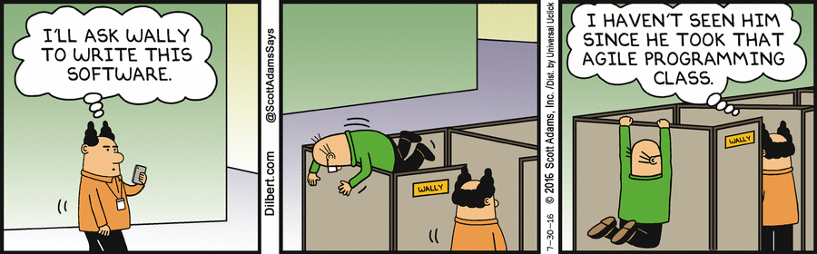
Agile or Fragile?

Slide 15
GemStone/S 64 Versions
Latest Release: 3.3.1 (June, 2016)
Next Major Release: 3.4 (Spring, 2017)

Slide 16
GemStone/S 64 3.3
Smalltalk Virtual Machine Performance
  Improved native code generation.
  Optimize native code for branch prediction.
  Improved math performance, especially integer math.
  Average overall improvement:
    25% faster vs. GS/64 3.2

Slide 17
GemStone/S 3.3
Faster Tranlog Restore
  Optimize object table generation during restore.
  ~30% improvement
  Affects:
    #restoreFromLogs
    Hot Standby Systems

Slide 18
GemStone/S 64 3.3
SmallFraction
  New immediate (special) class.
    Value encoded in the object.
    Guaranteed canonical.
  Numerator Range:
    -268435456 to 268435455
  Denominator Range:
    1 to 134217727

Slide 19
GemStone/S 64 3.3
GsFile Improvements
  Native UTF8 Support
  Methods Now Implemented as Primitives:
    next
    nextPut:
    _peek:
    _seekTo: opcode:
    isCompressed
    position

Slide 20
GemStone/S 64 3.3
Support LZ4 Data Compression
  “LZ4 is lossless compression algorithm, providing compression speed at 400 MB/s per core (0.16 Bytes/cycle). It also features an extremely fast decoder, with speed in multiple GB/s per core (0.71 Bytes/cycle).” -http://cyan4973.github.io/lz4/
  Up to 10X faster than zlib (aka gzip).
  Compression ratio slightly worse than zlib.

Slide 21
GemStone/S 64 3.3
3.3 LZ4 Support:
  Remote Gem to Page Server
  Remote GCI (ST Image) to Gem
  Stone to Remote Shared Page Cache(s)
  Stone to hot standby server(s).

Slide 22
GemStone/S 64 3.3
Remote Gem to Page Server Encryption
  Remote Gem to Page Server connection may now use SSL/TLS.
  Enabled with new GEM_PGSVR_USE_SSL option.
  Remote client to Gem connection already uses SSL/TLS.

Slide 23
GemStone/S 64 3.3
Start statmonitor automatically
Supports various wildcard args from strftime(3)
New Configuration parameters:
  STN_STATMONITOR_ARGS
    At stone startup
  GEM_STATMONITOR_ARGS
    At remote cache startup
  STN_STATMONITOR_MID_CACHE_ARGS
    At mid-level cache startup

Slide 24
GemStone/S 64 3.3
Make pageaudit Command Multi-threaded
  Used to audit the repository for page-level consistency.
  Up to 20 X faster than 3.2

Slide 25
GemStone/S 64 3.3
Object Canonicalization Framework
  A framework of classes that may be used to canonicalize instances of domain classes.
    AbstractReferencingObjectPolicy
    ReferencingObjectPolicy
    CanonicalObjectManager
    CanonicalObjectPolicy
    CanonicalObjectRegistry
Developed by a GemTalk – Customer partnership.

Slide 26
GemStone/S 64 3.3
Page Server Changes
  Previously (before 3.3)
    1 process (page server) is started for 1 remote gem.
    3000 sessions == 3000 page servers!
    Page Table Memory Problems (especially Linux)
  Now (3.3 and later)
    1 page server process is started for *all* gems on a remote host.
    1 thread is started for 1 remote gem.
    Each remote gem uses 1 native thread in the page server.

Slide 27
3.2 Architecture
Remote Gem Host
Stone Host
Page Server 1
Gem1
Page Server 2
Stone
Gem2
Gem1
Page Server 3
Gem3

Slide 28
3.3 Architecture
Remote Gem Host
Stone Host
Page Server 1
Thread 1
Gem1
Thread 2
Stone
Gem2
Gem1
Thread 3
Gem3

Slide 29
GemStone/S 64 3.3
Cache Warming With Mid Caches
  Leaf Caches may now use mid caches during cache warming.
  Advantageous for highly distributed, cloud based architectures.

Slide 30

GemStone Cloud Architecture
Remote Data Center (Cloud)
Main Data Center
Storage
SSL / TLS
Stone
Mid-Level Cache
Main Cache
Slow WAN
Leaf Cache 1
Leaf Cache 2
Gem
Gem
Leaf Cache 3
Gem

Slide 31
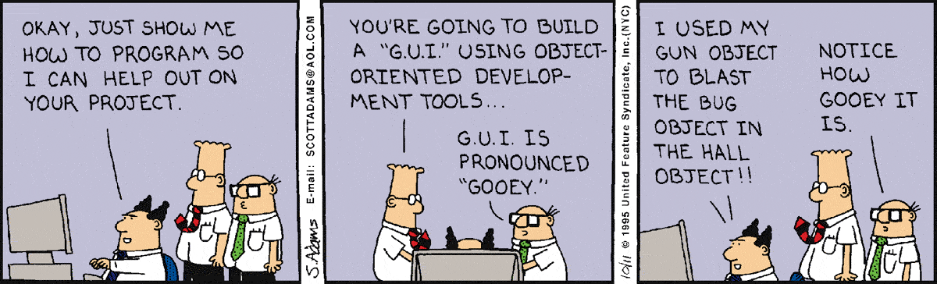
O-O Programming

Slide 32




GemBuilder for……..Android?!?
Experimental Project to Access GemStone from Android Devices
Uses GemBuilder for Java (GBJ)
(OpenSSL)

Slide 33
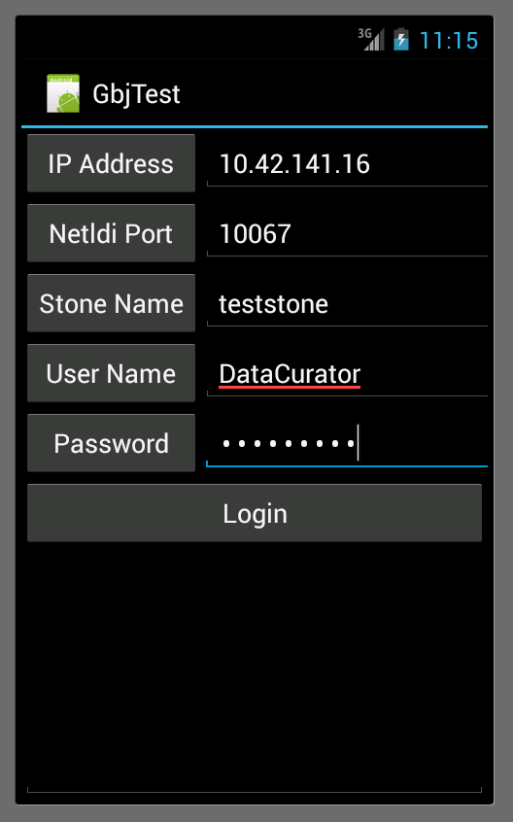
GbjTest App on Android
Login
Screen

Slide 34
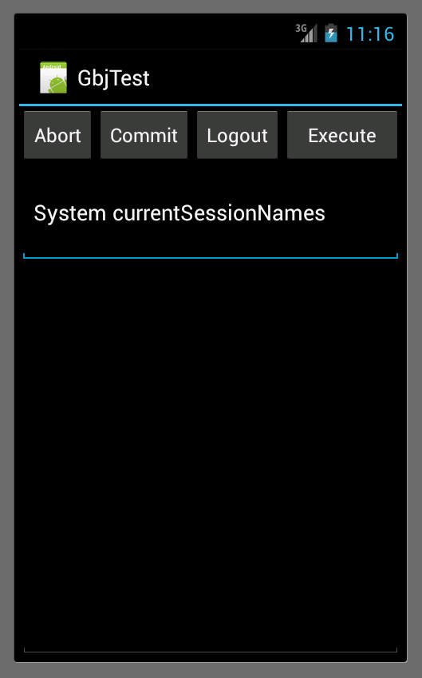
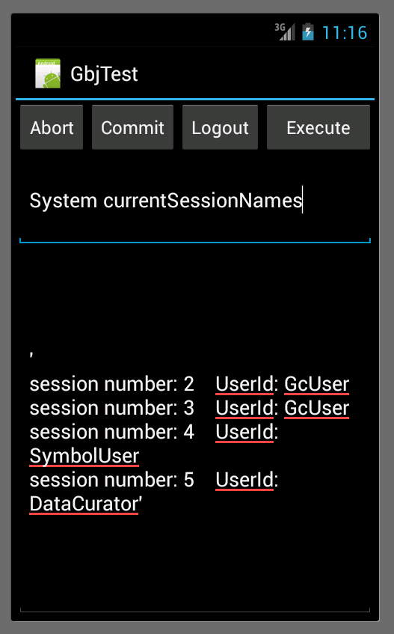
GbjTest App on Android
Command
Execution

Slide 35
Android Test App Source Code
Application Code:
  ftp://ftp.gemtalksystems.com/pub/GBJ/GbjTest.zip
Contact:
  bill.erickson@gemtalksystems.com

Slide 36
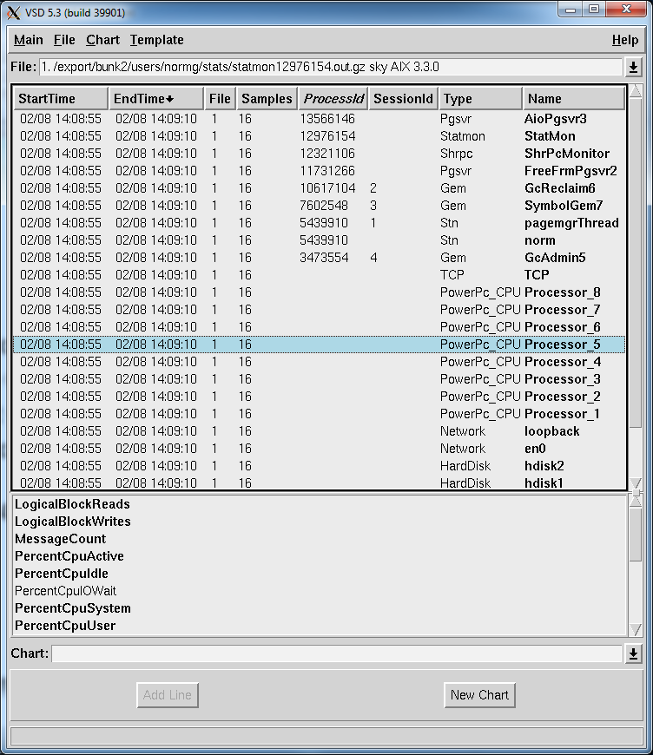
VSD 5.2
Faster load times on Windows
New End Time Column
Column Sort Arrows
Secondary Sort Column
Support for LZ4 compressed files.

Slide 37
GemStone/S 64 Platforms
Object Server (Database)
  Linux x86_64
  Apple Darwin 64 bit
  Oracle Solaris amd64
  Oracle Solaris SPARC 64 bit
  IBM AIX PowerPC 64 bit

Slide 38
GBS Platforms
Cincom® VisualWorks® 7.10.1 / 8.1.1
  MS Windows 7/8 32 bit
  MS Windows 7/8/10 64 bit
  Linux 32/64 bit
  Solaris SPARC 32/64 bit
Instantiations VA Smalltalk™ 8.6.2
  MS Windows 7/8 32 bit

Slide 39
GemStone/S 64 3.4
More lz4 Support:
  Statmonitor
  VSD
  Copydbf
  Backup/Restore
  Smalltalk Access (GsFile ? FileSystem ?)

Slide 40
GemStone/S 64 3.4
Encrypted Backups and Tranlogs
  AES 128, 192 or 256 bit encryption
  Public / private key pair
  Passphrase
  Secure Signing (MAC)

Slide 41
GemStone/S 64 3.4
OpenSSL 1.1.x
  Still in beta
  Will be supported once 1.1 is final

Slide 42
GemStone/S 64 3.4
Improved findReferencePath methods
  GemStone uses “persistence by reachability”
  Finds all references paths for a list of objects.
  Now multi-threaded

Slide 43
GemStone/S 64 3.4
GIT Support in Base Image
  Cypress Project
  https://github.com/CampSmalltalk/Cypress

Slide 44
GemStone/S 64 3.4
Single Sign On (SSO) Support
  GSSAPI / Kerberos (UNIX)
  SSPI (Windows)
  Service Name: “GEMSTONE64”
Database Login
  Enable UserProfile For SSO
Process Creation
  Enable NetLDI for SSO

Slide 45
GemStone/S 64 3.4
SSO Database Login Setup
  Create UserProfile and KerberosPrincipal objects
  run
  |profile kp|
  profile := AllUsers addNewUserWithId: 'normg' password: swordfish' .
  kp := KerberosPrincipal newPrincipalWithName: 'normg@GEMTALKSYSTEMS.COM'
  loginUserProfile: profile .
  profile enableSingleSignOnAuthenticationWithPrincipal: kp .
  %
  commit

Slide 46
GemStone/S 64 3.4
SSO Database Login Setup
  Add the Kerberos keytab file to the GemStone configuration file.
echo "GEM_KERBEROS_KEYTAB_FILE = /common/gemtalk.keytab;" >> $GEMSTONE/data/system.conf

Slide 47
GemStone/S 64 3.4
SSO Database Login Setup
  If UNIX login does not use Kerberos, get a ticket using kinit.
normg@bunk>kinit
Password for normg@GEMTALKSYSTEMS.COM: xxxxxxxx
normg@bunk>klist
Ticket cache: FILE:/tmp/krb5cc_300
Default principal: normg@GEMTALKSYSTEMS.COM
Valid starting Expires Service principal
08/01/16 12:32:49 08/01/16 22:32:49 krbtgt/GEMTALKSYSTEMS.COM@GEMTALKSYSTEMS.COM
renew until 08/02/16 12:34:09

Slide 48
GemStone/S 64 3.4
SSO Database Login Setup
  Login to GemStone with no password!
  normg@bunk>topaz -r
  _____________________________________________________________________________
  | GemStone/S64 Object-Oriented Data Management System |
  | Copyright (C) GemTalk Systems 1986-2016 |
  | All rights reserved. |
  +-----------------------------------------------------------------------------+
  | PROGRAM: topaz, Linear GemStone Interface (Remote Session) |
  | VERSION: 3.4.0, Wed May 18 13:11:30 2016 normg private build |
  | BUILD: 64bit-39535-PRIVATE |
  | BUILT FOR: x86-64 (Linux) |
  | MODE: 64 bit |
  | RUNNING ON: 4-CPU bunk x86_64 (Linux 3.2.0-90-generic #128-Ubuntu SMP Fri Aug
  | 14 21:43:58 UTC 2015) 11903MB |
  | PROCESS ID: 29215 DATE: 08/02/16 09:42:14 PDT |
  | USER IDS: REAL=normg (300) EFFECTIVE=normg (300) LOGIN=normg (300) |
  +-----------------------------------------------------------------------------+
  | GEMSTONE_NRS_ALL = #netldi:ldinormg#dir:/home/normg/local/gs64-3xb3/slow50/gs/product/data
  |_____________________________________________________________________________|
  topaz> set u normg
  Warning: clearing the previous GemStone password.
  topaz> login
  [Info]: libssl-3.4.0-64.so: loaded
  [08/02/16 09:42:18.559 PDT]
  gci login: currSession 1 rpc gem processId 29234 socket 6
  successful login
  topaz 1>

Slide 49
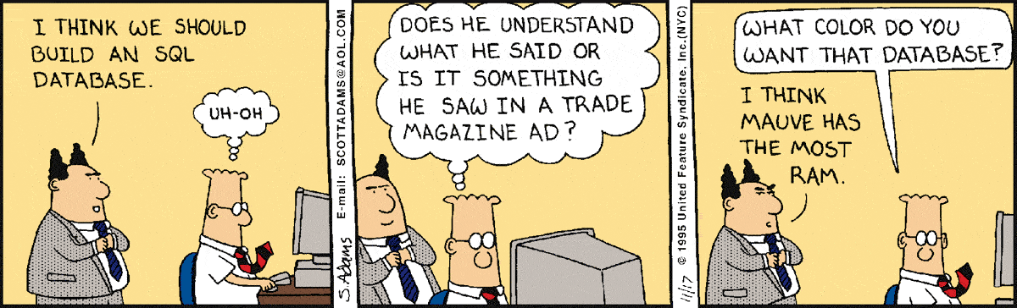

Slide 50
GemStone/S Licensing Models
Perpetual
  Buy once, own it forever
Annual Subscription
  Pay annually, cancel any time.
Value Added Reseller (VAR)
  Percentage of royalties

Slide 51
GemStone Community Edition
 | Starter | Limited | Full | Extended SPC | Extended CPU | Extended Full
License Kind | Perpetual | Subscription | Subscription | Subscription | Subscription | Subscription
Cores | 2 | 2 | 2 | 2 | 4 | 4
SPC | 1 G | 2 G | 2G | 4G | 2G | 4G
Gems | 10 | 20 | Unlimited | Unlimited | Unlimited | Unlimited
Disk | 10G | 50G | Unlimited | Unlimited | Unlimited | Unlimited
Development DB | Unlimited | Unlimited | Unlimited | Unlimited | Unlimited | Unlimited
Production DB | 1 | 2 | Unlimited | Unlimited | Unlimited | Unlimited
Tech Support | Community | Community | 5 tickets | 10 tickets | 10 tickets | 20 tickets
Price | Free | Free | $1500/yr | $3000/yr | $3000/yr | $6000/yr
Distribution | With Product | Email addr | Sales | Sales | Sales | Sales
Source: http://gemtalksystems.com/index.php/lc-licensing/

Slide 52
Smalltalk Advocacy
STIC
ESUG
FAST
Pharo Consortium
Open Source Projects
  Metacello
  tODE
  Tugrik

Slide 53

Questions?
Norman R. Green
Senior VP & Chief Technical Officer
®
GemTalk Systems LLC
15220 NW Greenbrier Pkwy., Suite 240
Beaverton, Oregon, 97006
Mobile: (503) 804-2041
norm.green@gemtalksystems.com
www.gemtalksystems.com

