Slide 1

Features of the New Cincom® ObjectStudio® Launcher By Andreas Hiltner @ahiltner (Twitter) #ESUG16

Slide 2
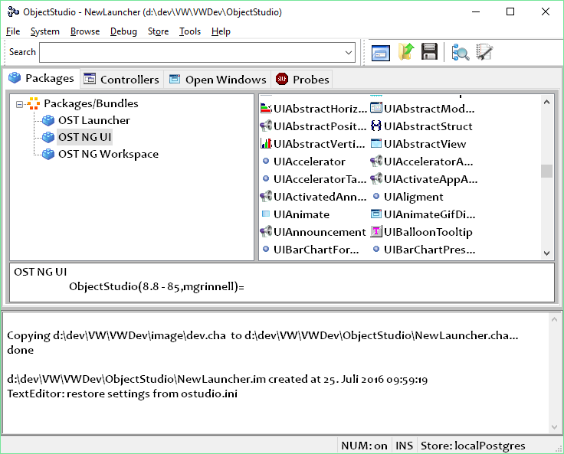
Topic
Motivation
Interface
Packages
Controllers
Open Windows
(…)
Next Steps
@cincomsmalltalk #esug16

Slide 3
Motivation
Create a new Launcher, that supports development and is not a simple collection of loaded tools
Combine the features from the VW Launcher and WPENFINController
Use the NG UI for more features
@cincomsmalltalk #esug16

Slide 4
Packages
Display content of Packages and Bundles
Easy access of frequently used Packages/Bundles
Double-Click on Package/Bundle opens the RB on selection
Double-Click on Class/Class Extension opens RB on selection
@cincomsmalltalk #esug16

Slide 5
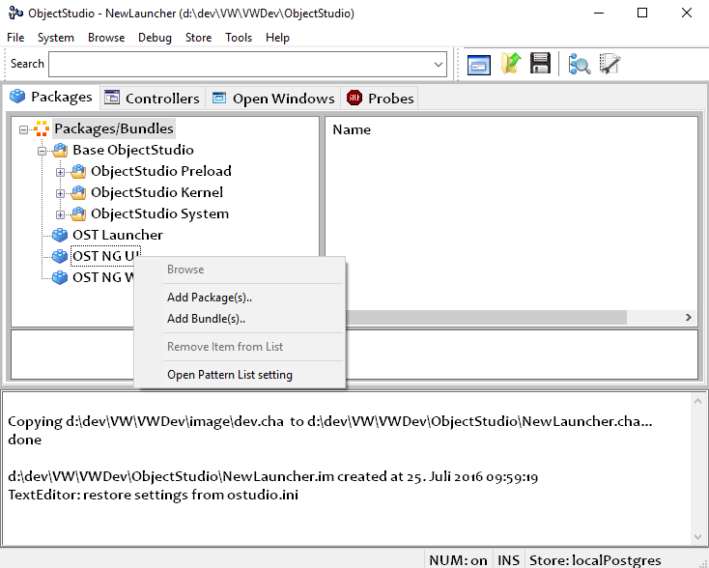
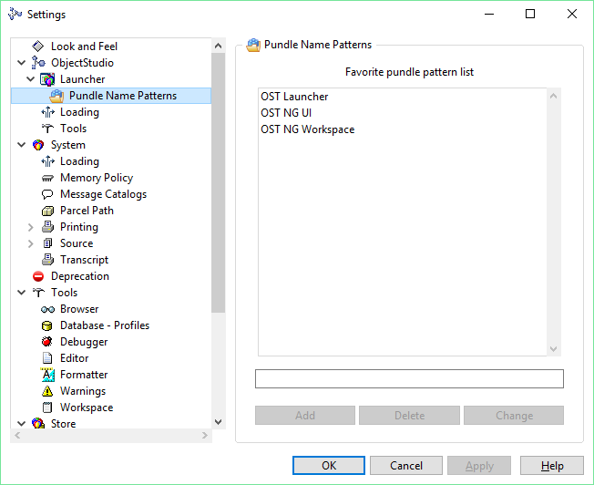
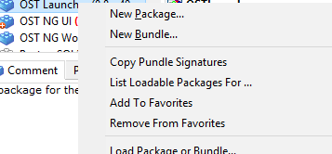
Packages
Packages can be added using
Context Menu
Refactoring Browser
Settings Dialog
@cincomsmalltalk #esug16

Slide 6
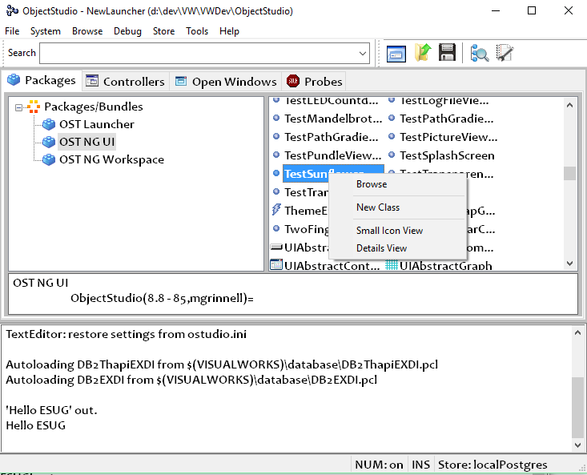
Packages
Default Action (double-click) is to open the RB on selection
‘New Class’ opens the standard New-Class-Dialog of the RB with the superclass and namespace set
The ListView can be changed to show different modes
@cincomsmalltalk #esug16

Slide 7
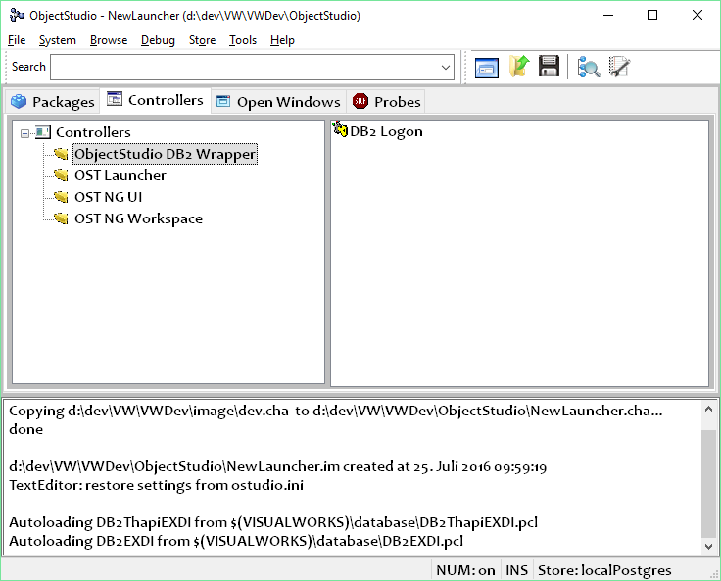
Controllers
Displays all Controllers and UIAbstractControllers
Package name is used for grouping
Double-Click on the controller will open it
Replacement for the functionality of WPENFIN
@cincomsmalltalk #esug16

Slide 8
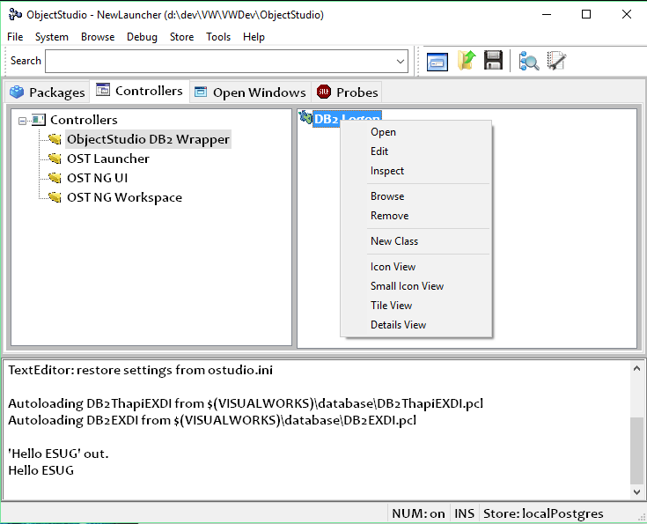
Controllers
Context menu for Controllers
Open
Edit
Inspect
Browse
Remove
New Class
Change ListView display mode
@cincomsmalltalk #esug16

Slide 9
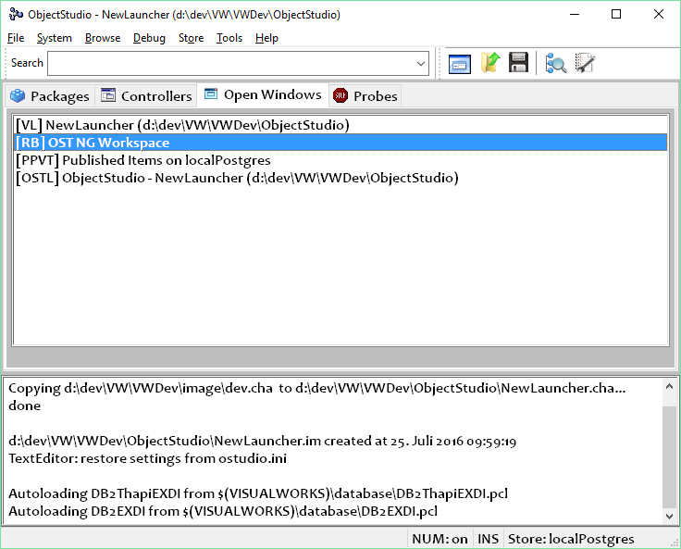
Open Windows
List of currently open windows in the System.
All Smalltalk windows are listed (ScheduledWindow/Form/ UIView)
Prefixed with the class name initials, e.g. RefactoringBrowser (RB), OSTLauncher (OSTL), etc.
‘F5’ will update the list
@cincomsmalltalk #esug16

Slide 10
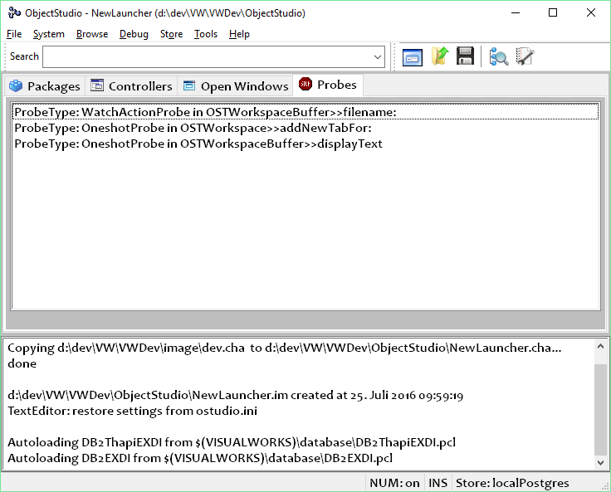
Probes
List of all existing probes (break points, watch expression) in the system
A double click of an entry will open the Refactoring Browser on that method.
‘F5’ will update the list
@cincomsmalltalk #esug16

Slide 11
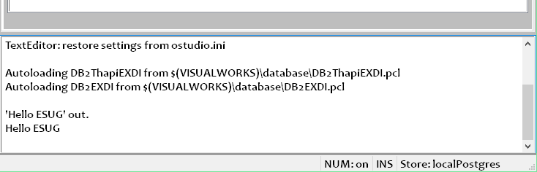
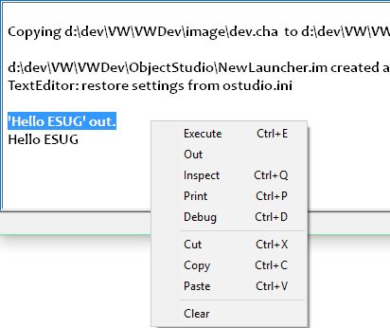
Transcript
This Transcript now only shows the output, but also can be used to execute snippets of Smalltalk code.
Limits:
No support for imports or Workspace-Variables
Code cannot be saved to/read from a file
@cincomsmalltalk #esug16

Slide 12

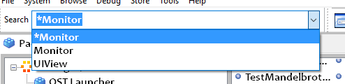
Search/Searchlight
Search for
Messages
Packages
Classes
Parcels
SharedVariables
No need to add wild-cards to the front or end of the search string
@cincomsmalltalk #esug16

Slide 13
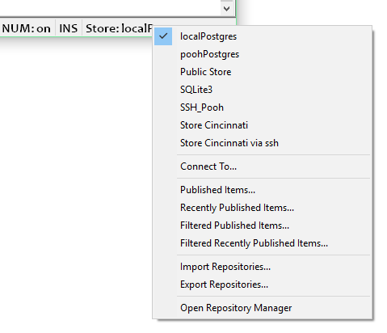
Statusbar
Clicking with the left mouse button on the Store-Connection-Status will open the menu shown, with some frequently used tasks
@cincomsmalltalk #esug16

Slide 14
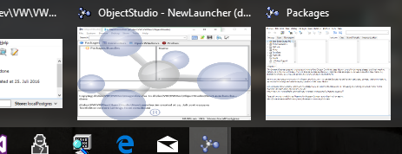
Taskbar
Icon overlay of the OSTLauncher window.
This way it is easy to find in the (sometimes pretty large) list of open Cincom Smalltalk windows.
This feature can be disabled in the settings
@cincomsmalltalk #esug16

Slide 15
Next Steps
Additional Settings, e.g. Color, initial open page, default views, etc.
Multi-Select-List for Open Windows
Additional Shortcuts, e.g. Del to close a Window
Tool to search for text inside of comments
Publish Bundles/Packages from Launcher
Performance improvements
(looking for some customer input …)
@cincomsmalltalk #esug16

Slide 16
Questions?
@cincomsmalltalk #esug16

Slide 17


Thank You!
Suzanne Fortman Program Director / Engineering Manager sfortman@cincom.com @SuzCST (Twitter)
Arden Thomas Product Manager athomas@cincom.com @ArdenTCST (Twitter)
Andreas Hiltner ahiltner@cincom.com @ahiltner (Twitter)
@cincomsmalltalk #esug16

