Slide 1
Pharo
in the Corner Cases
of the Enterprise
piotr@palacz.net

Slide 2
01
Background, Motivation, and Driving Questions
02
Case Descriptions
(code named: X, Y, and Z)
03
Observations, Reflections, and Suggestions
04
Wrapping up and Q&A

Slide 3
01
My [Smalltalk] Background
.
Smalltalk enterprise-type projects
in Advertising, Banking, Insurance,
Telco industries, in Australia and the US.
(D/V, VW, VA, Enfin, ST/X,…)
Leaving the Big Corp IT and Going
Independent
1987
’90s
-20y
-5y
-3y
2018
First Smalltalk course!
Dr. Artur Krepski,
Institute of Computer Science, Warsaw, Poland.
Architect work, in different guises (Technical, Solution, Application, Enterprise, etc.) in Telco, Medical, Government/State.
Using Smalltalk for project work again (Pharo 4/5/6)

Slide 4
01
My Perspective and Potential Biases
Being Independent typically means:
Small teams (<1 to 2-3 FT people)
Small budgets
Short timeframes
Relative freedom of choice in approach and tooling …
… But bearing the full risk for the choices made
Having to assume broad responsibilities (for requirements, design, implementation,
testing, deployment, monitoring, etc.)
Pragmatic Focus:
Solutions involve both business and software elements
Driving the solution rather than waiting for it to happen
Dealing with the reality of underspecified requirements
Limited opportunity for extended experimentation
Still being open to outside-the-box solutions

Slide 5
01
Motivation and Driving Questions
What are the areas (if any) where Pharo can be successfully used
in an enterprise [systems] context?
What are some of the effective ways of introducing Pharo to
non-mainstream-technology-averse organizations?
What in Pharo is attractive for the independents and small companies
working in an enterprise context?
What in Pharo is attractive in that context and what could be improved
to increase its attractiveness?

Slide 6
02
Sample Corner Cases
X
Legacy Archeological Dive
Recovering ’90s Social Services App for replacement
Y
Creating Self-Service Portals
Web-based Data Validation On-Demand for End-Users
Z
Chatbot-Enablement
Grokking Chatbot, Corpus for a Financial System

Slide 7
X
Legacy Archeological Dive
Recovering ’90s Social Services App for Replacement
Background and Goals
Tooling
1990’s System to manage social service-related funds (~$6B/yr) between the State and the Counties (53 offices, 4k employees). No longer maintainable.
Before replacing it/creating an RFP, it needs:
Use Cases, Business Rules
A Component/Realization Model
Navigation, Control and Data Flows, etc.
FoxPro IDE
FoxPro decompiler
Sparx EA
Pharo 4 (mid-2015)
GT
PetitParser
Roassal2
Telescope
1
3
Challenges and Insights
Outcomes
2
4
No implementation documentation or know-how available; implementation language is complex and has no grammar available
Manual analysis impractical; combination of automated processing and manual input required
Tool support and visualizations needed; static analysis should provide usable information for the effort
Use Cases established (Sparx EA)
An environment for examining relationships among realization artifacts, supporting visualizing, navigating, annotating these relationships
Use Cases mapped to Realization artifacts
Identification of key components and key areas for Business Rules analysis

Slide 8
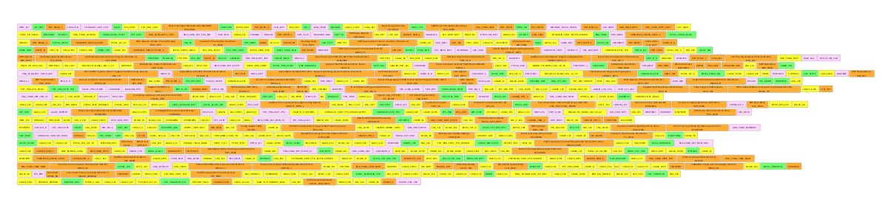
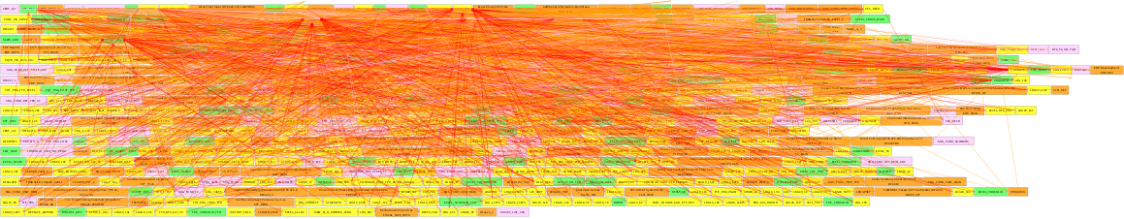
X
Legacy Archeology Dive
Top-Level Artifacts and Analysis
Realization Artifacts
125 Tables
335 Programs (incl. code pieces in Screens, Reports, and Libraries)
126 Screens
146 Reports
Relationships among the Artifacts
Derived Characterization
Relationship Type | Applies To | Count
Reads Or Writes To | Components interacting with Tables | 1122
Opens UI | Screens opening UIs (Screens or Reports) | 562
Executes | Programs or Procedures executing other Programs or Procedures | 560
Reads From | Read accessed from Tables, typically in Reports | 397
This is a Direct Data Entry app
% of Screens – Tables direct interactions
This is a Report Generation app
% Tables - Reports vs Screens - Tables
Support for Business Process is limited
% User-initiated interactions in the Screens
Simple inter-Program interactions
# Program-Program vs # Program
…

Slide 9
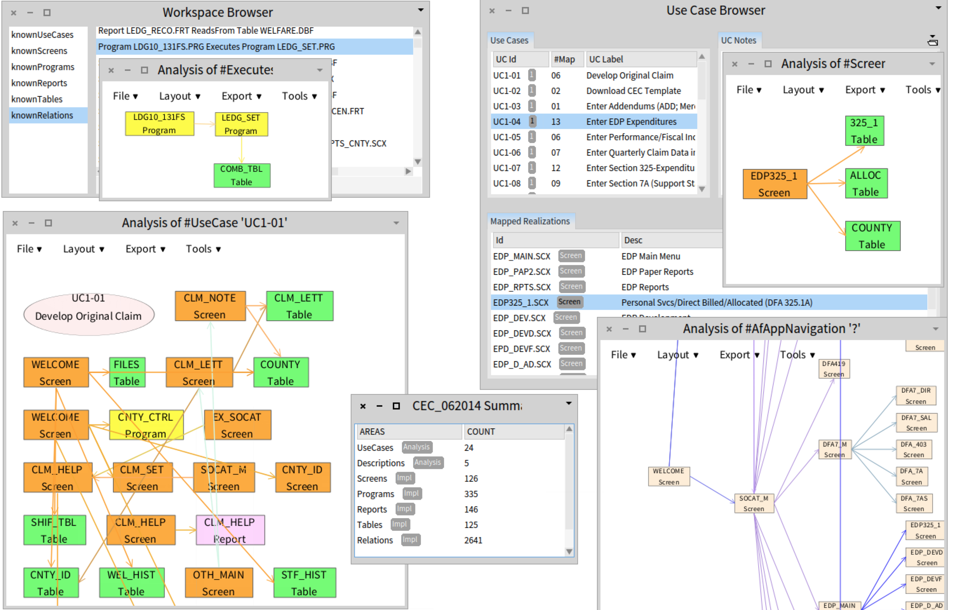
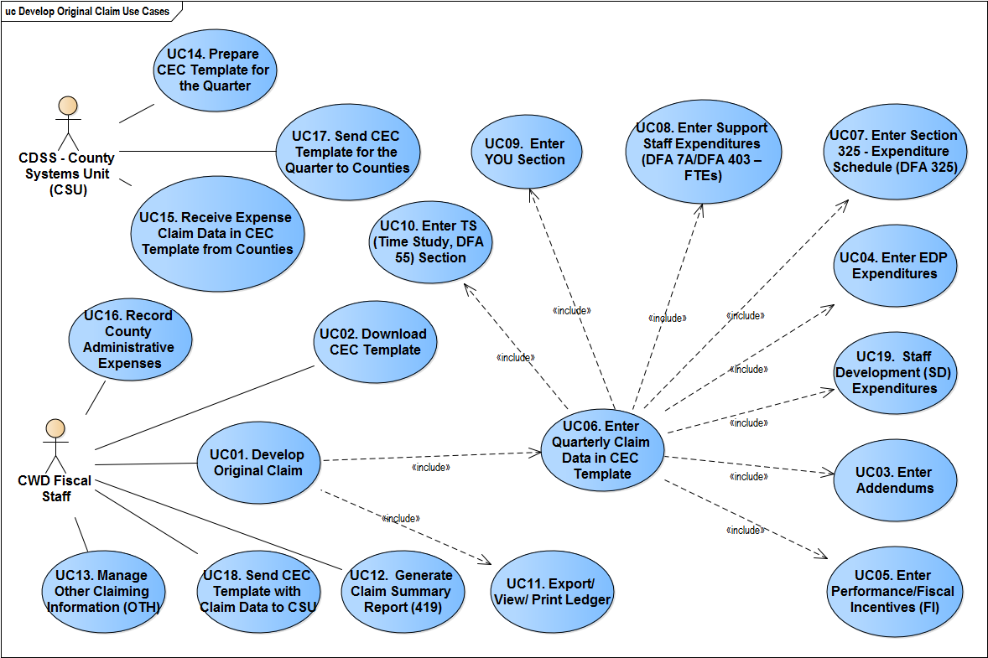
X
Legacy Archeological Dive
Exploration Workspace, Tools, Drill-Downs
Pharo 4
Sparx EA

Slide 10
Y
Self-Service Data Validation Portals
Fast Data Validation and Reporting for Data Migration
Background and Goals
Tooling
Part of a +$500M project replacing +1000 disparate financial systems in a single State.
This requires multi-stage data validation and migration as part of on-boarding.
The existing processing procedures could not scale.
Pharo 5/6 (2016-18)
Seaside + Bootstrap + extensions
NeoCSV + DataFrame + extensions
STON
Used pieces of Deltawerken’s Story Board
1
3
Challenges and Insights
Outcomes
Replace the initial stages of validation/migration at the target with self-service using internal portals
Allow data set submittal for integration only after quality thresholds have been met in self-service portals
Data layout specs are in flux
Error/warning rules are in flux
2
4
Initially, a single Portal for financial data
Over time, two additional separate portals for other data set types: file interfaces and security data
+500 registered users on a single Portal instance
Fast processing between page switches
Downloadable reports
Support for Validation Lifecycle

Slide 11
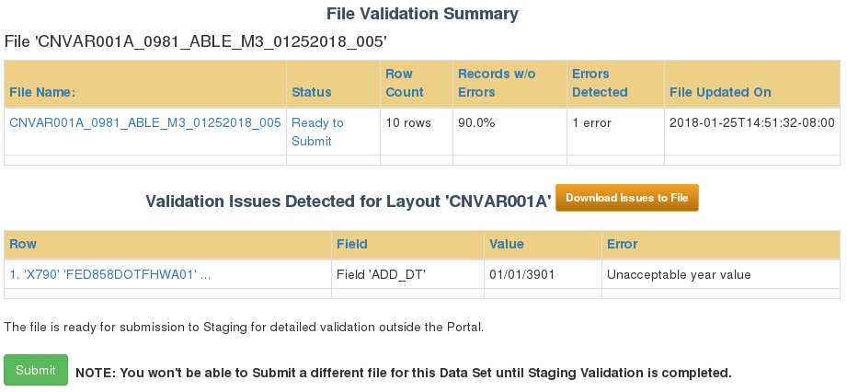
Y
Self-Service Data Validation Portals
Fast Data Validation and Reporting for Data Migration
Trivial Sample: a Web Page Fragment

Slide 12
Y
Self-Service Data Validation Portals
Spec-Driven Validation: Field-Level Simple Samples
A Layout Def may have +100 field definitions; they can be inter-dependent
Field 'VIN' 'Asset VIN’
Conditionally Required IF: 'ASSET_TYPE’ value is equal to: '060'
Type: AlphaNum
Size max: 18 chars
Field 'ZZ_PROJECT' 'Legacy Chartfield - Project'
Optional
Explicit error conditions:
IF (('ZZ_PROJECT' has no value) AND ('ZZ_FUND' value is equal to: '0890'))
THEN FAIL with message: 'Project ID is required if ZZ_FUND = 0890.'
Type: AlphaNum
Size min: 0 chars max: 15 chars

Slide 13
Y
Self-Service Data Validation Portals
Spec-Driven Validation: Row-Level Simple Samples
A Layout Def may have ~60 row-level rules, some inhumanly long (400+ lines) and inter-dependent
ROW Rule 'Rule 6009 Defined in ROLE_MAPPING':
IF (ROW has ALL values in FIELDS: 'RM.ZZ_AR_ITEM_RQST', 'RM.ZZ_AR_ITEM_PROC')
THEN ( WARN with MESSAGE: 'Assignment of roles (AR Item Requestor and AR Item Processor) are in conflict
with State Separation of Duties (SOD) policy.')
ROW Rule '50XY Defined in REQUISITION_APPROVER':
IF ((ROW has a value in FIELD: 'RA.ZZ_REQ_AD_HOC_APPR')
AND (ROW has at LEAST ONE value in FIELDS: 'RA.ZZ_REQ_APPROVER_1', 'RA.ZZ_REQ_APPROVER_2'))
THEN ( FAIL with MESSAGE: 'If Requisitions Ad Hoc Approver is identified,
then other Requisitions approver levels must not be identified')

Slide 14
Z
Chatbot-Enablement
Making sense of APIs and Long-Term Maintainability
Background and Goals
Tooling
Provide Chatbot services to +2k end-users
Determine simple ways of interacting with IBM Watson
Integrate Chatbot with existing PeopleSoft LOB system
Identify what is needed for maintaining the Corpus by the SMEs
Pharo 6
Seaside
Bootstrap
Telescope
DataFrame
1
3
Challenges and Insights
Outcomes
Simple REST interactions with complex node.js or JDK SDKs provided by IBM
Most first/naïve tests fail (terminology …)
Inherited PoC with JS/Angular2 code neither easily testable, documented, nor maintainable
Excel-based initial Corpus has logical/structural problems and is not maintainable
REST API exploratory tooling needed
Corpus exploratory tooling needed
REST API testbed to figure out Watson authentication and authorization conventions
Visualizing for the SMEs existing and target Corpus structure
Exploring integration mechanisms with PeopleSoft
WIP; future: Web-based multi-user Corpus editor with version control?
2
4

Slide 15
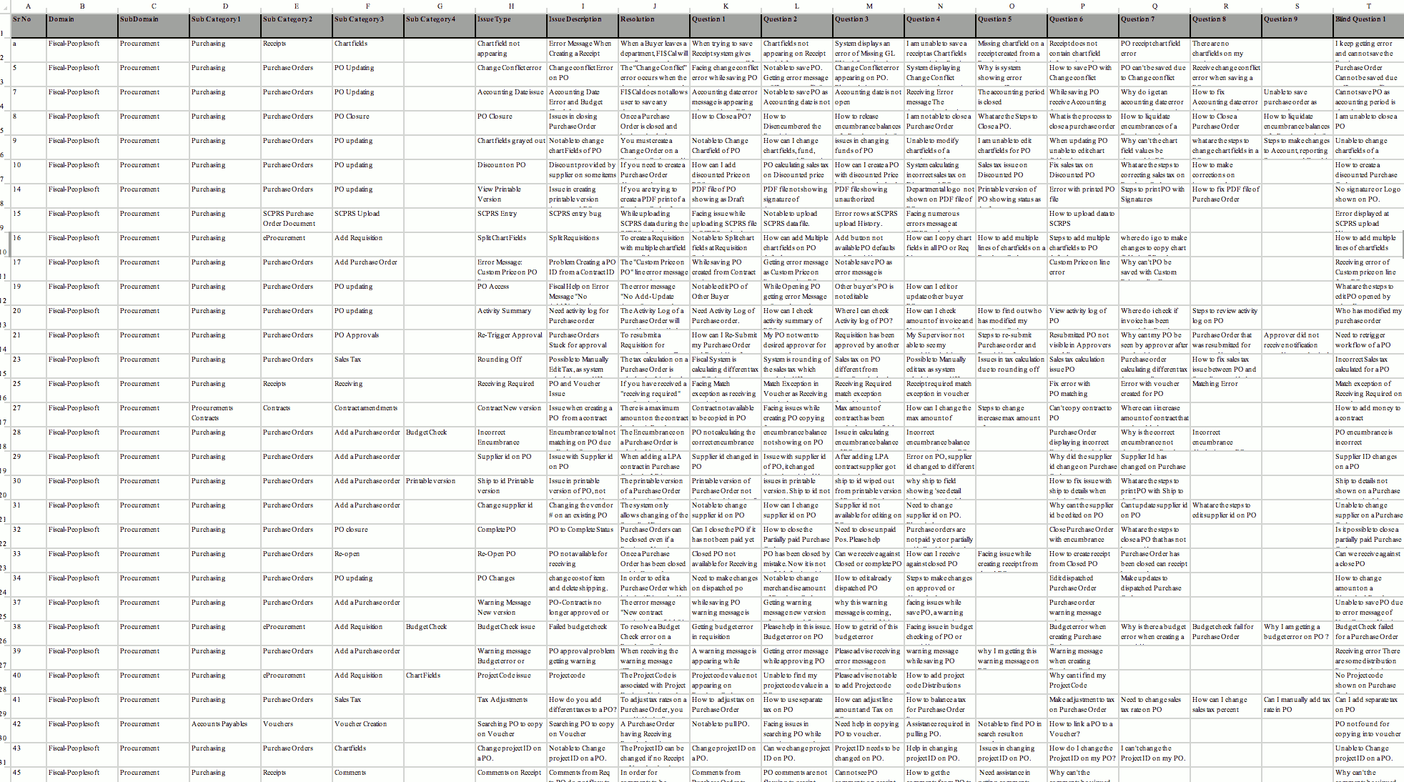
Z
Chatbot-Enablement
Towards a Reasonable Structure/Maintainable Corpus
Pharo 6 + Telescope + Corpus Model
Proposed Corpus Structure – Interactive Exploration
Initial Excel Corpus and its Issues

Slide 16
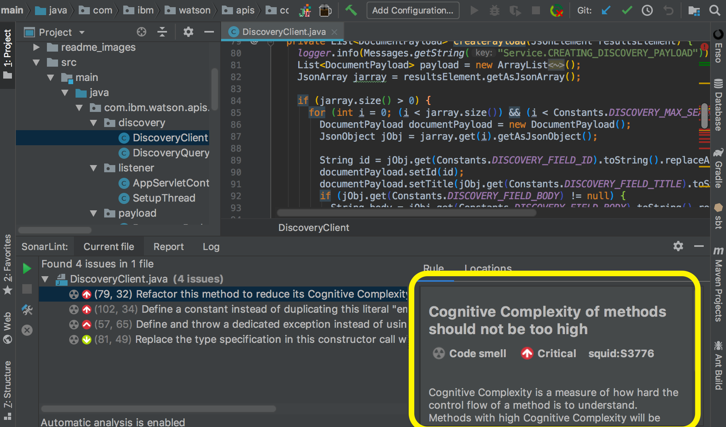
Z
Chatbot-Enablement
Dealing with the Unnecessary Complexity
IntelliJ + Watson JDK API

Slide 17
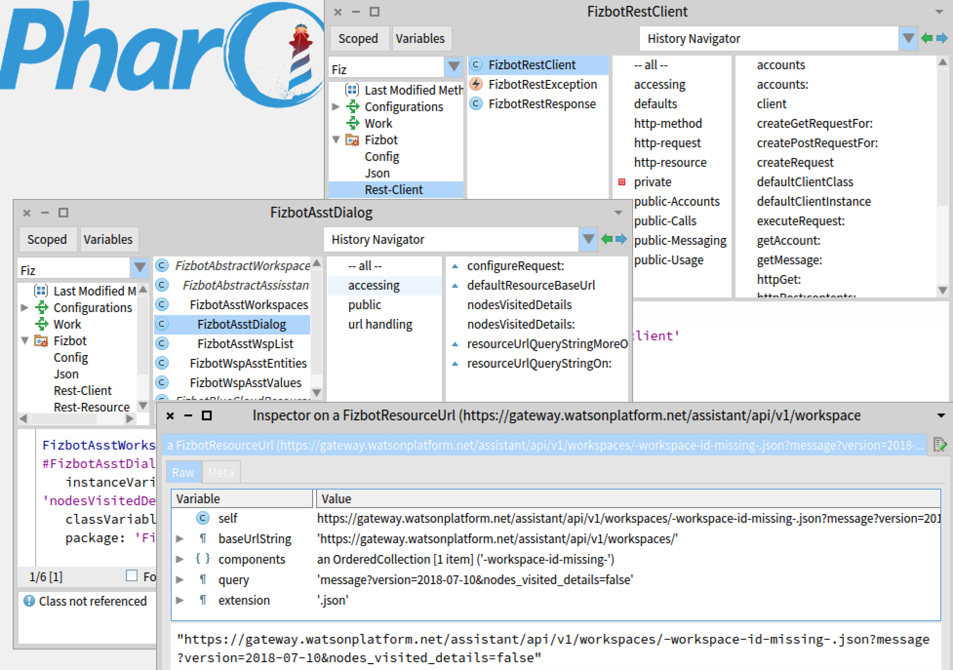
Z
Chatbot-Enablement
Making Sense of the Provider API & its Pitfalls
Pharo 6 + Zinc + Teapot + Cannibalized Twilio

Slide 18
02
Sample Corner Cases – Wrapping Up
Any visible similarities?
Any patterns perhaps?
Any Questions?

Slide 19
03
Observations and Reflections
Perspective
and
Biases
Areas where Pharo can be used successfully in the enterprise
Ways of introducing Pharo to non-mainstream-technology-averse orgs
Attractive facets of Pharo for the independents and small IT companies
Areas for improvement in Pharo to increase its attractiveness

Slide 20
03
  Fertile Enterprise Areas for Pharo
Generally, any area with the following features is a promising shot:
Where a solution must be provided at a fraction of time and cost
and resources, compared to what the mainstream approaches require
Where out-of-the-box approach might be the only way to go
in order to satisfy the above
Which is not central to the Enterprise (not a LOB system) but still
has a demonstrable business value
It helps (at least for starters) if:
There is an urgency about having the solution
It has a known (non-eternal) lifespan
It does not require massive scalability

Slide 21
03
  Introducing Pharo to Non-Friendlies
In non-mainstream-technology-averse organizations:
Do use Pharo to provide a solution
  … to tangible and clear business problems
  … rather than to solely technical problems
Do not make it a panaceum (silver bullet):
  It cannot be a solution to vague or incorrect requirements
  It cannot be a solution to fundamental SDLC problems, etc.
Do not introduce it solely on its technical merits:
  This is likely to be a non-starter or even an end to the conversation

Slide 22
03
  Making Pharo Acceptable
Perspective
and
Biases
Build acceptability on:
Delivering the solution in the first place, despite the constraints
Adopting reasonable (unit, integration, functional) testing to decrease reliance on the testing performed by others
Making the solution modifiable and maintainable
Improving the functional scope and reliability over time in a predictable way

Slide 23
03
  Attractive Facets of Pharo
Perspective
and
Biases
Open Source: less because of the cost, more of the typical red tape
and procurement cycle that is capable of killing any promising approach; and because it is Source after all
Location, location Productivity, Productivity, Productivity!
Habitability, moldability, and the overall unmatched pleasantness of working
in the environment
Small hardware/resource demands (compared to the mainstream)
Standard Class Library and a number of good facilities (Seaside, Zinc, parser builders, etc.)
Small but passionate community with many young people

Slide 24
03
  Areas for Improvement, 1 of 2
Perspective
and
Biases
Making the habit of providing at least a minimal documentation of the submitted packages
  Many packages do not have class comments or even package comments
  Unfortunately, this can be a self-disqualification
  Creating a curated list of Pharo packages on GitHub?
Improvements in Version and Configuration Control
  Keeping around what has worked just fine (e.g., gitfiletree)
  Being clear about the status and road map of key components (Iceberg?)
  Having reliable dependency specs in packages that work when loading
    Using CI to test dependencies of key packages?

Slide 25
03
  Areas for Improvement, 2 of 2
Perspective
and
Biases
Better information about the level of maturity of a given tool or package
  Maturity levels in Squeak are useful
  Is there a way of mechanically approximating the maturity level?
Better managing of the release cycle:
  Reconsidering the push for the bleeding edge
  Perhaps even/odd-numbered stable/bleeding edge releases?
  Clarity about fitness-for-purpose of the new features/tools
  Keeping things that work available
Promoting how small operators (including the independents) can
support development of Pharo, with emphasis on the financial support and what
this can buy everyone

Slide 26
04
Final Thoughts
Over the years, I came to believe that the actual value of (a specific piece of)
technology lies in its ability to change people’s attitudes and behaviors in IT.
Pharo/Smalltalk has that ability.
Starting with the small or the non-central (the corner cases)
within the big and the complex (the enterprise) can help realize
that capability, while producing good/usable solutions and making
the enterprise a bit more bearable in the process.

Slide 27
Thank you
Comments, suggestions, feedback, etc.: please email piotr@palacz.net

