Slide 1

Application Development
with VA Smalltalk
26th ESUG Conference
Cagliari, Italy – September 13, 2018
Alexander Mitin
Senior Software Engineer
Instantiations, Inc.

Slide 2
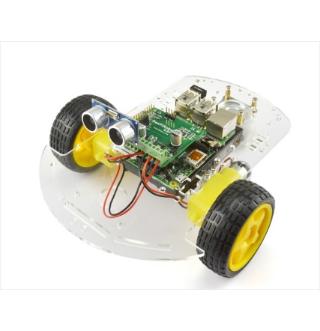
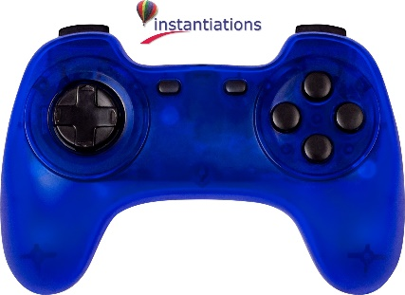
Architecture
VA Smalltalk
Client (Windows)
Server Smalltalk
Framework
VA Smalltalk
GPIO Server (Raspberry PI)

Slide 3
XD Remote Debugging
XD Debugger
Debugger
Proxy
Server Smalltalk
Framework
Real Object

Slide 4
Thank you for your Attention
Questions?
© Instantiations, Inc. All Rights Reserved.

