Slide 1
Analyzing a Soccer Game with WSO2 CEP
Srinath Perera
Director, Research, WSO2
srinath@wso2.com
@srinath_perera

Slide 2
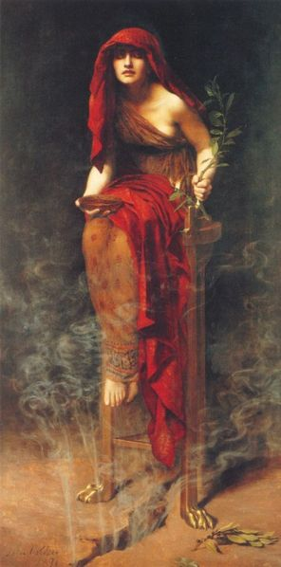
Vision of the Future
Sensors everywhere
Data collected from everywhere, analyzing, optimizing, and helping (and hopefully not taking over)
Analytics and Internet of things .. Immersive world
Big data and real-time analytics will be crucial. How far are we from realizing that?

Slide 3
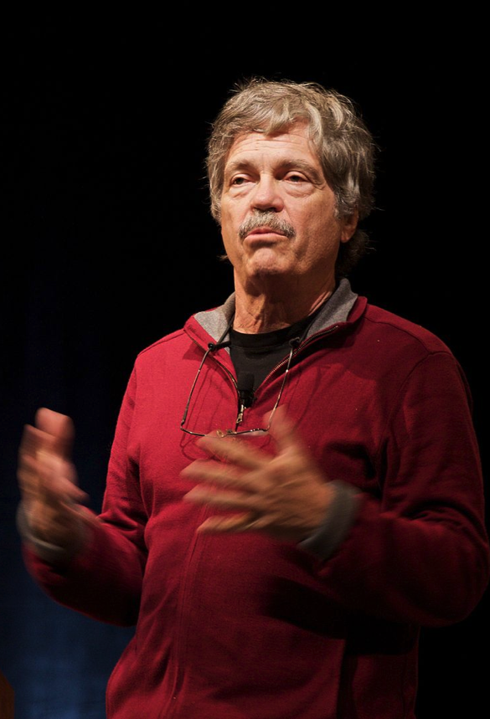
What would take to build such a world?
Sensors and actuators (Motes?)
Fast interoperable event systems (MQTT?)
Powerful query languages (CEP?)
Powerful control systems and decision systems
The best way to predict the future is to invent it

Slide 4
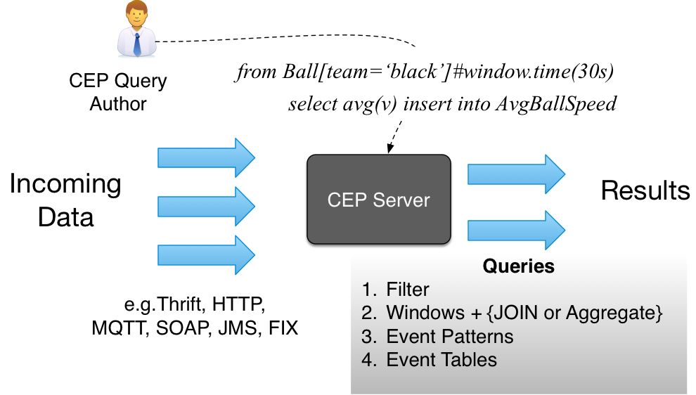
Complex Event Processing

Slide 5
CEP Operators
Filters or transformations (process a single event)
from Ball[v>10] select .. insert into ..
Windows + aggregation (track window of events: time, length)
from Ball#window.time(30s) select avg(v) ..
Joins (join two event streams to one)
from Ball#window.time(30s) as b join Players as p on p.v < b.v
Patterns (state machine implementation)
from Ball[v>10], Ball[v<10]*,Ball[v>10] select ..
Event tables (map a database as an event stream)
Define table HitV (v double) using .. db info ..

Slide 6
Sport (Soccer) Usecases?
Dashboard on game status
Alarms about critical events in the game
Real-time game analysis and predictions about the next move
Updates/ stats etc., on mobile phone with customized offers
Study of game and players effectiveness
Monitor players health and body functions

Slide 7
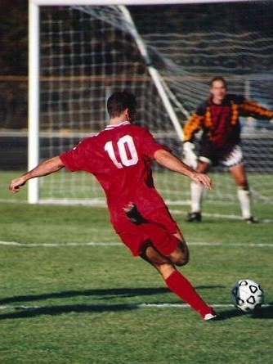
DEBS Challenge
Soccer game, players and ball has sensors (DESB Challenge 2013) sid, ts, x,y,z, v,a
Use cases: Running analysis, Ball Possession and Shots on Goal, Heatmap of Activity
WSO2 CEP (Siddhi) did 100K+ throughput

Slide 8
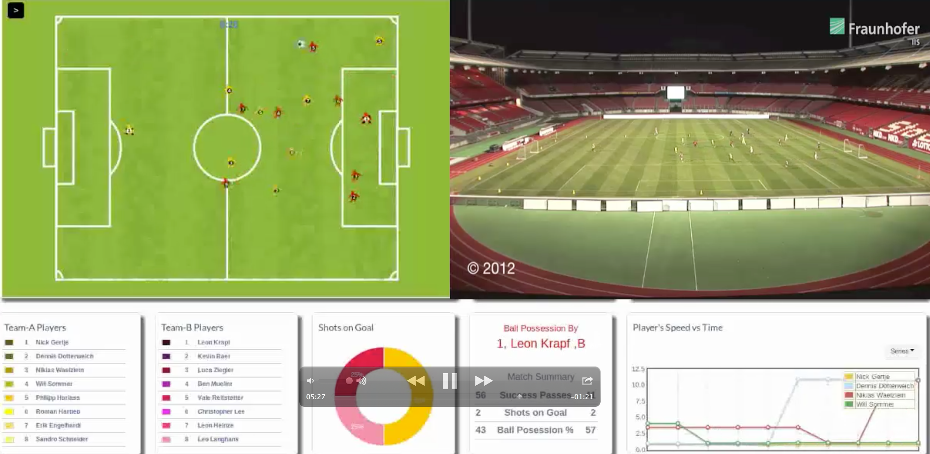

Slide 9
Usecase 1: Running Analysis
Main idea: detect when speed thresholds have passed
define partition player by Players .id;
from s = Players [v <= 1 or v > 11] ,
t = Players [v > 1 and v <= 11]+ ,
e = Players [v <= 1 or v > 11]
select s.ts as tsStart , e.ts as tsStop ,s.id as playerId ,
‘‘trot" as intensity , t [0].v as instantSpeed ,
(e.ts - s.ts )/1000000000 as unitPeriod
insert into RunningStats partition by player;

Slide 10
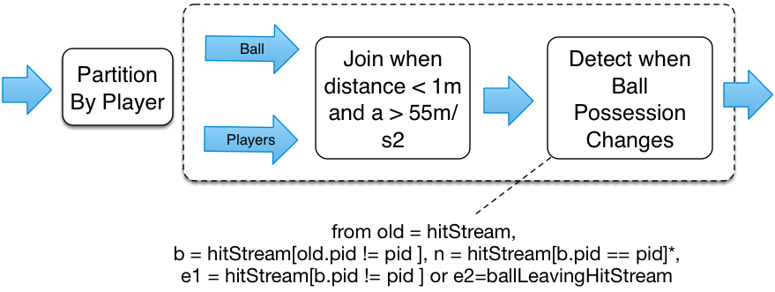
Usecase 2: Ball Possession
Ball possession (you possess the ball from time you hit it until someone else hit it or ball leaves the ground)

Slide 11
Usecase 3: Heatmap of Activity
Show where actions happened (via cells defined by a grid of 64X100 etc.), need updates once every second
Can solved via cell change boundaries, but does not work if one player stays more than 1 sec in the same cell. So need to join with a timer.

Slide 12
Usecase 4: Detect Kicks on the Goal
Main Idea: Detect kicks on the ball, calculate direction after 1m, and keep giving updates as long as it is in right direction

Slide 13
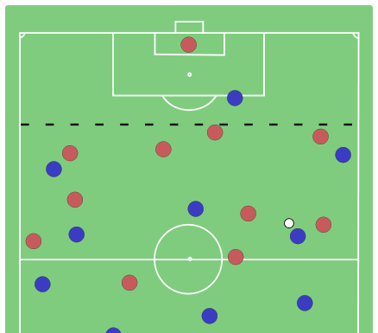
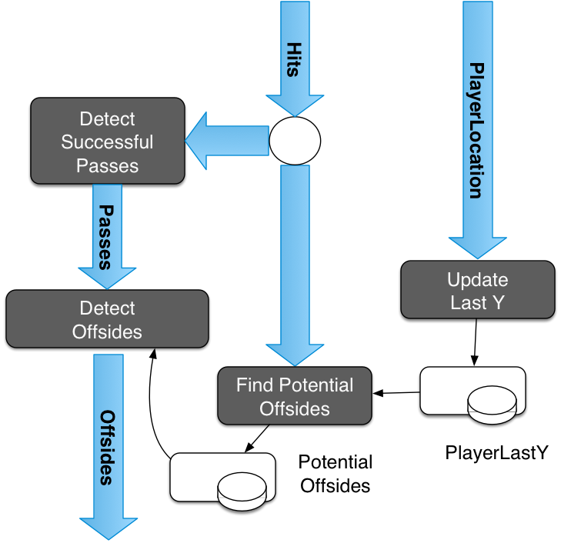
New Usecase: Offside Detection
If you have gone passed the last defender at time of a kick, you are in a offside position.
If you are part of that play after, it is foul

Slide 14
Results for DEBS Scenarios

Slide 15
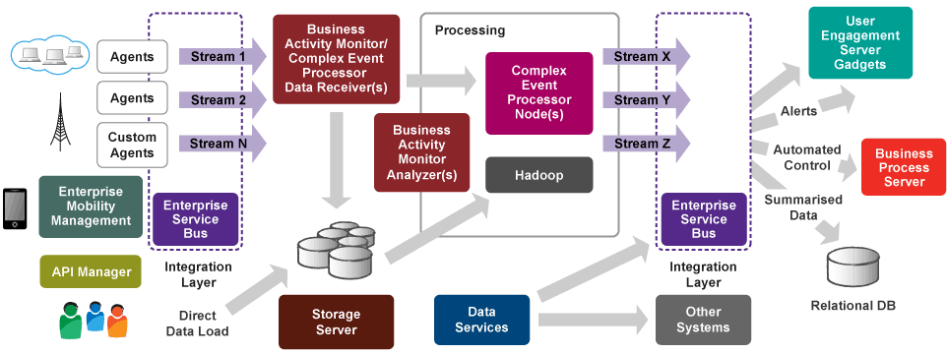
WSO2 Big Data Platform

Slide 16
Other Applications
System/ Device Management
Fleet/ Logistic Management
Fraud Detection
Targeted/ Location Sensitive Marketing
Smart Grid Control
Geo Fencing
…

Slide 17
Conclusion
We are heading for a deeply integrated world with real-time detection and actions
We have technology to do this now. E.g. (DEBS usecases)
Power of CEP
Use real-time and batch processing in tandem
All the software we discussed are Open source under Apache License. Visit http://wso2.com/.
Like to integrate with us, help, or join? Talk to us at Big Data booth or architecture@wso2.org

Slide 18
Thank You

