Slide 1
Solving DEBS Grand Challenge with WSO2 CEP
Srinath Perera, Suhothayan Sriskandarajah, Mohanadarshan Vivekanandalingam,
Paul Fremantle, Sanjiva Weerawarana
WSO2 Inc.

Slide 2
Outline
Grand Challenge
CEP
Basic Solution
Optimizations
Beyond Grand Challenge
Photo by John Trainoron Flickr http://www.flickr.com/photos/trainor/2902023575/, Licensed under CC

Slide 3
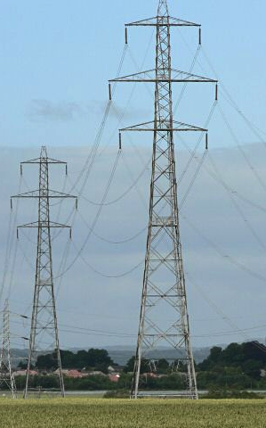
Grand Challenge Problem
Smart Home electricity data: power and load
90 days, 40 houses, 120GB, 2125 sensors
Event frequency per plug
load values: once 2s.
Work values: once 10-50s. Value sent through when the difference is more than 1Wh
Queries
Load prediction
Outlier detection

Slide 4
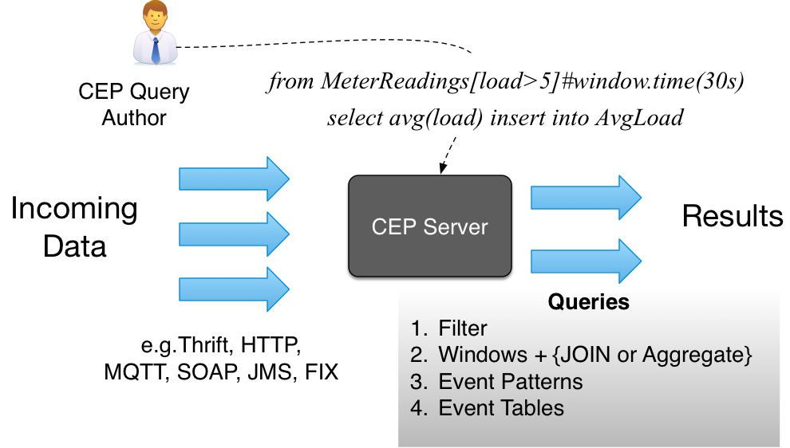
Complex Event Processing

Slide 5
WSO2 CEP Operators
Filters or transformations (process a single event)
From MeterReadings[load>10] select .. insert into ..
Windows + aggregation (track window of events: time, length)
from MeterReadings#window.time(30s) select avg(load) ..
Joins (join two event streams to one)
From MeterReadings#window.time(30s) as b join Cricket as c on ..
Patterns (state machine implementation)
From e1 = MeterReadings-> e2 = MeterReadings[load > e1.load + 10] within 1h
select ..
Event tables (join events against stored data)
Define table ReadingSummary(v double) using .. db info ..
WSO2 CEP Performance: (core i5 processor)
2-9 million events/sec on same JVM
300k events/sec over the network

Slide 6
How we did this?
Basic version using CEP EQL Queries
Does it use machines fully? (load average > 2X number of cores)
Find and fix bottlenecks (Write extensions if needed)
Repeat until the deadline ☺
“About 97% of the time: premature optimization is the root of all evil"
From http://seedtofeedme.blogspot.in/2013/09/watering-plants.html

Slide 7
Correcting Load Values
We receive load values roughly once every 2 seconds from each plug. Sensors send work values only when the difference is more than 1Wh: this happens roughly every 10 to 50 seconds.
Correcting function
Simple linear fitting using last two work values and the calculate load using that value
Correct using the fact that work from t2 and t < 1kWh as we have not seen the work value.
Micro-benchmark with 100 million events.
Errors < 16% of the load value 75% of the time.
Error Percentiles 25%=1.9 50%=6.39 75%=15.41

Slide 8
Q1 Challenges
CEP engine is single threaded, hence cannot use a multi-core machine fully.
Avoid calculating each timeslot (1,5 .. 120m) separately
Batch windows. Median calculations only keep < 129,600 events
No memory problem
Median calculated once for 30 sec, Min-Max Heap is good enough

Slide 9
Query 1: Single Node Solution

Slide 10
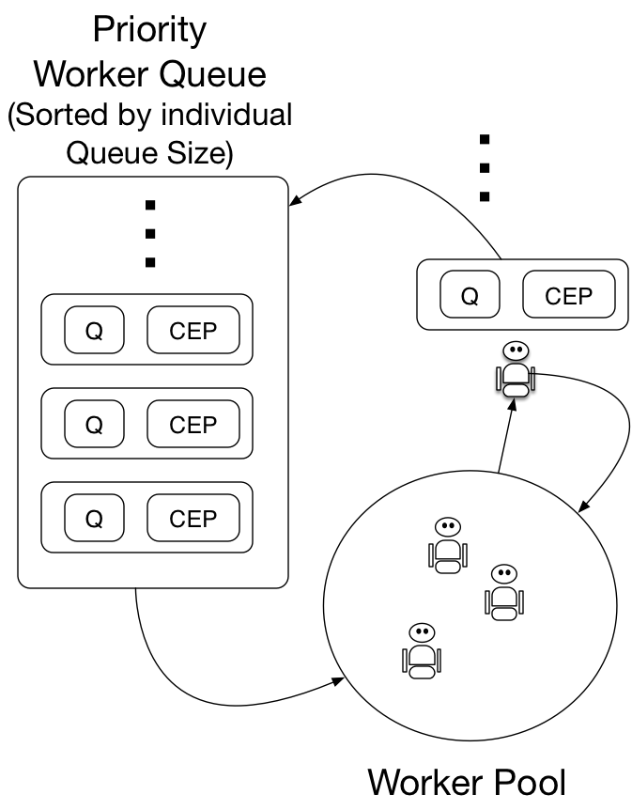
Optimizations: Improve Parallelism
Do we have enough parallelism? Does load average > 2X number of cores
Scale, parallelism => data partitions
Partition data and assign to different CEP engines
Partition by House (let us go up to 40 threads)
Not all houses would have the same workload
We use CEP engines and threads independently and use work stealing

Slide 11
Q2 Challenges
Sliding window has to remember each event in the window to expire them.
(1h=3M events and 24h=74M events)
Calculating mean over window. Q2 is limited by the Global median
Per plug windows and the global windows will keep two copies of events

Slide 12
Query 2: Single Node Solution

Slide 13
Calculating Median
MinMax Heap
Buckets – track how many fall on each bucket
Buckets with variable resolution
Does not work when median shift
Reservoir Sampling
Re-Median
Micro-benchmark: (1 million values)
Min-Max Heap 1000ms
Reservoir Sampling 4ms
Bucketing <1ms.

Slide 14
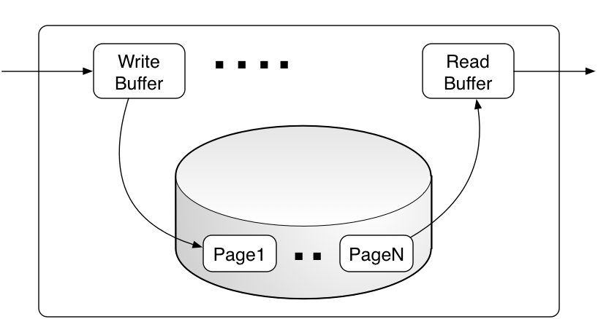
Disk backed Window
Sliding window reads from one end and writes to the other
Write in batches
Pre-fetch data in batches
Micro-benchmark shows almost no latency addition

Slide 15
More Optimizations
1 Sec Slide
Windows slide by 1second
Rather than tracking all events in a window, we can aggregate events in each second
Then adjust the Buckets accordingly when they are added or removed.
Q2 only asks for how many plugs are greater or less than the global median
If you know the global median, then you can check plug median < or > the global median without calculating plug median.

Slide 16
Q1 Single Node Results
16 core, 24GB machine
Fast (0.4M events/sec) with with 1s latency
Stable with different number of houses

Slide 17
Q2 Single Node Results
16 core, 24GB machine
Fast (3M to 1M events/sec) with < 100ms latency
Sensitive to houses (number of events), because that increases the number of events in windows

Slide 18
Query 1: Distributed Solution
Embarrassingly parallel by house
Partition by house

Slide 19
Distributed Communication
WSO2 CEP uses a thrift based binary protocol (can handle variable size messages) that can do 0.3M events/sec
Too slow to scale up (only got 0.18M/sec with thrift)
We did a custom fixed message size solution (using java ByteBuffer) that can do up to 0.8M events/sec
Then we got close 1M events/sec for Q1 distributed
Also tried ZeroMQ, which was bit slower.

Slide 20
Query 2: Distributed Solution

Slide 21
Q1 Distributed Results
Using Amazon c1.xlarge, 1 client to 2 CEP nodes ratio
Got close to 1M msg/sec 2X speedup

Slide 22
Beyond Grand Challenge
Support for automatic parallelization on partitions with WSO2 CEP
Adding some custom functions as inbuilt operators
Describing distributed deployment via queries and automating the deployment
All new features (e.g. disk backed window, median, scaling) released with WSO2 CEP coming 2014 Q4.

Slide 23
Scaling CEP
Think like MapReduce! ask user to define partitions: parallel and non parallel parts of computations.
Each node as Storm bolt, communication and HA via storm

Slide 24
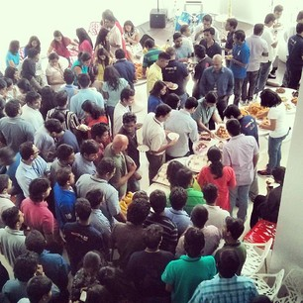
WSO2 CEP
WSO2 is an opensource middleware company
350+ people
Customers: Ebay, Boeing, Cisco …
Funded by Intel Capital, Quest, Cisco
WSO2 CEP is available opensource under apache license from https://github.com/wso2/siddhi
We welcome contributions (both code and ideas)!! and collaborations
If you want to build your research on top of WSO2 CEP, let us know. (architecture@wso2.org)

Slide 25
Conclusions
Main Ideas
Load correction via linear prediction
Partitioning data via house for parallelism and distribution
Did an study for median calculation options
Disk backed window with paging
Fixed message sized protocol
About 400k single node throughput and close to 1M distributed throughput
Try out WSO2 CEP/ Siddhi: Open source under Apache License.

Slide 26
Questions?

