Slide 1
Virtualization in the Cloud
Lars Kurth Xen Community Manager lars.kurth@xen.org
@lars_kurth @xen_com_mgr

Slide 2
A Brief History of Xen in the Cloud
Late 90s
XenoServer Project
(Cambridge Univ.)
Global Public Computing
“This dissertation proposes a new distributed computing paradigm, termed global public computing, which allows any user to run any code anywhere. Such platforms price computing resources, and ultimately charge users for resources consumed.“
Evangelos Kotsovinos, PhD dissertation, 2004
The XenoServer project is building
public infrastructure for wide-area distributed computing.
We envisage a world in which XenoServer execution platforms will be scattered across the globe and available for any member of the public to submit code for execution.
Notes:
XenoServer : enablers as well the concept

Slide 3
A Brief History of Xen in the Cloud
Late 90s
Oct ‘03
‘06
‘08
‘09
‘11
‘12
XenoServer Project
(Cambridge Univ.)
Amazon EC2 and Slicehost launched
XCP 1.x Cloud Mgmt
Xen Presented at SOSP
Rackspace Cloud
XCP packages in Linux
XCP Announced
Notes:
Note: 10th birthday of the project is coming up

Slide 4
The Xen Hypervisor was designed for the Cloud straight from the outset!
Notes:
Hold this thought! We will come back to this later….!

Slide 5
Xen.org
Guardian of Xen Hypervisor and related OSS Projects
Xen project Governance similar to Linux Kernel
Projects
Xen Hypervisor (led by Citrix)
Xen Cloud Platform aka XCP (led by Citrix)
Xen ARM : Xen for mobile devices (led by Samsung)
PVOPS : Xen components and support in Linux Kernel (led by Oracle)
10+ vendors contributing more than 1% to the project (AMD, Citrix, Fujitsu, Huawei, Intel, Novell, Oracle, Samsung, Suse, …)

Slide 6
Xen Overview
Notes:
PVOPS is the Kernel Infrastructure to run a PV Hypervisor on top of Linux

Slide 7
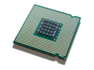
Basic Xen Concepts
Console
Control Domain aka Dom0
Dom0 kernel with drivers
Xen Management Toolstack
Trusted Computing Base
Guest Domains
Your apps
E.g. your cloud management stack
Driver/Stub/Service Domain(s)
A “driver, device model or control service in a box”
De-privileged and isolated
Lifetime: start, stop, kill
VM_{n}
Control domain (dom0)
VM₁
One or more driver, stub or service domains
VM₀
Toolstack
Guest OS
and Apps
Dom0 Kernel
Xen Hypervisor
Scheduler, MMU
Host HW
I/O
Memory
CPUs
Notes:
Dom 0:
In a typical Xen set-up Dom0 contains a smorgasboard of functionality:
System boot
Device emulation & multiplexing
Administrative toolstack
Drivers (e.g. Storage & Network)
Etc.
LARGE TCB – BUT, Smaller as in a Type 2 hypervisor
Driver/Stub/Service Domains: also known as Disaggregation

Slide 8
Xen Variants for Server & Cloud
Xen Hypervisor
XCP
Toolstack / Console
Default / XL (XM)
Libvirt / VIRSH
XAPI / XE
Increased level of functionality and integration with other components
Get Binaries from …
Linux Distros
Linux Distros
Debian & Ubuntu
XCP from Xen.org
Products
Oracle VM
Huawei UVP
Citrix XenServer
Used by …
Many Others

Slide 9
Xen : Types of Virtualization
Notes:
PVOPS is the Kernel Infrastructure to run a PV Hypervisor on top of Linux

Slide 10
PV Domains
PV Domains & Driver Domains
Linux PV guests have limitations:
limited set of virtual hardware
Advantages
Fast
Works on any system (even without virt extensions)
Driver Domains
Security
Isolation
Reliability and Robustness
Control domain (dom0)
Guest VM_{n}
Driver Domain e.g.
Disk
Network
Apps
PV Back Ends
PV Front Ends
PV Back End
HW Drivers
HW Driver
Guest OS
Dom0 Kernel*
Xen Hypervisor
Host HW
I/O
Memory
CPUs
*) Can be MiniOS

Slide 11
HVM
HVM & Stub Domains
Disadvantages
Slower than PV due to Emulation (mainly I/O devices)
Advantages
Install the same way as native Linux
Stub Domains
Security
Isolation
Reliability and Robustness
Dom0
Guest VM_{n}
Stubdom_{n}
Guest VM_{n}
Device Model
IO Emulation
Device Model
IO Emulation
IO Event
IO Event
VMEXIT
Mini OS
VMEXIT
Xen Hypervisor
Host HW
Notes:
Device Model emulated in QEMU
Models for newer devices are much faster, but for now PV is even faster

Slide 12
PV on HVM
A mixture of PV and HVM
Linux enables as many PV interfaces as possible
This has advantages
install the same way as native
PC-like hardware
access to fast PV devices
exploit nested paging
Good performance trade-offs
Drivers in Linux 3.x
 | HVM | PV on HVM | PV
Boot Sequence | Emulated | Emulated | PV
Memory | HW | HW | PV
Interrupts, Timers & Spinlocks | Emulated | PV* | PV
Disk & Network | Emulated | PV | PV
Privileged Operations | HW | HW | PV
*) Emulated for Windows
Notes:
Automatic
Performance
PV on HVM guests are very close to PV guests in benchmarks that favour PV MMUs
PV on HVM guests are far ahead of PV guests in benchmarks that favour nested paging

Slide 13
Xen and Linux
Notes:
PVOPS is the Kernel Infrastructure to run a PV Hypervisor on top of Linux

Slide 14
Xen and the Linux Kernel
Xen was initially a University research project
Invasive changes to the kernel to run Linux as a PV guest and Dom0

Slide 15
Current State
PVOPS Project
Xen support in Linux 3.0+ (it is functional but not yet fully optimized)
On-going optimization work in Linux 3.4 +
Notes:
Where are we?
1) Linux 3 contains everything needed to run Xen on a Vanilla Kernel, both as Dom0 and DomU
2) That’s of course a little bit of an old hat now
3) But it is worth mentioning that it only took 5 years to upstream that PVOPS into the kernel

Slide 16
What does this mean?
Xen Hypervisor is not in the Linux kernel
BUT: everything Xen needs to run is!
Xen packages are (or will be) in Linux distros
Install Dom0 Linux distro
Install Xen package(s) or meta package
Reboot
Config stuff: set up disks, peripherals, etc.

Slide 17
“Security and QoS/Reliability are amongst the top 3 blockers for cloud adoption”
www.colt.net/cio-research
Notes:
Just one example of a survey, many more
http://www.colt.net/cio-research/z2-cloud-2.html
According to many surveys, security is actually the main reason which makes or breaks cloud adoption
Better security means more adoption
Concerns about security means slowed adoption

Slide 18
Security and the Next Wave of Virtualization
Security is a key requirement for Cloud
Security is the primary goal of virtualization on the Client
Desktop, Laptops, Tablets & Smart Phones
Maintaining isolation between VMs is critical
Notes:
So for a hypervisor, as Xen which is powering 80% of the public cloud – rackspace, AWS and many other VPS providers use Xen and with cloud computing becoming mainstream, furthering security is really important
One of the key things there is isolation between VMs, but also simplicity as I pointed out earlier
But there are also a number of advanced features in Xen, which are not that widely know. So I wanted to give you a short overview of two of them

Slide 19
Xen Security & Robustness Advantages
Even without Advanced Security Features
Well-defined trusted computing base (much smaller than on type-2 HV)
No extra services in hypervisor layer
More Robustness: Mature, Tried & Tested, Architecture
Xen Security Modules (or XSM)
Developed and contributed to Xen by NSA
Generalized Security Framework for Xen
Can also run with SELinux
Notes:
Ask some questions

Slide 20
Advanced Security: Disaggregation
Split Control Domain into Driver, Stub and Service Domains
Each contains a specific set of control logic
See: ”Breaking up is hard to do” @ Xen Papers
Unique benefit of the Xen architecture
Security: Minimum privilege; Narrow interfaces
Robustness: ability to safely restart parts of the system
Performance: lightweight, e.g. Mini OS directly on hypervisor
Scalability: more distributed system (less reliable on Dom0)
Used by Qubes OS and Citrix XenClient XT
Notes:
Example: XOAR
Self-destructing VMs (destroyed after initialization): PCIBack = virtualize access to PCI Bus config
Restartable VMs (periodic restarts):
NetBack (Physical network driver exposed to guest) = restarted on timer
Builder (instantiate other VMs) = Restarted on each request

Slide 21
Advanced XenClient Architecture
Per host/device
Service VMs
Per guest
Service VMs
User VM
User VM
Management Domain
VPN Isolation
Device Emulate
Control Domain (dom0)
Network Isolation
VPN Isolation
Device Emulation
Policy Granularity
Policy Granularity
Xen Hypervisor
Xen Security Modules
Host HW
I/O
Memory
CPUs

Slide 22
Example: Network Driver Domain for HA
Detect failure e.g.
Illegal access
Timeout
Kill domain, restart
E.g. Just 275ms outage from failed Ethernet driver
Auto-restarts to enhance security
350
300
250
200
150
100
50
0
0
5
10
15
20
25
30
35
40
time (s)
Notes:
2004 paper in which Ethernet Driver is run in its own Driver Domain (in use by XenClient)

Slide 23
BUT…
Today, XCP and commercial Xen based Server products
Do not yet make use of XSM
Do not yet make use of Advanced Security Features (Disaggregation)
In XCP, work has started to add these features
Various articles of how this may be done on the xen wiki
More information soon (likely at XenSummit)
Commitment on improving docs for Security, Reliability & Tuning
Notes:
What about domain 0 itself?
Once we've disaggregated domain 0, what will be left?
The answer is: very little! We'll still have the logic for booting the host, for starting and stopping VMs, and for deciding which VM should control which piece of hardware... but that's about it. At this point domain 0 could be considered as a small "embedded" system, like a home NAT box or router.

Slide 24
XCP Project

Slide 25
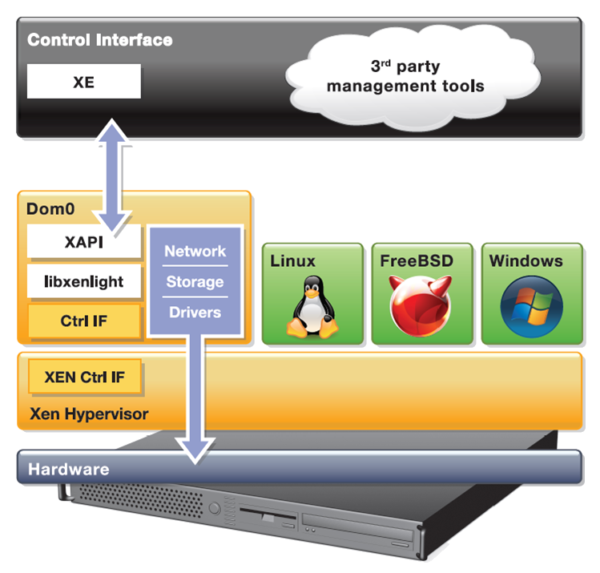
XCP
Complete vertical stack for server virtualization
Distributed as a closed appliance (ISO) with CentOS 5.5 Dom0, misc DomU’s, network & storage support and Xen API
Open source distribution of Citrix XenServer
Notes:
A few things to point out:
XCP stands for Xen Cloud Platform
Meant more in the sense of [Xen] Hypervisor Cloud Computing Platform that makes it easier to integrate with the likes of cloudstack, etc.
That does not mean that it aims to compete with the likes of cloudstack, openstack, etc.
XAPI depends on CentOS 5.5
The appliance is distributed as ISO

Slide 26
XCP Overview
Open source version of Citrix XenServer
wiki.xen.org/wiki/XCP/XenServer_Feature_Matrix
Enterprise-ready server virtualization and cloud platform
Extends Xen beyond one physical machine and other functionality
Lots of other additional functionality compared to Xen
Datacenter and cloud-ready management API
XenAPI (XAPI) is fully open source
CloudStack and OpenStack integration

Slide 27
Major XCP Features
VM lifecycle: live snapshots, checkpoint, migration
Resource pools: flexible storage and networking
Event tracking: progress, notification
Upgrade and patching capabilities
Real-time performance monitoring and alerting
Built-in support and templates for Windows and Linux guests
Open vSwitch support built-in
Notes:
VM lifecycle (start, stop, resume) ... automation is the key point
Live snapshots: Takes a snapshot of a live VM (e.g. for disaster recovery or migration)
Resource pools (multiple physical machines): XS & XCP only
live migration: VM is backed up while running, onto shared storage (e.g. NFS) in a pool and when completed restarted elsewhere in that pool.
disaster recovery: you can find lots of information on how this works at http://support.citrix.com/servlet/KbServlet/download/17141-102-19301/XenServer_Pool_Replication_-_Disaster_Recovery.pdf (the key point is that I can back up the metadata for the entire VM)
Flexible storage:
XAPI does hide details for storage and networking
I.e. I apply generic commands (NFS, NETAPP, iSCSI ... once its created they all appear the same) from XAPI. I only need to know the storage type when I create storage and network objects (OOL)
Upgrading a host to a later version of XCP (all my configs and VMs stay the same) …
and patching (broken now - bug, can apply security patches to XCP/XS or Dom0 but not DomU)

Slide 28
XCP 1.5 (in beta)
Architectural Improvements: Xen 4.1, GPT, smaller Dom0
GPU pass through: for VMs serving high end graphics
Performance and Scalability:
1 TB mem/host
16 VCPUs/VM, 128 GB/VM
Networking: Open vSwitch (default), Active-Backup NIC Bonding
Virtual Appliance: multi-VM and boot sequenced, OVF support
More guest OS templates
Notes:
* Host Architectural Improvements. XCP 1.5 now runs on the Xen 4.1 hypervisor, provides GPT (new partition table type) support and a smaller, more scalable Dom0.
* GPU Pass-Through. Enables a physical GPU to be assigned to a VM providing high-end graphics.
* Increased Performance and Scale. Supported limits have been increased to 1 TB memory for XCP hosts, and up to16 virtual processors and 128 GB virtual memory for VMs. Improved XCP Tools with smaller footprint.
* Networking Improvements. Open vSwitch is now the default networking stack in XCP 1.5 and now provides formal support for Active-Backup NIC bonding.
* Enhanced Guest OS Support. Support for Ubuntu 10.04 (32/64-bit).
Updated support for Debian Squeeze 6.0 64-bit, Oracle Enterprise Linux
6.0 (32/64-bit) and SLES 10 SP4 (32/64-bit). Experimental VM templates for CentOS 6.0 (32/64-bit), Ubuntu 10.10 (32/64-bit) and Solaris 10.
* Virtual Appliance Support (vApp). Ability to create multi-VM and boot sequenced virtual appliances (vApps) that integrate with Integrated Site Recovery and High Availability. vApps can be easily imported and exported using the Open Virtualization Format (OVF) standard.

Slide 29
XAPI: What is it?
XAPI is the backbone of XCP
Provides the glue between all components
Is the backend for all management applications
Also called XenAPI
It's a XML-RPC style API, served via HTTPS
Provided by a service on every XCP dom0 host
Designed to by highly programmable
API bindings for many languages: .NET, Java, C, Powershell, Python
XAPI is Extensible via plugins
E.g. used by OpenStack
Notes:
Note: not exactly 1:1 with XE
Comparisons to other APIs in the virtualization space (source: Steven Maresca)
Generally speaking XAPI is well-designed and well-executed
XAPI makes it pleasantly easy to achieve quick productivity
XAPI is set up to work with frameworks such as CloudStack and OpenStack.
Some SOAPy lovers of big XML envelopes and WSDLs scoff at XML-RPC, but it certainly gets the job done with few complaints
Example code
http://bazaar.launchpad.net/~nova-core/nova/github/files/head:/plugins/xenserver/xenapi/etc/xapi.d/plugins/
https://github.com/xen-org/xen-api/blob/master/scripts/examples/python/XenAPIPlugin.py

Slide 30
XCP-XAPI Packages in Linux
Make the XAPI toolstack independent of CentOS 5.5
Extend the delivery model
Deliver Xen, XAPI and everything in between (storage manager, network support, OCaml libs, etc.) via your favorite Linux distro
“apt-get install xcp-xapi” or “yum install xcp-xapi”
Debian 7.0 “Wheezy"
Ubuntu 12.04 LTS
Next: Fedora & CentOS

Slide 31
XAPI Management Options
XAPI frontend command line tool: XE (tab-completable)
Desktop GUIs
Citrix XenCenter (Windows-only)
OpenXenManager (open source cross-platform XenCenter clone)
Web interfaces
Xen VNC Proxy (XVP)
XenWebManager (web-basedclone of OpenXenManager)
XCP Ecosystem:
xen.org/community/vendors/XCPProjectsPage.html
xen.org/community/vendors/XCPProductsPage.html

Slide 32
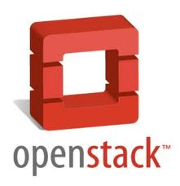
XCP and Cloud Orchestration Stacks

Slide 33
Summary: Why Xen?
Notes:
Hold this thought! We will come back to this later….!

Slide 34
Designed for the Cloud : many advantages for cloud use!
Resilience, Robustness & Scalability
Security: Small surface of attack, Isolation & Advanced Security Features
Widely used by Cloud Providers and Vendors
XCP & XAPI
Ready for use with cloud orchestration stacks
XCP-XAPI packages in Linux distros: flexibility and choice
Lots of additional improvements for cloud coming in 2012
Open Source with a large community and eco-system
Notes:
Performance : similar to other hypervisors
Maturity: Tried & Tested, Most Problems that are Problems are well known
Open source: Good body of Knowledge, Tools

Slide 35
Questions …
IRC: ##xen @ FREENODE
Mailing List: xen-users & xen-api
Wiki: wiki.xen.org
Beginners & User Categories
XCP Category
Excellent XCP Tutorials
A day worth of material @ xen.org/community/xenday11
Ecosystem pages
Slides available under CC-BY-SA 3.0
From www.slideshare.net/xen_com_mgr

