Slide 1
Virtualization in the Cloud: Featuring Xen
Lars Kurth Xen Community Manager lars.kurth@xen.org
FREENODE: lars_kurth
@lars_kurth @xen_com_mgr

Slide 2
A Brief History of Xen in the Cloud
Late 90s
XenoServer Project
(Cambridge Univ.)
Global Public Computing
“This dissertation proposes a new distributed computing paradigm, termed global public computing, which allows any user to run any code anywhere. Such platforms price computing resources, and ultimately charge users for resources consumed.“
Evangelos Kotsovinos, PhD dissertation, 2004
The XenoServer project is building
public infrastructure for wide-area distributed computing.
We envisage a world in which XenoServer execution platforms will be scattered across the globe and available for any member of the public to submit code for execution.
Notes:
Xen started out as a research project at Cambridge University, UK in the late 90’s
Aim: to define infrastructure for wide-area distributed computing
Vision: was pretty much cloud computing as we know it today
Out of the project came a dissertation by Evangelos Kotsovinos which defines Global Public Computing in terms of
Distributed resources
Public compute infrastructure
Charge users for resources consumed
What we understand as Public Cloud Computing AWS style today

Slide 3
A Brief History of Xen in the Cloud
Late 90s
Oct ‘03
‘06
‘08
‘09
‘11
‘12
XenoServer Project
(Cambridge Univ.)
Amazon EC2 and Slicehost launched
XCP 1.x Cloud Mgmt
Xen Presented at SOSP
Rackspace Cloud
XCP packages in Linux
XCP Announced
Xen for ARM based Servers
PV in HVM Containers

Slide 4
The Xen Hypervisor was designed for the Cloud straight from the outset!
Notes:
Hold this thought! We will come back to this later….!

Slide 5
Xen.org
Guardian of Xen Hypervisor and related OSS Projects
Xen project Governance similar to Linux Kernel
Projects
Xen Hypervisor (led by Citrix)
Xen Cloud Platform aka XCP (led by Citrix)
Xen ARM : Xen for mobile devices (led by Samsung)
PVOPS : Xen components and support in Linux Kernel (led by Oracle)
10+ vendors contributing more than 1% to the project (AWS, AMD, Citrix, GridCentric, Fujitsu, Huawei, iWeb, Intel, NSA, Oracle, Samsung, Suse, …)
Notes:
Overall, we have around 40-45 vendors contributing to the project per year and

Slide 6
Xen Overview

Slide 7
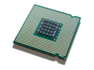
Architecture Considerations
Type 1: Bare metal Hypervisor
A pure Hypervisor that runs directly on the hardware and hosts Guest OS’s.
Type 2: OS ‘Hosted’
A Hypervisor that runs within a Host OS and hosts Guest OS’s inside of it, using the host OS services to provide the virtual environment.
VM_{n}
User-level VMM
VM_{n}
VM₁
User Apps
VM₁
VM₀
Device Models
VM₀
Guest OS
and Apps
Guest OS
and Apps
Host OS
Hypervisor
Scheduler
Ring-0 VM Monitor “Kernel “
Device Drivers/Models
Device Drivers
MMU
Host HW
Host HW
I/O
Memory
CPUs
I/O
Memory
CPUs
Provides partition isolation + reliability, higher security
Low cost, no additional drivers Ease of use & installation
Notes:
Type 1 hypervisor: example ESX
Simple architecture; Hypervisor replaces the kernel
No need to provide rich “process” semantics, like “user”, filesystems, etc.
Device drivers need to be rewritten for each hardware platform
Type 2 is hosted: example kvm
- The hypervisor is just a driver that typically works with user-level monitor.
HW access is intercepted by the ring 0- VM monitor passed to the User level Virtual Monitor, which passes requests to the kernel
Re-use of device drivers is traded off against security and a large trusted computing base (green)

Slide 8
Xen: Type 1 with a Twist
Thinner hypervisor
Functionality moved to Dom0
Using Linux PV OPS
Using Linux Device Drivers
PV, PV on HVM and PVH modes
Sharing components with KVM
In other words
Driver re-use
Ease of use & Installation
Isolation & Security
Control domain (dom0)
Device Models
VM_{n}
VM₁
Drivers
VM₀
Guest OS
and Apps
Linux & BSD
Hypervisor
Scheduler
MMU
XSM
Host HW
I/O
Memory
CPUs

Slide 9
Basic Xen Concepts
Console
Control Domain aka Dom0
Dom0 kernel with drivers
Xen Management Toolstack
Trusted Computing Base
Guest Domains
Your apps
E.g. your cloud management stack
Driver/Stub/Service Domain(s)
A “driver, device model or control service in a box”
De-privileged and isolated
Lifetime: start, stop, kill
VM_{n}
Control domain (dom0)
VM₁
One or more driver, stub or service domains
VM₀
Toolstack
Guest OS
and Apps
Dom0 Kernel
Hypervisor
Scheduler
MMU
XSM
Host HW
I/O
Memory
CPUs

Slide 10
Xen Variants for Server & Cloud
Xen Hypervisor
XCP
Toolstack / Console
Default / XL (XM)
Libvirt / VIRSH
XAPI / XE
Increased level of functionality and integration with other components
Get Binaries from …
Linux Distros
Linux Distros
Debian & Ubuntu
ISO from Xen.org
Products
Oracle VM
Huawei UVP
Citrix XenServer
Used by …
Many Others
More info …
More info …

Slide 11
Xen : Types of Virtualization
Notes:
PVOPS is the Kernel Infrastructure to run a PV Hypervisor on top of Linux

Slide 12
PV Domains
PV Domains & Driver Domains
Linux PV guests have limitations:
limited set of virtual hardware
Advantages
Fast
Works on any system (even without virt extensions)
Driver Domains
Security
Isolation
Reliability and Robustness
Control domain (dom0)
Guest VM_{n}
Driver Domain e.g.
Disk
Network
Apps
PV Back Ends
PV Front Ends
PV Back End
HW Drivers
HW Driver
Guest OS
Dom0 Kernel*
Xen Hypervisor
Host HW
I/O
Memory
CPUs
*) Can be MiniOS

Slide 13
HVM
HVM & Stub Domains
Disadvantages
Slower than PV due to Emulation (mainly I/O devices)
Advantages
No kernel support needed
Stub Domains
Security
Isolation
Reliability and Robustness
Dom0
Guest VM_{n}
Stubdom_{n}
Guest VM_{n}
Device Model
IO Emulation
Device Model
IO Emulation
IO Event
IO Event
VMEXIT
Mini OS
VMEXIT
Xen Hypervisor
Host HW
Notes:
Device Model emulated in QEMU
Models for newer devices are much faster, but for now PV is even faster

Slide 14
PV on HVM
HVM guest with PV elements
Linux enables as many PV interfaces as possible
This has advantages
Install the same way as native
PC-like hardware
Access to fast PV devices
Exploit nested paging
Good performance trade-offs
Drivers in Linux 3.x
 | HVM | PV on HVM | PV
Boot Sequence | Emulated | Emulated | PV
Memory | HW | HW | PV
Interrupts, Timers & Spinlocks | Emulated | PV* | PV
Disk & Network | Emulated | PV | PV
Privileged Operations | HW | HW | PV
*) Emulated for Windows
Notes:
Automatic
Performance
PV on HVM guests are very close to PV guests in benchmarks that favour PV MMUs
PV on HVM guests are far ahead of PV guests in benchmarks that favour nested paging

Slide 15
PV in HVM Containers: Xen 4.3
Salient Features
Dom0 runs in ring0
Event channel (no APIC)
Native page tables
Native IDT
Fastest of PV and HVM
No need for emulation
Uses HW, where PV is slower than HVM
Being up streamed now
More info …
 | HVM | PV on HVM | PVH | PV
Boot Sequence | Emulated | Emulated | PV | PV
Memory | HW | HW | HW | PV
Interrupts, Timers & Spinlocks | Emulated | PV* | PV | PV
Disk & Network | Emulated | PV | PV | PV
Privileged Operations | HW | HW | HW | PV
*) Emulated for Windows
Notes:
APIC = Advanced Programmable Interrupt Controller
IDT = Interrupt Descriptor Table

Slide 16
Xen and Linux
Notes:
PVOPS is the Kernel Infrastructure to run a PV Hypervisor on top of Linux

Slide 17
Xen and the Linux Kernel
Xen was initially a University research project
Invasive changes to the kernel to run Linux as a PV guest and Dom0

Slide 18
Current State
PVOPS Project
Xen support in Linux 3.0+ (it is functional – some optimizations missing)
On-going optimization work in Linux 3.6 + Supporting new Xen 4.3 functionality (e.g. PVH, ARM)

Slide 19
What does this mean?
Xen Hypervisor is not in the Linux kernel
BUT: everything Xen needs to run is!
Xen packages are mostly in Linux distros
Install Dom0 Linux distro
Install Xen package(s) or meta package
Reboot
Config stuff: set up disks, peripherals, etc.
More info …

Slide 20
XCP Project

Slide 21
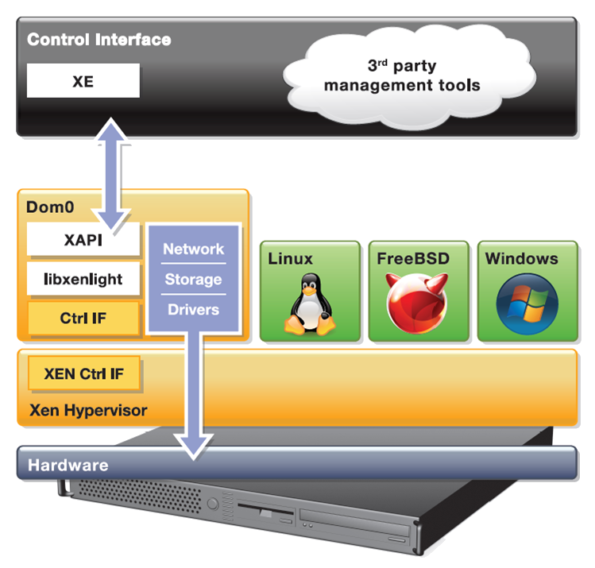
XCP – Xen Cloud Platform
GPLv2
XenServer is a commercial distro
Complete vertical stack for server virtualization
Distributed as
Appliance (ISO)
Packages in Debian & Ubuntu (more distros to come)

Slide 22
Major XCP Features
VM lifecycle: live snapshots, checkpoint, migration
Resource pools: flexible storage and networking
Event tracking: progress, notification
Upgrade and patching capabilities
Real-time performance monitoring and alerting
Built-in support and templates for Windows and Linux guests
Open vSwitch support built-in (default)
Notes:
VM lifecycle (start, stop, resume) ... automation is the key point
Live snapshots: Takes a snapshot of a live VM (e.g. for disaster recovery or migration)
Resource pools (multiple physical machines): XS & XCP only
live migration: VM is backed up while running, onto shared storage (e.g. NFS) in a pool and when completed restarted elsewhere in that pool.
disaster recovery: you can find lots of information on how this works at http://support.citrix.com/servlet/KbServlet/download/17141-102-19301/XenServer_Pool_Replication_-_Disaster_Recovery.pdf (the key point is that I can back up the metadata for the entire VM)
Flexible storage:
XAPI does hide details for storage and networking
I.e. I apply generic commands (NFS, NETAPP, iSCSI ... once its created they all appear the same) from XAPI. I only need to know the storage type when I create storage and network objects (OOL)
Upgrading a host to a later version of XCP (all my configs and VMs stay the same) …
and patching (broken now - bug, can apply security patches to XCP/XS or Dom0 but not DomU)

Slide 23
XCP 1.6 – to ship in Sep/Oct 12
• Internal Improvements: Xen 4.1.2, CentOS 5.7 with kernel 2.6.32.43, Open vSwitch 1.4.1
• New format Windows drivers: installable by Windows Update Service
• Networking: Better VLAN scalability, LACP bonding, IPv6
• More guest OS templates: Ubuntu Precise 12.04, RHEL/CentOS, Oracle Enterprise Linux 6.1 & 6.2, Windows 8
• Storage XenMotion:
– Migrate VMs between hosts or pools without shared storage
– Move a VM’s disks between storage repositories while the VM is running
More Info …
Notes:
* Host Architectural Improvements. XCP 1.5 now runs on the Xen 4.1 hypervisor, provides GPT (new partition table type) support and a smaller, more scalable Dom0.
* GPU Pass-Through. Enables a physical GPU to be assigned to a VM providing high-end graphics.
* Increased Performance and Scale. Supported limits have been increased to 1 TB memory for XCP hosts, and up to16 virtual processors and 128 GB virtual memory for VMs. Improved XCP Tools with smaller footprint.
* Networking Improvements. Open vSwitch is now the default networking stack in XCP 1.5 and now provides formal support for Active-Backup NIC bonding.
* Enhanced Guest OS Support. Support for Ubuntu 10.04 (32/64-bit).
Updated support for Debian Squeeze 6.0 64-bit, Oracle Enterprise Linux
6.0 (32/64-bit) and SLES 10 SP4 (32/64-bit). Experimental VM templates for CentOS 6.0 (32/64-bit), Ubuntu 10.10 (32/64-bit) and Solaris 10.
* Virtual Appliance Support (vApp). Ability to create multi-VM and boot sequenced virtual appliances (vApps) that integrate with Integrated Site Recovery and High Availability. vApps can be easily imported and exported using the Open Virtualization Format (OVF) standard.

Slide 24
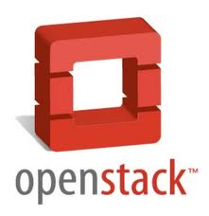
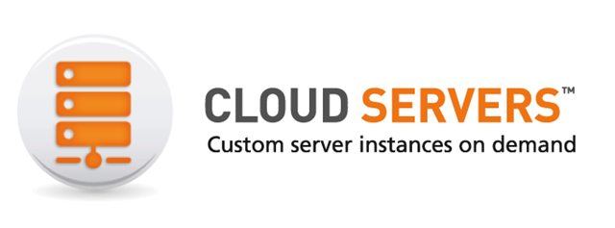
XCP and Cloud Orchestration Stacks

Slide 25
Challenges for FOSS hypervisors
Notes:
PVOPS is the Kernel Infrastructure to run a PV Hypervisor on top of Linux

Slide 26
“Security and QoS/Reliability are amongst the top 3 blockers for cloud adoption”
www.colt.net/cio-research
Notes:
Just one example of a survey, many more
http://www.colt.net/cio-research/z2-cloud-2.html
According to many surveys, security is actually the main reason which makes or breaks cloud adoption
Better security means more adoption
Concerns about security means slowed adoption

Slide 27
Security and the Next Wave of Virtualization
Security is a key requirement for Cloud
Security is the primary goal of virtualization on the Client
Xen’s advanced security features were developed for security sensitive Desktop use-cases (NSA)
Maintaining isolation between VMs is critical (multi-tenancy)

Slide 28
Xen Security & Robustness Advantages
Even without Advanced Security Features
Well-defined trusted computing base (much smaller than on type-2 HV)
Minimal services in hypervisor layer
More Robustness: Mature, Tried & Tested, Architecture
Xen Security Modules (or XSM)
Developed, maintained and contributed to Xen by NSA
Generalized Security Framework for Xen
Compatible with SELinux (tools, architecture)
XSM object classes maps onto Xen features
Notes:
Ask some questions

Slide 29
Advanced Security: Disaggregation
Split Control Domain into Driver, Stub and Service Domains
Each contains a specific set of control logic
See: ”Breaking up is hard to do” @ Xen Papers
See: “Domain 0 Disaggregation for XCP and XenServer”
Unique benefit of the Xen architecture
Security: Minimum privilege; Narrow interfaces
Robustness: ability to safely restart parts of the system
Performance: lightweight, e.g. Mini OS directly on hypervisor
Scalability: more distributed system (less reliable on Dom0)
Used today by Qubes OS and Citrix XenClient XT
Soon for XCP and XenServer

Slide 30
User VM
User VM
NF
BF
NF
BF
NB
gntdev
NB
gntdev
gntdev
Dom0
Network driver domain
NFS/
iSCSI driver domain
Qemu
domain
xapi domain
Logging domain
Qemu
domain
Network driver domain
NFS/
iSCSI driver domain
Local storage driver domain
Domain manager
healthd
storaged
qemu
qemu
storaged
storaged
networkd
networkd
xenopsd
libxl
vswitch
tapdisk
blktap3
xapi
syslogd
vswitch
tapdisk
blktap3
tapdisk
blktap3
dbus over v4v
eth
eth
eth
eth
scsi
Xen
NIC
(or SR-IOV VF)
NIC
(or SR-IOV VF)
CPU
CPU
NIC
(or SR-IOV VF)
NIC
(or SR-IOV VF)
RAID
RAM
RAM

Slide 31
News from the Xen Community
Notes:
PVOPS is the Kernel Infrastructure to run a PV Hypervisor on top of Linux

Slide 32
Cool new functionality & initiatives
Xen for ARM using HW virt (using new PVH mode)
Started our first guest domain, including PV console disk and network devices!
No emulation (QEMU is needed)
New PVH virtualization mode (Oracle)
FreeBSD Xen port (SpectraLogic & HP)
Xen MIPS port (by BroadCom)
Language run-times running on bare-metal Xen
Openmirage.org, ErlangOnXen.org
Disaggregation is moving from Client into Server and Cloud
Portable Service VMs
Agree interface and mechanism to allow service VMs across products and hosting services

Slide 33
Summary: Why Xen?

Slide 34
Designed for the Cloud : many advantages for cloud use!
Resilience, Robustness & Scalability
Security: Small surface of attack, Isolation & Advanced Security Features
Widely used by Cloud Providers and Vendors
XCP
Ready for use with cloud orchestration stacks
Packages in Linux distros: flexibility and choice
Open Source with a large community and eco-system
Exciting new developments in the pipeline
Notes:
Performance : similar to other hypervisors
Maturity: Tried & Tested, Most Problems that are Problems are well known
Open source: Good body of Knowledge, Tools

Slide 35
Questions …
IRC: ##xen @ FREENODE
Mailing List: xen-users & xen-api
Wiki: wiki.xen.org
Excellent XCP Tutorials
A day worth of material @ xen.org/community/xenday11
Ecosystem pages
Presentations: slideshare.net/xen_com_mgr
Videos: vimeo.com/channels/xen
@lars_kurth @xen_com_mgr
FREENODE: lars_kurth
Slides available under CC-BY-SA 3.0
From www.slideshare.net/xen_com_mgr

