Slide 1
Xen Cloud Platform
Lars Kurth Xen Community Manager lars.kurth@xen.org
@lars_kurth @xen_com_mgr

Slide 2
A Brief History of Xen in the Cloud
Late 90s
XenoServer Project
(Cambridge Univ.)
Global Public Computing
“This dissertation proposes a new distributed computing paradigm, termed global public computing, which allows any user to run any code anywhere. Such platforms price computing resources, and ultimately charge users for resources consumed.“
Evangelos Kotsovinos, PhD dissertation, 2004
The XenoServer project is building a public infrastructure for wide-area distributed computing. We envisage a world in which XenoServer execution platforms will be scattered across the globe and available for any member of the public to submit code for execution.
Notes:
XenoServer : enablers as well the concept

Slide 3
A Brief History of Xen in the Cloud
Late 90s
Nov ‘02
Oct ‘03
‘06
‘08
‘09
‘11
XenoServer Project
(Cambridge Univ.)
Amazon EC2 and Slicehost launched
XCP 1.x Xen in Linux Kronos
Cloud Mgmt
Xen Repository Published
Xen Presented at SOSP
Rackspace Cloud
XCP Announced
Notes:
Note: 10th birthday of the project is coming up

Slide 4
The Xen Hypervisor was designed for the Cloud straight from the outset!
Notes:
Hold this thought! We will come back to this later….!

Slide 5
Xen.org
Guardian of Xen Hypervisor and related OSS Projects
Xen project Governance similar to Linux Kernel
Projects
Xen Hypervisor (led by Citrix)
Xen Cloud Platform aka XCP (led by Citrix)
Xen ARM (led by Samsung)
PVOPS : Xen components and support in Linux Kernel (led by Oracle)

Slide 6
The Xen Community

Slide 7
Xen Contributions & Vendors
By Change Sets ^{*)}
2011 Contributions by KLOC ^{**) ***)}
*) Does not count activity on XenARM (as not yet in an official repo)
*) Activity on Development branch (not yet in xen-unstable)
**) Includes PVOPS ***) Figures up to end of Q3 2011

Slide 8
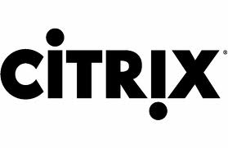
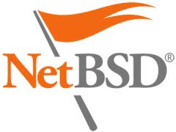
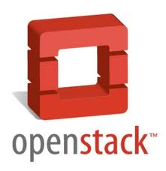
Community & Ecosystem Map
xen.org/community/projects
Research
ADD #s
Hosting Vendors
Xen Projects
XCP Products
XCP Projects
Xen Products
Consulting People
Consulting Firms
Notes:
Key notes:
Just a subset of vendors, projects, etc. that build, use or provide services on top of Xen

Slide 9
Xen Overview
Notes:
PVOPS is the Kernel Infrastructure to run a PV Hypervisor on top of Linux

Slide 10
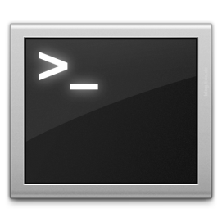
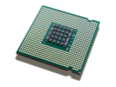
Basic Xen Concepts
Control Domain aka Dom0
Dom0 kernel with drivers
Xen Management Toolstack
Trusted Computing Base
Guest Domains
Your apps
E.g. your cloud management stack
Driver/Stub/Service Domain(s)
A “driver, device model or control service in a box”
De-privileged and isolated
Lifetime: start, stop, kill
XL, XM (deprecated)
VM_{n}
VM₁
Control domain (dom0)
One or more driver, stub or service domains
VM₀
Guest OS
and Apps
Dom0 Kernel
Xen Hypervisor
Scheduler, MMU
Host HW
I/O
Memory
CPUs
Notes:
Dom 0:
In a typical Xen set-up Dom0 contains a smorgasboard of functionality:
System boot
Device emulation & multiplexing
Administrative toolstack
Drivers (e.g. Storage & Network)
Etc.
LARGE TCB – BUT, Smaller as in a Type 2 hypervisor
Driver/Stub/Service Domains: also known as Disaggregation

Slide 11
PV Domains
PV Domains & Driver Domains
Linux PV guests have limitations:
limited set of virtual hardware
Advantages
Fast
Works on any system (even without virt extensions)
Driver Domains
Security
Isolation
Reliability and Robustness
Control domain (dom0)
Guest VM_{n}
Driver Domain e.g.
Disk
Network
Apps
PV Back Ends
PV Front Ends
PV Back End
HW Drivers
HW Driver
Guest OS
Dom0 Kernel*
Xen Hypervisor
Host HW
I/O
Memory
CPUs
*) Can be MiniOS

Slide 12
HVM
HVM & Stub Domains
Disadvantages
Slower than PV due to Emulation (mainly I/O devices)
Advantages
Install the same way as native Linux
Stub Domains
Security
Isolation
Reliability and Robustness
Dom0
Guest VM_{n}
Stubdom_{n}
Guest VM_{n}
Device Model
IO Emulation
Device Model
IO Emulation
IO Event
IO Event
VMEXIT
Mini OS
VMEXIT
Xen Hypervisor
Host HW
Notes:
Device Model emulated in QEMU
Models for newer devices are much faster, but for now PV is even faster

Slide 13
PV on HVM
A mixture of PV and HVM
Linux enables as many PV interfaces as possible
This has advantages
install the same way as native
PC-like hardware
access to fast PV devices
exploit nested paging
Good performance trade-offs
Drivers in Linux 3.x
 | HVM | PV on HVM | PV
Boot Sequence | Emulated | Emulated | PV
Memory | HW | HW | PV
Interrupts, Timers & Spinlocks | Emulated | PV* | PV
Disk & Network | Emulated | PV | PV
Privileged Operations | HW | HW | PV
*) Emulated for Windows
Notes:
Automatic
Performance
PV on HVM guests are very close to PV guests in benchmarks that favour PV MMUs
PV on HVM guests are far ahead of PV guests in benchmarks that favour nested paging

Slide 14
Xen and the Linux Kernel
Xen was initially a University research project
Invasive changes to the kernel to run Linux as a PV guest
Even more changes to run Linux as dom0

Slide 15
Xen and the Linux Kernel
Xen support in the Linux kernel not upstream
Great maintenance effort on distributions
Risk of distributions dropping Xen support
Xen harder to use

Slide 16
Current State
PVOPS Project
Xen Domain 0 in Linux 3.0+ (it is functional but not yet fully optimized)
On-going work to round out the feature set in Linux 3.2 +
Notes:
Where are we?
1) Linux 3 contains everything needed to run Xen on a Vanilla Kernel, both as Dom0 and DomU
2) That’s of course a little bit of an old hat now
3) But it is worth mentioning that it only took 5 years to upstream that PVOPS into the kernel

Slide 17
XCP Project

Slide 18
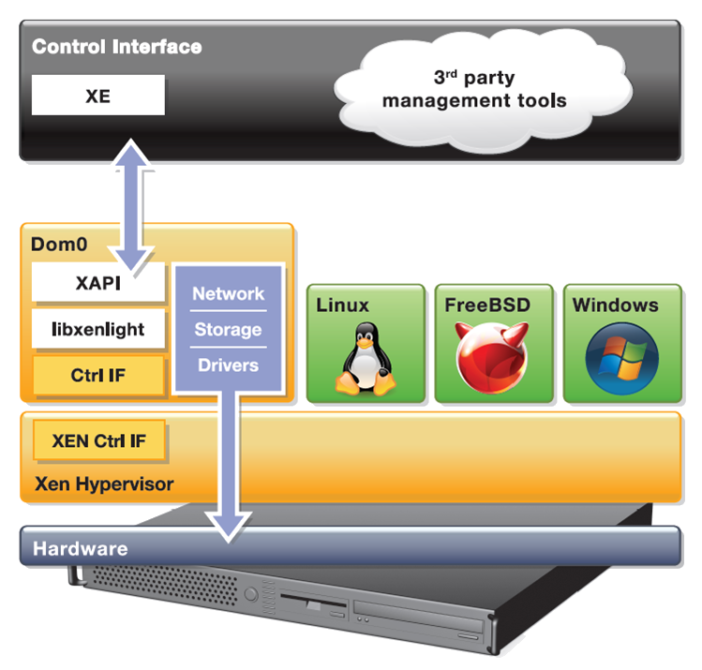
XCP
Complete vertical stack for server virtualization
Distributed as a closed appliance (ISO) with CentOS 5.5 Dom0, misc DomU’s, network & storage support and Xen API
Open source distribution of Citrix XenServer
Notes:
A few things to point out:
XCP stands for Xen Cloud Platform
Meant more in the sense of [Xen] Hypervisor Cloud Computing Platform that makes it easier to integrate with the likes of cloudstack, etc.
That does not mean that it aims to compete with the likes of cloudstack, openstack, etc.
XAPI depends on CentOS 5.5
The appliance is distributed as ISO

Slide 19
XCP Overview
Open source version of Citrix XenServer
wiki.xen.org/wiki/XCP/XenServer_Feature_Matrix
Enterprise-ready server virtualization and cloud platform
Extends Xen beyond one physical machine and other functionality
Lots of other additional functionality compared to Xen
Built-in support and templates for Windows and Linux guests
Datacenter and cloud-ready management API
XenAPI (XAPI) is fully open source
CloudStack and OpenStack integration
Open vSwitch support built-in

Slide 20
Project “Kronos”: XAPI on Linux
Make the XAPI toolstack independent of CentOS 5.5
Extend the delivery model
Deliver Xen, XAPI and everything in between (storage manager, network support, OCaml libs, etc.) via your favorite Linux distro
“apt-get install xcp-xapi” or “yum install xcp-xapi”
Debian
Next: Ubuntu 12.04 LTS
Later: other major Linux distro (Fedora, CentOS, etc.)
Volunteers are welcome!

Slide 21
Xen vs. XCP vs. XAPI on Linux
Xen | XCP (up to 1.1) | XAPI on Linux
Hypervisor: latest | lagging | Linux distro
Dom0 OS: CentOS, Debian, Fedora, NetBSD, OpenSuse, RHEL 5.x, Solaris 11, … | CentOS 5.5 | Debian, Ubuntu, …
Dom 0: 32 and 64 bits | 32 bits | 32 and 64 bits
Linux 3 PVOPS Dom0: Yes | No | Yes
Toolstack: XM (deprecated), XL or Libvirt | XAPI + XE (lots of additional functionality to Xen) | Same as XCP
Storage, Network, Drivers: build and get yourself | Integrated with Open vSwitch, multiple storage types & drivers | Get them yourself
Configurations: Everything | constrained by XAPI | Same as XCP
Usage Model: Do it yourself | Shrink wrapped and tested | Do it yourself
Distribution: Source or via Linux\Unix distributions | ISO | Via host Linux distribution

Slide 22
XCP/XAPI Vision & Next Steps
XCP & XAPI for Linux are the configuration of choice for clouds
Optimized for cloud use-cases
Optimized for usage patterns in cloud projects
XAPI toolstack is more easily consumable
We are doing this by …
XenServer is built from XCP (almost there)
Track unstable Xen hypervisor and Linux kernels aggressively (almost there)
Deliver into Linux distributions : more flexibility (almost there)
Exploit advanced Xen security features
Fully open development model (build & test capability)

Slide 23
XCP 1.5 (soon)
Architectural Improvements: Xen 4.1, GPT, smaller Dom0
GPU pass through: for VMs serving high end graphics
Performance and Scalability:
1 TB mem/host
16 VCPUs/VM, 128 GB/VM
Networking: Open vSwitch (default), Active-Backup NIC Bonding
Virtual Appliance: multi-VM and boot sequenced, OVF support
More guest OS templates
Notes:
* Host Architectural Improvements. XCP 1.5 now runs on the Xen 4.1 hypervisor, provides GPT (new partition table type) support and a smaller, more scalable Dom0.
* GPU Pass-Through. Enables a physical GPU to be assigned to a VM providing high-end graphics.
* Increased Performance and Scale. Supported limits have been increased to 1 TB memory for XCP hosts, and up to16 virtual processors and 128 GB virtual memory for VMs. Improved XCP Tools with smaller footprint.
* Networking Improvements. Open vSwitch is now the default networking stack in XCP 1.5 and now provides formal support for Active-Backup NIC bonding.
* Enhanced Guest OS Support. Support for Ubuntu 10.04 (32/64-bit).
Updated support for Debian Squeeze 6.0 64-bit, Oracle Enterprise Linux
6.0 (32/64-bit) and SLES 10 SP4 (32/64-bit). Experimental VM templates for CentOS 6.0 (32/64-bit), Ubuntu 10.10 (32/64-bit) and Solaris 10.
* Virtual Appliance Support (vApp). Ability to create multi-VM and boot sequenced virtual appliances (vApps) that integrate with Integrated Site Recovery and High Availability. vApps can be easily imported and exported using the Open Virtualization Format (OVF) standard.

Slide 24
XAPI Overview

Slide 25
XAPI: What is it?
XAPI is the backbone of XCP
Provides the glue between all components
Is the backend for all management applications
Call it XAPI or XenAPI
It's a XML-RPC style API, served via HTTPS
Provided by a service on every XCP dom0 host
Designed to by highly programmable
API bindings for many languages: .NET, Java, C, Powershell, Python
XAPI is Extensible via plugins
E.g. used by OpenStack
Notes:
Note: not exactly 1:1 with XE
Comparisons to other APIs in the virtualization space (source: Steven Maresca)
Generally speaking XAPI is well-designed and well-executed
XAPI makes it pleasantly easy to achieve quick productivity
XAPI is set up to work with frameworks such as CloudStack and OpenStack.
Some SOAPy lovers of big XML envelopes and WSDLs scoff at XML-RPC, but it certainly gets the job done with few complaints
Example code
http://bazaar.launchpad.net/~nova-core/nova/github/files/head:/plugins/xenserver/xenapi/etc/xapi.d/plugins/
https://github.com/xen-org/xen-api/blob/master/scripts/examples/python/XenAPIPlugin.py

Slide 26
XAPI from 30000 Feet
xen.org/files/XenCloud/ocamldoc/apidoc
SM
Storage
Network
host_cpu
SR
BBD_ metrics
PDB
VDI
user
session
host
task
VBD
pool
event
crash dump
Host_ metrics
PIF
VM
network
VIF
VM_ metrics
PIF_
metrics
VM_guest_ metrics
console
task
Notes:
All elements on the diagram just shown are called classes:
diagram omits another twenty or more minor classes. Visit the SDK documentation for documentation of all classes,
Classes are the objects XCP knows about and exposes through API bindings
Each class has attributes called fields and functions called messages. We'll stick with 'attributes' and 'functions.'
Classes on diagram:
VM: A virtual machine
Host: A physical XCP host system
PBD: physical block device through which an SR is accessed
SR: Storage repository
VDI: Virtual disk image
VDB: Virtual block device
Network: A virtual network
VIF: A virtual network interface
PIF: A physical network interface

Slide 27
XAPI Functionality Overview
VM lifecycle: live snapshots, checkpoint, migration
Resource pools: live migration, auto configuration, disaster recovery
Flexible storage and networking
Event tracking: progress, notification
Upgrade and patching capabilities
Real-time performance monitoring and alerting
Full list: wiki.xen.org/wiki/XCP/XenServer_Feature_Matrix
Notes:
VM lifecycle (start, stop, resume) ... automation is the key point
Live snapshots: Takes a snapshot of a live VM (e.g. for disaster recovery or migration)
Resource pools (multiple physical machines): XS & XCP only
live migration: VM is backed up while running, onto shared storage (e.g. NFS) in a pool and when completed restarted elsewhere in that pool.
disaster recovery: you can find lots of information on how this works at http://support.citrix.com/servlet/KbServlet/download/17141-102-19301/XenServer_Pool_Replication_-_Disaster_Recovery.pdf (the key point is that I can back up the metadata for the entire VM)
Flexible storage:
XAPI does hide details for storage and networking
I.e. I apply generic commands (NFS, NETAPP, iSCSI ... once its created they all appear the same) from XAPI. I only need to know the storage type when I create storage and network objects (OOL)
Upgrading a host to a later version of XCP (all my configs and VMs stay the same) …
and patching (broken now - bug, can apply security patches to XCP/XS or Dom0 but not DomU)

Slide 28
Open vSwitch
Software switch, similar to:
VMware vNetwork Distributed Switch
Cisco Nexus 1000V
Distribution agnostic. Plugs right into Linux kernel.
Reuses existing Linux kernel networking subsystems.
Backwards-compatible with traditional userspace tools.
Free and Open Source http://openvswitch.org/

Slide 29
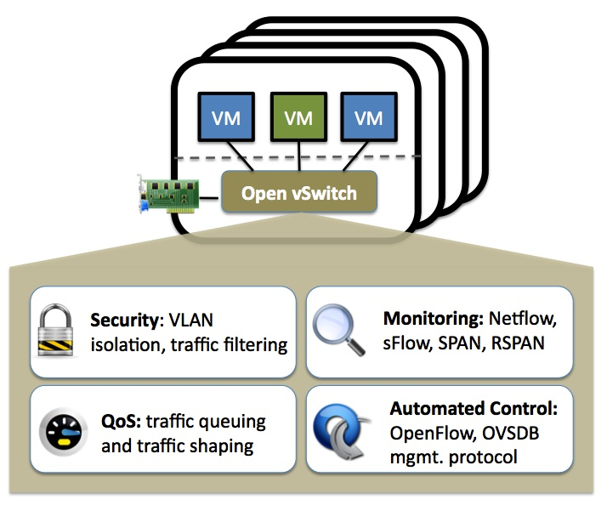
Why use Open vSwitch with Cloud?
Automated control: OpenFlow
Multi-tenancy
Monitoring and QoS
Notes:
Automated Control/OpenFlow: e.g. Firewall rules, Access Control Rules (does help with things like Multi Tenancy – program visibility of a switch), Ford Locking (security mechanism – a VM can only use a particular MAC address, if you tamper with it can’t connect to the switch).
Multi-tenancy: separate virtual networks for different cloud customers
Monitoring: of course for charging per use
QoS: rate limiting (customer pays for a specific amount of bandwidth)

Slide 30
XAPI Management Options
XAPI frontend command line tool: XE (tab-completable)
Desktop GUIs
Citrix XenCenter (Windows-only)
OpenXenManager (open source cross-platform XenCenter clone)
Web interfaces
Xen VNC Proxy (XVP)
lightweight VM console only
user access control to VMs (multi-tenancy)
XenWebManager (web-based clone of OpenXenManager
XCP Ecosystem:
xen.org/community/vendors/XCPProjectsPage.html
xen.org/community/vendors/XCPProductsPage.html

Slide 31
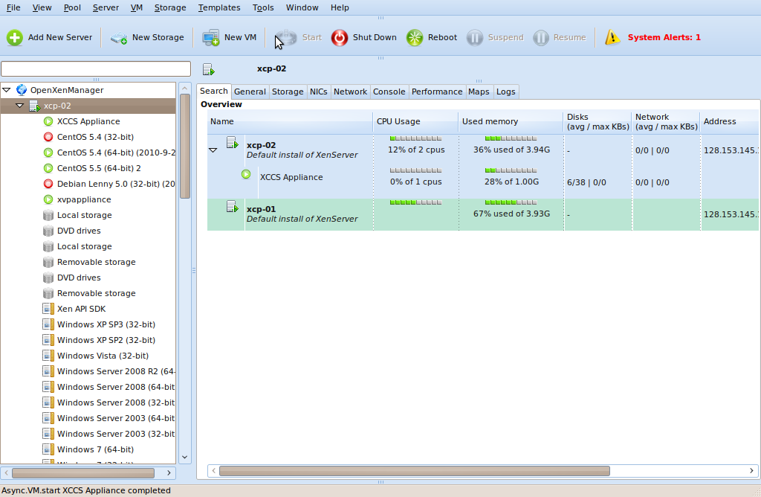
OpenXenManager

Slide 32
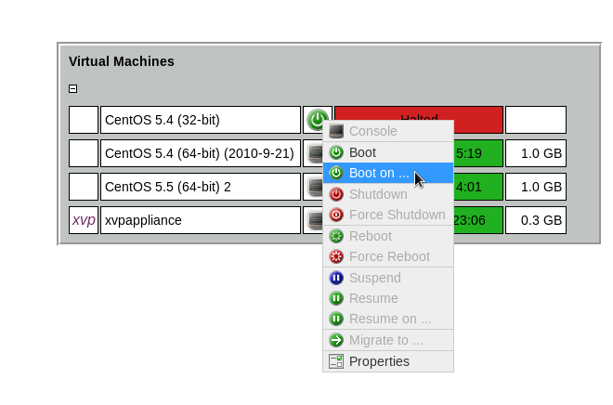
Xen VNC Proxy (XVP)

Slide 33
XCP and Cloud Orchestration Stacks

Slide 34
Cloud VM vs. Cloud Package(s) in Dom0
Cloud VM (DomU)
Pros
Isolation of cloud VM
Security properties
Pre-package + appliance
Cons
Slightly more complex
Less flexible
Cloud Package(s) in Dom0
Pros
Simple install
Flexibility
Simpler overall
Cons
Less isolation
Cloud node is a potential entry point to compromise Dom0
Notes:
Note: the original reason for project Kronos was to enable the Cloud Package model for the OpenStack Dev community
At a high level, there are two distinct ways to deploy the cloud orchestration layer on top of XCP or XAPI on Linux-based systems. One is to use a pre-packaged cloud VM (in DomU) and the other is to install the cloud packages directly on Dom0.
In some instances, such as when installing Nova on XCP (today), the VM appliance method is the only possible way due to python library dependencies. In general though, the deployment method is a matter of preference and/or the specific needs of the deployer.
The advantages of using a cloud VM are that you gain isolation and security properties as well as the ability to treat the cloud VM as a pre-packaged appliance. For instance, when deploying as a VM, you can specify the memory, disk, and other resource usage for the VM and this is enforced by the hypervisor. Further, since the cloud VM is in a distinct DomU, even if it is compromised, Dom0 is unaffected. Further, (after a compromise) an administrator could simply rollback the cloud VM to a known good state and restart it. Finally, with a Cloud VM, upgrades are easier, since the full VM can simply be replaced with a updated one and so there is no need to worry about dependencies on Dom0.
The disadvantages of a cloud VM is that it is slightly more complicated. For example, the cloud VM is an extra VM to manage. Also, using a VM is another layer of abstraction that needs to make calls to either the hypervisor and/or Dom0. Another disadvantage is that it is less flexible to have to have a VM with the cloud packages inside of it as opposed to being able to have the packages directly in Dom0 (configurations are not as easily shared, integration points need to be over the virtual network, etc.)
The advantages of installing the cloud packages in Dom0 are that it is simpler to set up (a simple package install in Dom0), it's more flexible for integration, and it is overall a simpler scenario. However, the isolation and security properties of having a Cloud VM are lost. The cloud service, since it is exposed to the network is a potential direct security entry point into Dom0, if the cloud service is compromised.
The Citrix Olympus project has chosen the Cloud VM approach for the security and isolation benefits (not surprisingly as appliances are a preferred deployment option for many XenServer services - NetScaler, the SDK, Distributed Switch Controller, etc.)
On the other hand, there are a lot of deployers that want to have more direct control and flexibility with the cloud software, and so the Linux on XAPI project was started to facilitate this use case.

Slide 35
Xen Hypervisor Project

Slide 36
Xen 4.1 Release: 21 March 2011
Very large system support
4 TB; >255 CPUs
Reliability, Availability, Scalability enhancements
CPU Pools for system partitioning
Page sharing enhancements
Hypervisor emergency paging / compression
New “xl” lightweight control stack
Memory Introspection API
Enhanced SR-IOV support
Software-implemented Hardware Fault Tolerance
Notes:
Earlier this year, we released Xen 4.1
I just put up the feature list, but I wont go through it in detail. I did want to point out that the focus of this release was on
Support for large systems and easier management of large systems with CPU poolks
As well as on security
And that is starting a trend to optimize the hypervisor for cloud use cases

Slide 37
Upcoming Xen 4.2 Release
Security: Intel Supervisor Mode Execution Protection, XSM / Flask improvements
Scalability: increased VM density for VDI use-cases, up to 256 Host CPUs for 64 bit HV , Multiple PCI segment support, prefer oxenstored
Performance: PCI pass-through for Linux Guests, AMD SVM DecodeAssist support, Remus memory image compression
EFI support
Libvchan cross domain comms in Xen mainline
XL improvements, XEND is formally deprecated
Documentation improvements (e.g. man pages)
Notes:
Detailed List
General
Documentation improvements (e.g. man pages)
Lots of bug fixing of course.
[edit]Tools
xl is now default toolstack and xend is formally deprecated
lots of xl improvements.
we should highlight xend deprecation (not effectively maintained since 2008)
Remus compression (compression of memory image improves performance)
Prefer oxenstored when available (improves scalability!)
Support for upstream qemu; nearing feature parity (non default still, but we want people to be testing it)
Added libvchan to xen mainline(cross domain comms)
[edit]Xen
Improvements to paging and sharing, enabling higher VM density for VDI use-cases
EFI (extensible Firmware Interface) support for HV (i.e. if I have a machine that has EFI, I can use Xen on it)
Support up to 256 Host CPUs for 64 bit h/v (from 128)
Support dom0 kernels compressed with xz
Per-device interrupt remapping (increases scalability)
Support for pvhvm guest direct pirq injection (Performance improvement for PCI passthrough for Linux Guests)
Intel SMEP (Supervisor Mode Execution Protection) support
Mem event stuff? (Allows to externally observe what guests are up to and can be used for external virus checking - not sure what the right terminology is)
Multiple PCI segment support
Added xsave support(floating point)
Lots of XSM / Flask fixes (security)
AMD SVM "DecodeAssist" support (AMD CPU feature that avoids emulation and increases performance)
[edit]Removed Functionality
ACM (alternative XSM to Flask) was removed (unmaintained)
Removed vnet (unmaintained)
[edit]Xen Development Support
Can build with clang
Added "make deb" target
Lots of xentrace improvements
update ocaml bindings and make them usable by xapi (which previously had it's own fork of the same codebase)

Slide 38
Xen, Security, QoS and the Cloud

Slide 39
“Security and QoS/Reliability are amongst the top 3 blockers for cloud adoption”
www.colt.net/cio-research
Notes:
Just one example of a survey, many more
http://www.colt.net/cio-research/z2-cloud-2.html
According to many surveys, security is actually the main reason which makes or breaks cloud adoption
Better security means more adoption
Concerns about security means slowed adoption

Slide 40
Security and the Next Wave of Virtualization
Security is key requirement for Cloud
Security is the primary goal of virtualization on the Client
Desktop, Laptops, Tablets & Smart Phones
Maintaining isolation between VMs is critical
Spatial and Temporal isolation
Run multiple VMs with policy controlled information flow
E.g. Personal VM; Corporate VM; VM for web browsing; VM for banking
Notes:
So for a hypervisor, as Xen which is powering 80% of the public cloud – rackspace, AWS and many other VPS providers use Xen and with cloud computing becoming mainstream, furthering security is really important
One of the key things there is isolation between VMs, but also simplicity as I pointed out earlier
But there are also a number of advanced features in Xen, which are not that widely know. So I wanted to give you a short overview of two of them

Slide 41
Architecture Considerations
Type 1: Bare metal Hypervisor
A pure Hypervisor that runs directly on the hardware and hosts Guest OS’s.
Type 2: OS ‘Hosted’
A Hypervisor that runs within a Host OS and hosts Guest OS’s inside of it, using the host OS services to provide the virtual environment.
VM_{n}
User-level VMM
VM_{n}
VM₁
User Apps
VM₁
VM₀
Device Models
VM₀
Guest OS
and Apps
Guest OS
and Apps
Host OS
Hypervisor
Scheduler
Ring-0 VM Monitor “Kernel “
Device Drivers/Models
Device Drivers
MMU
Host HW
Host HW
I/O
Memory
CPUs
I/O
Memory
CPUs
Provides partition isolation + reliability, higher security
Low cost, no additional drivers Ease of use & installation
Notes:
At this point I want to make a quick detour into the different hypervisor architectures from a viewpoint of security.
Let’s look at type 1 hypervisor:
Basically a very simple architecture, where the Hypervisor replaces the kernel
The architecture is significantly simpler that a Type 2 hypervisor, because it does not need to provide rich “process” semantics, like “user”, filesystems, etc.
BUT: the trade-off is that all the device drivers need to be rewritten for each hardware platform
Type 2 is hosted
- The hypervisor is just a driver that typically works with user-level monitor.
HW access is intercepted by the ring 0- VM monitor passed to the User level Virtual Monitor, which passes requests to the kernel
Re-use of device drivers is traded off against security and a large trusted computing base (green)

Slide 42
Xen: Type 1 with a Twist
Thin hypervisor
Functionality moved to Dom0
Using Linux PVOPS
Take full advantage of PV
PV on HVM
No additional device drivers (Linux 3.x dom0)
In other words
low cost (drivers)
Ease of use & Installation
Isolation & Security
Control domain (dom0)
Device Models
VM_{n}
VM₁
Drivers
VM₀
Guest OS
and Apps
Linux, BSD, etc.
Hypervisor
Scheduler
MMU
XSM
Host HW
I/O
Memory
CPUs
Notes:
Dom 0:
In a typical Xen set-up Dom0 contains a smorgasboard of functionality:
System boot
Device emulation & multiplexing
Administrative toolstack
Drivers (e.g. Storage & Network)
Etc.
LARGE TCB – BUT, Smaller as in a Type 2 hypervisor

Slide 43
Xen Security & Robustness Advantages
Even without Advanced Security Features
Well-defined trusted computing base (much smaller than on type-2 hypervisor)
No extra services in hypervisor layer
More Robustness: Mature, Tried & Tested, Architecture
Xen Security Modules (or XSM)
Developed and contributed to Xen by NSA
Generalized Security Framework for Xen
The Xen equivalent of SELinux
Notes:
Ask some questions

Slide 44
Advanced Security: Disaggregation
Split Control Domain into Driver, Stub and Service Domains
Each contains a specific set of control logic
See: ”Breaking up is hard to do” @ Xen Papers
Unique benefit of the Xen architecture
Security: Minimum privilege; Narrow interfaces
Performance: lightweight, e.g. Mini OS directly on hypervisor
Robustness: ability to safely restart parts of the system
Scalability: more distributed system (less reliable on Dom0)
Notes:
Example: XOAR
Self-destructing VMs (destroyed after initialization): PCIBack = virtualize access to PCI Bus config
Restartable VMs (periodic restarts):
NetBack (Physical network driver exposed to guest) = restarted on timer
Builder (instantiate other VMs) = Restarted on each request

Slide 45
Example: Network Driver Domain for HA
Detect failure e.g.
Illegal access
Timeout
Kill domain, restart
E.g. Just 275ms outage from failed Ethernet driver
Auto-restarts to enhance security
350
300
250
200
150
100
50
0
0
5
10
15
20
25
30
35
40
time (s)
Notes:
2004 paper in which Ethernet Driver is run in its own Driver Domain (in use by XenClient)

Slide 46
Qubes OS / XenClient XT
First products configured to take advantage of the security benefits of Xen’s architecture
Isolated Driver Domains
Virtual hardware Emulation Domains
Service VMs (global and per-guest)
Xen Security Modules
Notes:
This is not pie in the sky: these features are actually in use already for desktop virtualization.
I wanted to point out Qubes OS which is an OSS project in its second beta
And a commercial Citrix product which makes use of these features
In the last 6 months there has been lots of talk in the community, how these features can be adopted for Server virtualization and I expect that we see adoption of these in XCP and commercial Xen products.
But of course this is not easy: there are challenges around Configuartion and Usability

Slide 47
Advanced XenClient Architecture
Per host/device
Service VMs
Per guest
Service VMs
User VM
User VM
Management Domain
VPN Isolation
Device Emulate
Control Domain
Network Isolation
VPN Isolation
Device Emulation
Policy Granularity
Policy Granularity
Xen Hypervisor
Xen Security Modules
Intel vPro Hardware
VT-d
TXT
VT-x
AES-NI

Slide 48
BUT…
Today, XCP and commercial Xen based Server products
Do not make use of XSM
Do not make use of Advanced Security Features (Disaggregation)
Most of these features are poorly documented on xen wiki
In XCP, work has started to add these features
Various articles of how this may be done on the xen wiki
Hopefully more information soon
Commitment on improving docs for Security, Reliability & Tuning
Notes:
What about domain 0 itself?
Once we've disaggregated domain 0, what will be left?
The answer is: very little! We'll still have the logic for booting the host, for starting and stopping VMs, and for deciding which VM should control which piece of hardware... but that's about it. At this point domain 0 could be considered as a small "embedded" system, like a home NAT box or router.

Slide 49
PVOPS : Xen in Linux 3.x
Notes:
PVOPS is the Kernel Infrastructure to run a PV Hypervisor on top of Linux

Slide 50
New in Linux 3.1 & 3.2
Xen-pciback module
Usability improvements
Auto loading of backend modules
Helps distros to package / deploy
Memory Hotplug
Bug fixes
e.g. VGA text console for dom0 fixed
Many bug fixes: THANK YOU!
Support for more than 256 PCI devices
Kexec support for PV on HVM
Laid foundations for HVM Driver Domains
Blkback/front: added support for discard (TRIM or UNMAP) and emulation of barriers
Notes:
Let’s have a quick look at what’s new in the kernel 3.1
Mainly usability improvements
The most significant addition is the PCI back module which enables the kernel to pass PCI/PCIe devices to Xen guests
3.2: see http://www.gossamer-threads.com/lists/xen/users/229720
Quite a lot of features are planned to go into Linux 3.2 and beyond. I will just explain a few. For the rest, do talk to me afterwards
3.2 Feature Discard: Tells the HW that disk sectors are unused
This is good for Solid State Drives
But it is also good for filers doing thin provisioning
3.3 PV Spinlocks: Better performance under contention
ACPI S3: Which gives us Suspend to RAM, which is good for Xen on Laptop Use cases
The key is that all this is about optimization and rounding out of features
------------------
3.2:
hwclock -s: Makes time (i.e. wallclock, RTC time) handling work as expected for the dom0 administrator.
"feature-barrier": Required for correctness by certain guests (SLES10, I think). AIUI various filesystem implementations rely on barriers to Yup (and Oracle's guests applicance thingies) actually do something for correctness. Without this there coudl be corruption (I wouldn't necessarily stand on stage and say that out loud though) Some form of it can appear if you unplug the machine right as it is writting data out. But I am not entirely sure how to reproduce that 100%.. But yes - barries and flushes provide a mechanism to do 'write meta data NOW', and then the normal data can be written. So that in case of power failure you can go back to the meta data and figure stuff out. So yes. corruption averted!
"feature-discard": Used to indicate to h/w that disk sectors are unused. This is good for SSDs and also for filers which do thin provisioning since it improves wear-levelling and allows the space to be recovered respectively. <nods> Not sure what there is to say about the others.

Slide 51
Planned for 3.3 and beyond
Documentation improvements
Continue to round out the feature set, usability, rough edges
Graphics improvements
More Blkback and Netback optimisations
New driver for doing ioctl
ACPI power management
Make Netback work much much better than it does now!
Allow backends and xenstore to run in guests
Completing work for Device Driver Domains
See full list at PVOPS Wiki
Notes:
http://www.gossamer-threads.com/lists/xen/users/229706
3.3:
PV spinlocks: PV spinlocks improve performance under contention by allowing lock takers to sleep/yield instead of spinning wasting scheduling quanta. The current PV spinlock replaces the entire spinlock algorithm/datastructure. The new work simply adds a PV slow path but keeps the core "ticket lock" algorithm. This is beneficial in terms of sharing more code (and hence perf analysis etc) with native. The benefit is that during high contention (so more guests using VCPUs that there are physical CPUS - think four guests, each using 2 VCPU, and the box only has four physical) we can schedule the guests appropiately instead of spinning uselessly wasting CPU resources.
ACPI S3: Suspend to RAM. Useful for Xen on laptop type scenarios. Yeah, that one is taking longer than I thought. Got some feedback and will post a new set shortly.
3D graphics: THe RAM used by graphics cards has various constraints on the RAM which they use which we need to work with in order to make those cards work correctly It pretty much is in. Another graphics guy picked up the patches, reworked them even further and they are definitly in for
3.3. ACPU cpufreq: Power management, useful in servers etc. I suspect this also improves performance in some cases by allowing access to faster states. Still a bit behind sadly. The patches are "nicer" but still not sure how to make them even more nicer for Len. Will have to post them at some point. Maybe I shoudl do it on Dec 24th

Slide 52
OK, so Upstream has stuff!
So I can just install <favorite distro> and use Xen?
Yes!
But, check whether your distributions has 3.0+ kernel
For details visit Dom 0 Kernels for Xen Wiki
Some distros don't enable all backends – please open distro bugs (and let xen-devel know)
Or you can build a v3.x Linux kernel with Xen 4.1.2 on existing distro.
Details, explanations, etc: XenParavirtOps Wiki
Notes:
So what does all that mean?
Firstly, you can just Download the latest Linux distro, get the Xen package and you can get started
Of course that requires distros which have the Linux 3 kernel in it
Debian Squeeze, Fedora 16, Ubuntu 10.10

Slide 53
How you can help
Take Linux 3.2 or 3.3 RCs (soon) for a spin with Xen 4.1.2
Run it first without Xen to establish a baseline
Then run it under Xen and see what happens
Please send e-mail to xen-devel with what works and with what does not.
Notes:
Why should you help?
There are lots of HW variants and our developers cant possibly test all of them
So if you do wangt to help ...
If you see any issues: and that may mean bugs, unexpected behavior, unexpected performance: let is know such that we can fix it.

Slide 54
Xen ARM Project

Slide 55
Xen ARM History
‘04
‘08
‘09
‘10
‘11
x86 Xen Hypervisor
Release
(Cambridge University)
Xen ARM 1st Release: ARM9 Xen Hypervisor, Mini-OS (Samsung)
Xen ARM 2nd Release: Paravirtualized Linux kernel (v2.6.24), Xen tool
(Samsung)
Xen ARM 3rd Release:
ARM11MPCore Support
(Samsung)
Xen ARM 4th Release: Performance Optimization (Samsung)
Xen ARM 5th Release: Cortex-A9 MPCore Support
(Samsung)
More information:
wiki.xen.org/wiki/Xen ARM (PV) & xen-arm mailing list
Good overview in slides and papers links section
wiki.xen.org/wiki/Xen_ARMv7_with_Virtualization_Extensions
Notes:
The key point here is
Xen ARM has a long history
Uses paravirtualization
And supports a wide range of ARM processor features
As Kiko pointed out, there are quite few challenges in the ARM space such as complexity and Linux ports and that also affects Xen
So for example to build Xen ARM, it was necessary to modify the ARM Linux kernel and we are facing questions such as a) do we try and upstream, or do we go for a clean start with newer ARM architectures

Slide 56
From Mobiles to Laptops to Servers
Smart Phones
HW Consolidation: AP(Application Processor) and BP(Baseband Processor) can share multicore ARM CPU SoC in order to run both Linux and Real-time OS efficiently
OS Isolation: important call services can be effectively separated from downloaded third party applications by Xen ARM combined with access control
Rich User Experience: multiple OS domains can run concurrently on a single smartphone
Client Virtualization: Qubes OS / XenClient / XenClient XT
ARM based Servers: ARM v7 & v8
Notes:
This slide is all about pointing out that there is pull for the ARM architecture
CALXEDA| HP

Slide 57
Current Developments
‘11
‘12
‘13
Finish rebase and new repos
Cortex-A15 Support (ARM virt extensions)
Lightweight version of
Xen tools
Key Activities
Align Xen ARM with Xen mainline
Rebased on xen-unstable.hg: public repo for Xen ARM that is routinely synced with xen-unstable.hg
Many parts of the Xen ARM has been rewritten for the integration
Publish source for PV port of ARM Linux Kernel
Prototyping of Cortex A15 support using ARM virtualization extensions
First patches have made it into xen-unstable.hg
Select reference platform(s) for Xen ARM [likely that we will follow Linaro]
Notes:
Goals:
Mobile, Client and Server for ARM
Realtime capability
Make sure that we have an architecturally clean start moving forward

Slide 58
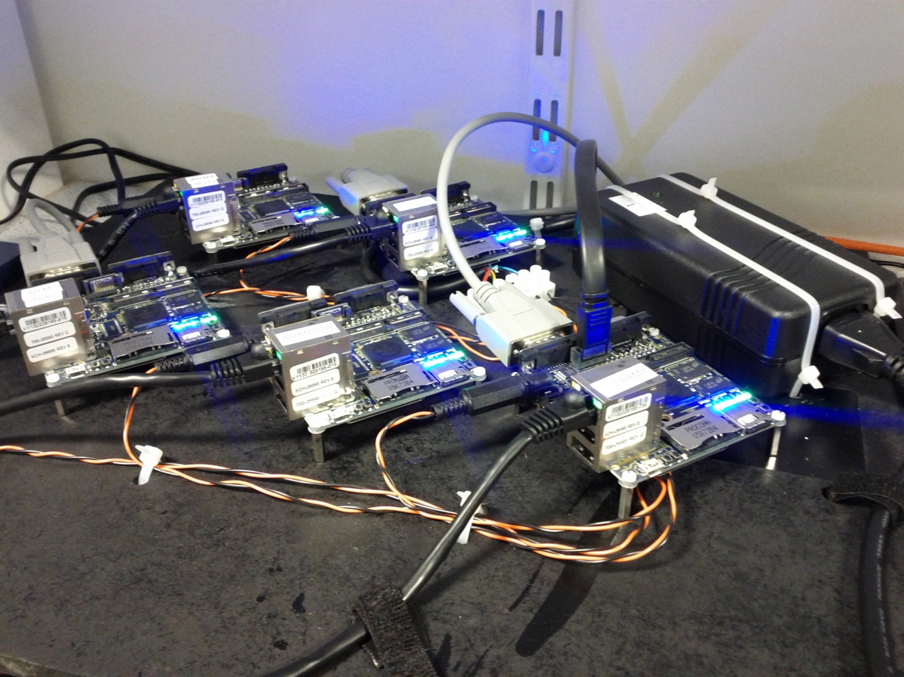
A bit of fun: our ARM Build Farm
10 Freescale i.MX53 Loco Quickstart boards
Running Debian "armhf" with a mainline 3.2.0 kernel
Speed up development of Xen for Cortex A15 (avoid cross compilation)

Slide 59
Summary: Why Xen?
Notes:
Hold this thought! We will come back to this later….!

Slide 60
Designed for the Cloud : many advantages for cloud use!
Resilience, Robustness & Scalability
Security: Small surface of attack, Isolation & Advanced Security Features
Widely used by Cloud Providers
XCP & XAPI
Ready for use with cloud orchestration stacks
XCP and XAPI on Linux: flexibility and choice
Lots of additional improvements for cloud coming in 2012
Flexibility and choice of Usage Models
Also one of the challenges for Xen
Catching up on “Ease of deployment and getting started”
Open Source with a large community and eco-system
Notes:
Performance : similar to other hypervisors
Maturity: Tried & Tested, Most Problems that are Problems are well known
Open source: Good body of Knowledge, Tools

Slide 61
Resources

Slide 62
Xen Resources
IRC: ##xen @ FREENODE
Mailing List: xen-users & xen-api
Wiki: wiki.xen.org
Beginners & User Categories
Excellent XCP Tutorials
A day worth of material @ xen.org/community/xenday11

Slide 63
How to Contribute
Same process as for Linux Kernel
Same license: GPLv2
Same roles: Developers, Maintainers, Committers
Contributions by patches + sign-off (Developer Certificate of Origin)
Details @ xen.org/projects/governance.html

Slide 64
Shameless Marketing
Vendors in the Xen community are hiring!
Vendors in the Xen community are hiring!
Vendors in the Xen community are hiring!
xen.org/community/jobs.html

Slide 65
Questions …

