Slide 1

Service Health Monitoring
Maxim Tyukov
Tools engineer
09/22/2012

Slide 2
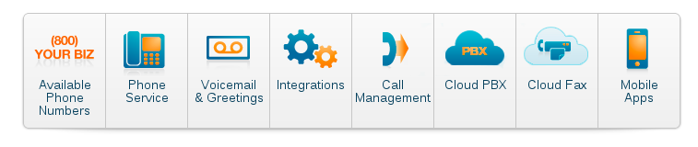
RingCentral
Cloud based PBX telephony

Slide 3
Content
Service health monitoring goals
  Information delivery improvements
  Visualization of fast outage/issues determination
Building service level monitoring
  Multilevel monitoring approach
  Items determination and hierarchy
  Service state criteria determination
Visualization
  Building main dashboard
  Submaps component determination and dependencies building
Service health dashboard
  See in action on working example
  Advantages and disadvantages of implementation with Zabbix tools

Slide 4
Service health monitoring goals
Section 1

Slide 5
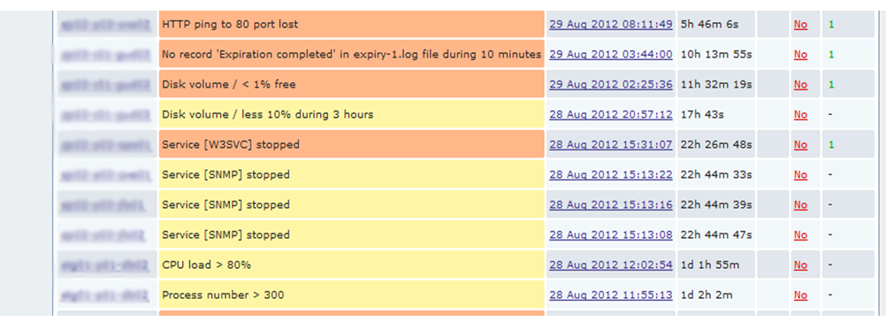
Information delivery improvement
With usual OS/Application data collection

Slide 6
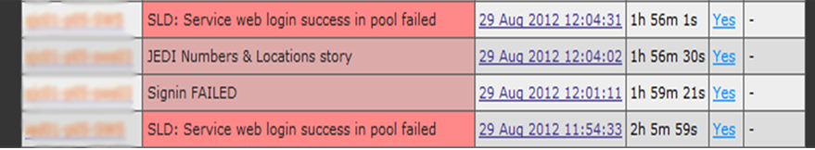
Information delivery improvement
After implementation of high level monitoring

Slide 7
Visualization of fast outage/issues detection

Slide 8
Building high level monitoring
Section 2

Slide 9
Multilevel monitoring approach

Slide 10
Items determination and hierarchy
Quantitative data
  Host level (collected by zabbix agent active/passive, externalscripts, snmp, etc.)
  OS data – CPU, memory, I/O, etc.
  Application data – 2xx,4xx,5xx responses, telephone lines busy, media ports opened, etc
  Pool level (aggregated on the basis of host data with group aggregated and calculated items)
  Number of hosts alive in pool
  Pool capacity free/busy on the basis of hosts alive
  Service level (aggregated on the basis of pool data with group aggregated and calculated items)
  Service capacity
  Service health
Functional checks
  Check host
  Check pool
  Check service

Slide 11
Host level “functional checks” items example
Functional check items
If return value is a text

Slide 12
Host level “functional checks” items example
Then use calculated item with str() function

Slide 13
Pool level “quantitative data” items example
Group aggregated items
Combination of group aggregated and calculated items

Slide 14
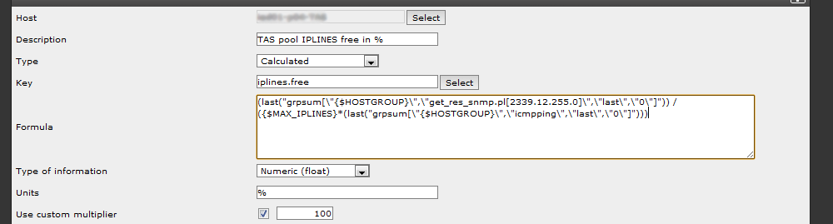
Pool level “quantitative data” items example
Calculated item formula

Slide 15
Service state criteria
Service capacity
Service_capacity1 = avg(pool1_load+pool2_load+…+poolN_load)
Service_capacity2 = avg(pool1_load*j+pool2_load*k+…+poolN_load*w)

Slide 16
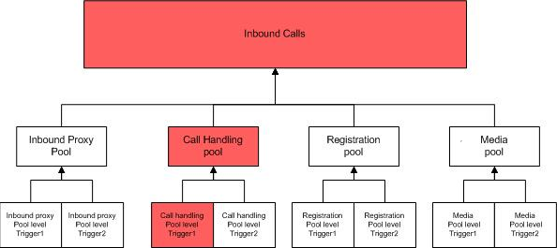
Service state criteria
Service Health
  Service is healthy until at least on of its pools goes down

Slide 17
Visualization
Section 3

Slide 18
How to build Service health dashboard
What is Service Health Dashboard in Zabbix?
This is a map
This is a background image(.png)

Slide 19
What is inside?
Map’s important options
  Icon label type – nothing
  Mark elements on triggers status change – disabled
Each cell of dashboard is a submap (with custom status images)
There are two levels of submaps under dashboard
  Service level
  Pool level

Slide 20
What is inside?
Map’s element options

Slide 21
What is inside?
Going deeper

Slide 22
How to create service level maps
This is one service in one unit
These are Submaps
One of the components have problem, service is affected

Slide 23
How to create pool level maps
On host level map, use triggers, not hosts

Slide 24
Dashboard in action.
Advantages and disadvantages
Section 4

Slide 25
Dashboard in action

Slide 26
Advantages and disadvantages
+
No need to develop any additional tools, or custom pages
Unambigiuos identification, which service is affected
Immediate state change – depends only on items “Interval” option
-
Has only two states Ok & Problem (or smth like that) due to Zabbix maps implementation
Background image dependent
Big amount of submaps
Not able to see history of service health

Slide 27
Questions

Slide 28
Thank you!
Maxim Tyukov
Service health dashboard
RingCentral

